Slide 1
COMP 1600 Introduction to Programming
David J Stucki
Fall 2025

Slide 2
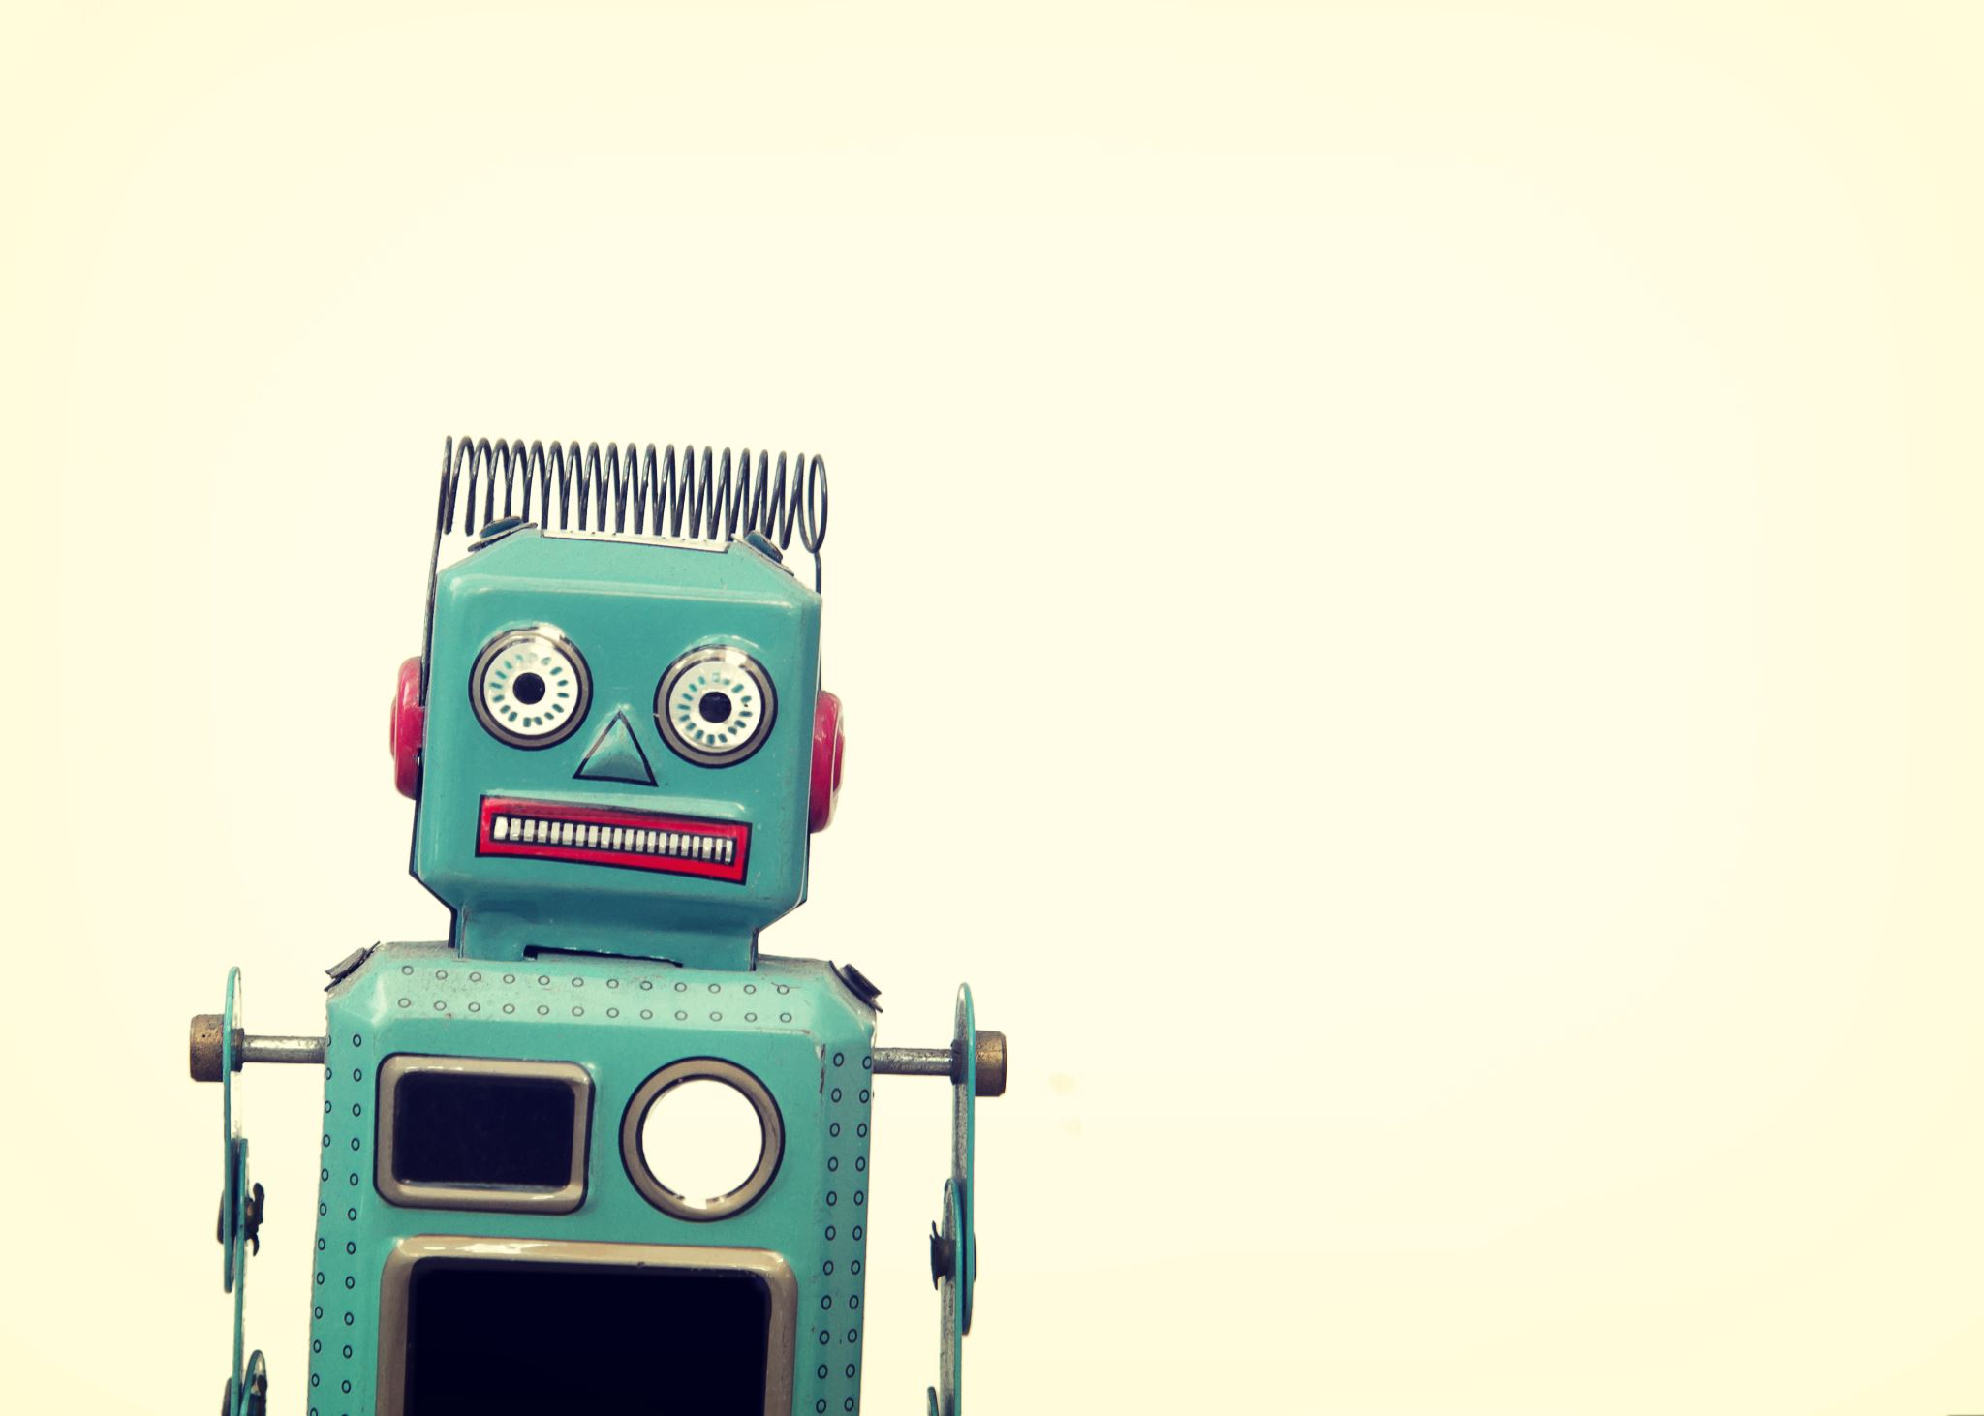
I really hate this darn machine; I wish that they would sell it. It won’t do what I want it to, but only what I tell it.
—Programmer’s Lament

Slide 3
Introductions
Prof. Stucki...
Who are you?
Name, home town, favorite musician
What was the most surprising thing about first flight?
What is your coding experience?
Discussion
What is the purpose of this class?
What do you want to get out of it?

Slide 4
How can you reach me?
E-mail: dstucki@otterbein.edu
Office: Comm 141
Phone: (614) 823-1722
Office hours: MWF 12:30 – 1:30 p.m.,
and by appointment
Website:
http://faculty.otterbein.edu/dstucki/

Slide 5
Textbook
Barry Wittman, Tim Korb, and Aditya Mathur
Attacking Problems with Java
Available at: https://attacking-problems.github.io/

Slide 6
A note about the book (from Dr. Wittman)…
The book's not bad
At least it's free
Your feedback is highly valued for the next edition
I highly encourage you to read it
However, computer science is very much an applied science
Reading the book is not enough
You should be programming every day (or maybe every other day) to master the concepts

Slide 7
Course focus
Problem solving (writing the algorithm)
Converting the algorithm to Java
Features of Java we'll focus on:
Variables
Mathematical operations
Selection statements (making choices)
Loops (repeating things)
Methods (dividing work into chunks)
Arrays (lists of things)
Input and output
Classes and object orientation
Searching and sorting
Image and audio processing

Slide 8
More information
For more information, visit the course web site: http://faculty.otterbein.edu/dstucki/comp1600
The webpage will contain:
The syllabus
The most current schedule
Notes available for download
Reminders about projects and exams
Detailed policies and guidelines

Slide 9
Five projects
35% of your grade will be five projects
Each will focus on a different area from the course:
I/O and arithmetic
if statements
Loops
Methods and arrays
Sorting, searching, and image processing
Each project is individual, not group, effort

Slide 10
Turning in projects
Projects must be turned in by uploading them to Brightspace before the deadline
Late projects will not be accepted
Exception: Each student will have 3 grace days
You can use the grace days together or separately as extensions for your projects
You must inform me before the deadline that you are going to use grace days
Assignments that don't compile get 0 points

Slide 11
In-Class Labs
15% of your grade will be based around programming labs
Labs are on Tuesdays and Thursdays, but only one day a week has a graded lab
The days are marked on the schedule
You're still expected to come every Tuesday and Thursday to work on projects when you're not working on a lab
Each lab will focus on the solution of a problem
Work should be done individually, but the goal is to learn, and I will help everyone

Slide 12
Programming projects
Must compile
If your program does not compile, it will score zero points
Must be handed in on time
If your program is late (and grace days are not available), it will score zero points
Must be done individually
If I can ascertain that code from one student's project appears in another student's project, both projects will score zero points
Both students will also have a full letter grade reduction at the end of the semester

Slide 13
Pop Quizzes
5% of your grade will be pop quizzes
These quizzes will be based on material covered in the previous one or two lectures
They will be graded leniently
They are useful for these reasons:
Informing me of your understanding
Feedback to you about your understanding
Easy points for you
Attendance

Slide 14
Exams
There will be two equally weighted exams totaling 30% of your final grade
Exam 1: 09/17/2025 (Wednesday)
Exam 2: 10/31/2023 (Friday)
The final exam will be worth 15% of your grade
Final: 10:15 – 12:15 a.m. 12/10/2025
All exams will be in our normal classroom

Slide 15
Tentative schedule
Week | Starting | Topics | Chapters | Notes
1 | 08/18/25 | Introduction | 1
2 | 08/25/25 | Primitive data types | 2 & 3
3 | 09/01/25 | Basic operations | 3
4 | 09/08/25 | Conditionals | 4 | Project 1 Due
5 | 09/15/25 | Loops | 5 | Exam 1
6 | 09/22/25 | More loops | 5
7 | 09/29/25 | Arrays | 6 | Project 2 Due
8 | 10/06/25 | Static methods | 8 | Fall Break
9 | 10/13/25 | Advanced methods | 8
10 | 10/20/25 | Classes and objects | 9 | Project 3 Due
11 | 10/27/25 | Custom classes | 9 | Exam 2
12 | 11/03/25 | Searching and sorting | TBA
13 | 11/10/25 | Image processing | 11 | Project 4 Due
14 | 11/17/25 | Advanced topics | 20
15 | 11/24/25 | TBA | TBA | Thanksgiving
16 | 12/01/25 | Review | All | Project 5 Due

Slide 16
Attendance
You are expected to attend class
You are expected to have read the material we are going to cover before class
Missed quizzes cannot be made up
Exams and labs must be made up before the scheduled time, for excused absences

Slide 17
R-E-S-P-E-C-T
I hate having a slide like this
I ask for respect for your classmates and for me
You are smart enough to figure out what that means
A few specific points:
Silence communication devices (phones put away)
Don't use the computers except when explicitly asked to

Slide 18
Academic dishonesty
Don't cheat
Refer to the Student Handbook for the official policy
Ask me if you have questions or concerns
You are never allowed to look at another student's code
Don't use AI tools like ChatGPT to write any code that you turn in
I will use tools that automatically test code for similarity

Slide 19
Preliminaries
"Introduction to Programming": what are we programming?
"Computer": what is that?
A computer is an Automatic Formal System. Huh?
A "Formal System" is like a game in which tokens are manipulated according to definite rules, in order to see what configurations can be obtained. i.e., they are
Token-manipulation systems
Digital
Medium independent
Note: Not all formal systems are games and not all games are formal systems.

Slide 20
Token Manipulation Systems
Components
a set of types of formal tokens or pieces
one or more allowable starting positions
a set of formal rules specifying how arrangements of tokens may or must be changed into others
Self-contained
Rules have a ‘local’ perspective: current ⇨ next

Slide 21
Digital Systems
A process that makes things and then later identifies what was made is digital if it is positive and reliable.
It is positive if the reidentification can be absolutely perfect.
A positive technique is reliable if it not only can be perfect, but almost always is.
chess, tic-tac-toe, go, checkers
vs.
baseball, billiards, tiddly-winks, marbles

Slide 22
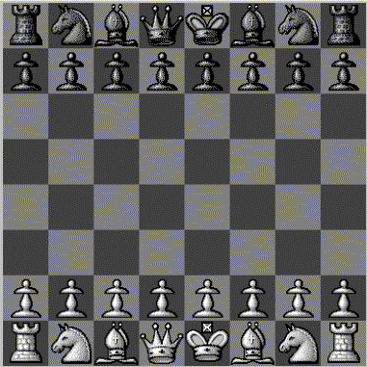
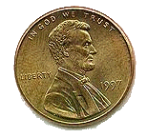
Chess
Assume the board is 8” square
Place a penny exactly 4.0747 inches from the bottom and 1.9761 inches from the left
Place a penny in the fourth rank (row) and second file (column).

Slide 23
Digital Systems
A process that makes things and then later identifies what was made is digital if it is positive and reliable.
It is positive if the reidentification can be absolutely perfect.
A positive technique is reliable if it not only can be perfect, but almost always is.
chess, tic-tac-toe, go, checkers
vs.
baseball, billiards, tiddly-winks, marbles

Slide 24
Medium Independence
Form, or structure, is what defines a formal system.
Its substance, or material, is irrelevant insofar as it supports the requisite form.
Chess
Can be played with pieces of wood, plastic, ivory, patterns of light on a video monitor, sand-drawings, even helicopters on skyscrapers;
but not frogs, shapes traced in water, or mountains.
Fire, food, electrical circuits, billiards, baseball are not independent of substance

Slide 25
Automatic Formal Systems
A formal system that “moves” by itself.
A physical device or machine that
has configurations and states which can be regarded as tokens and arrangements of some formal system, and
in its normal operation it automatically manipulates these tokens in accord with the rules of that system.
E.g., a Computer!
For more information about this view of computers, see John Haugeland, “What is Mind Design?”, in Mind Design II, MIT press, 1997, pp. 8-15.

Slide 26
Universal Computation
The most basic idea of computer science:
“You can use one automatic formal system to implement another.”
This is what programming is!
One computer implements another when:
some configurations of tokens and positions of the former can be regarded as the tokens and positions of the latter, and
as the former follows its own rules, it automatically manipulates those tokens of the latter in accord with the latter’s rules.

Slide 27
Next time…
On Friday, we'll cover a few Java basics
Then we will talk about the history of computers and the definition of computer science
Come to lab tomorrow (even though we won't have a graded assignment)
I will introduce IntelliJ
I will show you how to use OneDrive to save your work

Slide 28
Reminders
Read Chapter 1
I recommend installing the following on your computer
Java JDK 21, available here: https://www.oracle.com/java/technologies/downloads/#java21
IntelliJ IDEA Community using the installer here: https://www.jetbrains.com/idea/download/
You should always be able to use the lab, but it's good to have a backup option
Come to office hours if you need assistance!

