Slide 1
COMP 1600 Introduction to Programming
David J Stucki
Fall 2025

Slide 2
Alerts
Project 4 is due today
Project 5 is available: due December 3
Read Chapter 11

Slide 3
Review
Last time:
Images

Slide 4
Picture methods
Everything you'd want a picture to do:
Method | Use
Picture(String file) | Creates a Picture from a file
Picture(int w, int h) | Create a blank Picture with width w and height h
int width() | Return the width of the image
int height() | Return the height of the image
Color get(int x, int y) | Return the Color of the pixel at (x,y)
void set(int x, int y, Color c) | Set the Color of the pixel at (x,y) to c
void show() | Display the image
void save(String file) | Save the Picture to a file

Slide 5
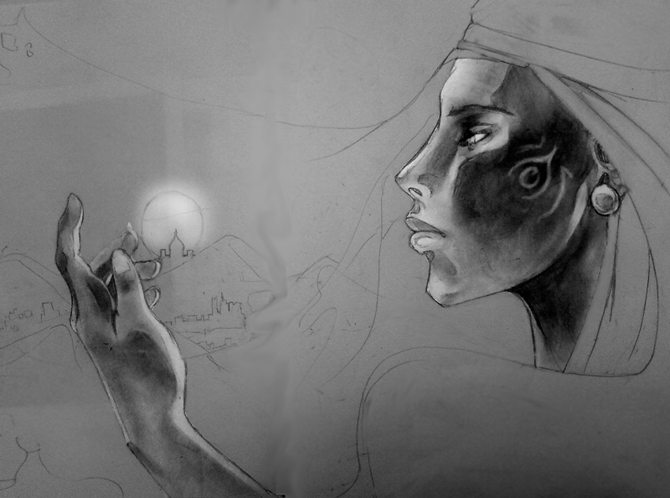
Mirroring an image horizontally
Straightforward idea
Flip an image around the y-axis

Slide 6
How to perform a horizontal mirror
Given an image with width w and height h:
Moving from left to right in the original image, copy each column, storing each column from right to left in the new image

Slide 7
Horizontal mirror example
Original
Mirrored
 | 0 | 1 | 2
0 | A
1 | B
2 | C
3 | D
 | 0 | 1 | 2
0 |  |  | A
1 |  |  | B
2 |  |  | C
3 |  |  | D

Slide 8
Horizontal mirror in code
What would the code for mirroring look like?
Picture picture = new Picture(file);
Picture mirrored = new Picture(picture.width(), picture.height());
for(int x = 0; x < picture.width(); ++x) {
for(int y = 0; y < picture.height(); ++y) {
Color color = picture.get(x, y);
mirrored.set(picture.width() - x - 1, y, color);
}
}

Slide 9
Mirroring vertically
Pretty much the same thing
Instead of copying each column in reverse order, copy each row in reverse order

Slide 10

Rotating an image
Another straightforward idea
Necessary if you are writing software for a digital camera (the user might turn the camera for portrait instead of landscape)

Slide 11
How to perform a 90° right rotation
Given an image with width w and height h:
Create a new image with width h and height w
Copy each column in the original image into a row in the new image, remembering to move back along the row

Slide 12
Right rotation example
Original
 | 0 | 1 | 2
0 | A
1 | B
2 | C
3 | D
Rotated
 | 0 | 1 | 2 | 3
0 | D | C | B | A
1
2

Slide 13
Rotation in code
What would the code for a rotation look like?
Picture picture = new Picture(file);
Picture rotated = new Picture(picture.height(), picture.width());
for(int x = 0; x < picture.width(); ++x){
for(int y = 0; y < picture.height(); ++y) {
Color color = picture.get(x, y);
rotated.set(picture.height() - y - 1, x, color);
}
}

Slide 14
Rotating other amounts
Rotating 180°, 270°, -90°, -180°, or -270° can be done using similar techniques or simply performing right rotations multiple times
Rotations that aren't multiples of 90° are much trickier, result in non-rectangular final images, and need some trigonometry
Don't worry about rotations that aren't multiples of 90°

Slide 15
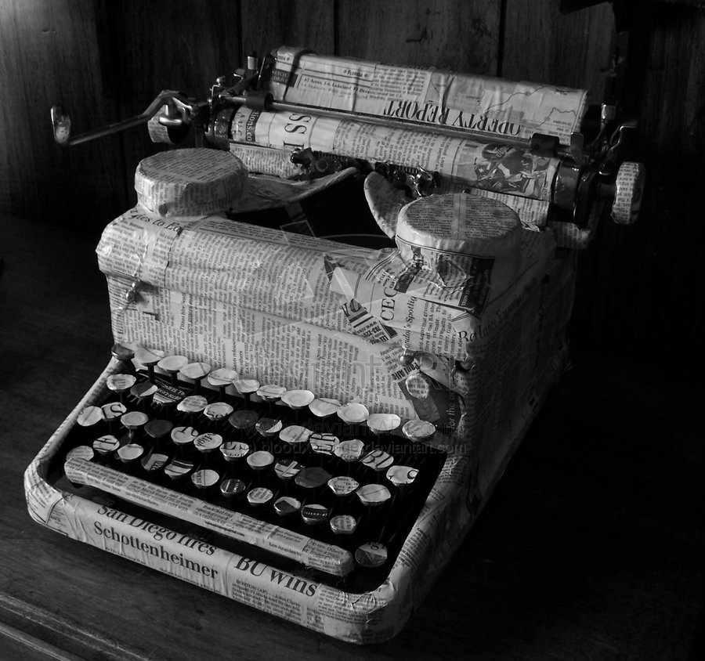

Resizing an image
You've seen this many times before
Sometimes an image won't fit nicely in on a PowerPoint slide

Slide 16
How to perform a resize
Let's just focus on growing, because that's what you need to do in your project
If we are just doubling the image, we create a new image whose width and height are twice the original
Then, we go through the new image, copying the pixels from the original using pixels whose column and row are half as big as the ones we are putting into the new image

Slide 17
Resizing example
Doubling an image
Each old pixels maps to four new ones
 | 0 | 1 | 2 | 3
0 | A | A | B | B
1 | A | A | B | B
2 | C | C | D | D
3 | C | C | D | D
 | 0 | 1
0 | A | B
1 | C | D

Slide 18
Resizing issues
This kind of resize works but is crude
To shrink an image, a clever resize might average together pixels
When growing an image, different techniques can be done to fill in "guesses" for pixels that sit between pixels from the original image, instead of just duplicating them
People who program Photoshop have thought long and hard about how to do these tasks better

Slide 19
Hierarchy of complexities
Here is a table of several different complexity measures, in ascending order, with their functions evaluated at n = 100
Description | Big Oh | f(100)
Constant | O(1) | 1
Logarithmic | O(log n) | 6.64
Linear | O(n) | 100
Linearithmic | O(n log n) | 664.39
Quadratic | O(n²) | 10000
Cubic | O(n³) | 1000000
Exponential | O(2^{n}) | 1.27 x 10³⁰
Factorial | O(n!) | 9.33 x 10¹⁵⁷

Slide 20
Practical implications
Computers get faster, but not in unlimited ways
If computers get 10 times faster, here is how much a problem from each class could grow and still be solvable
Description | Big Oh | Increase in Size
Constant | O(1) | Unlimited
Logarithmic | O(log n) | 1000
Linear | O(n) | 10
Linearithmic | O(n log n) | 10
Quadratic | O(n²) | 3-4
Cubic | O(n³) | 2-3
Exponential | O(2^{n}) | Hardly changes
Factorial | O(n!) | Hardly changes

Slide 21
Rules of thumb
There is nothing better than constant time
Logarithmic time means that the problem can become much larger and only take a little longer
Linear time means that time grows with the problem
Linearithmic time is just a little worse than linear
Quadratic time means that expanding the problem size significantly could make it impractical
Cubic time is about the reasonable maximum if we expect the problem to grow
Exponential and factorial time mean that we cannot solve anything but the most trivial problem instances

Slide 22
Memory
Remember, there are multiple levels of memory on a computer
Each next level is on the order of 500 times larger and 500 times slower
Cache
Actually on the CPU
RAM
Primary memory for a desktop computer
Pretty fast and relatively expensive
Hard Drive
Slow and cheap
Secondary memory for a desktop computer
Fast and expensive
Size
Speed
500X
500X
500X
500X

Slide 23
Memory speed
If you can do a lot of number crunching without leaving cache, that will be very fast
If you have to fetch data from RAM, that will slow things down
If you have to read and write data to the hard drive (unavoidable with large pieces of data like digital movies), you will slow things down a lot

Slide 24
Measuring memory
Memory can be easier to estimate than running time
Depending on your input, you will allocate a certain number of objects, arrays, and primitive data types
It is possible to count the storage for each item allocated
Remember that a reference to an object or an array costs an additional 4 or 8 bytes on top of the size of the object

Slide 25
Memory footprints
Here are the sizes of various types in Java
Note that the N refers to the number of elements in the array or String
Type | Bytes
boolean | 1
char | 2
int | 4
double | 8
Type | Bytes
boolean[] | 16 + N
char[] | 16 + 2N
int[] | 16 + 4N
double[] | 16 + 8N
Type | Bytes
reference | 8
String | 40 + 2N
object | 8 + size of members
array of objects | 16 + (8 + size of members)N

Slide 26
Next time…
On Monday,
Searching
Sorting
Inheritance

