Slide 1
COMP 1600 Introduction to Programming
David J Stucki
Fall 2025

Slide 2
Alerts
Project 4 is due Friday

Slide 3
Review
Last time:
Hunters & Prey
Big-Oh

Slide 4
Multiplication by hand
How long does it take to do multiplication by hand?
Let's assume that the length of the numbers is n digits
(n multiplications + n carries) x n digits + (n + 1 digits) x n additions
Running time: O(n²)
123
x 456
738
615
492__
56088

Slide 5
Finding the largest element in an array
How do we find the largest element in an array?
Running time: O(n) if n is the length of the array
What if the array is sorted in ascending order?
Running time: O(1)
int largest = array[0];
for (int i = 1; i < array.length; i++) {
if (array[i] > largest) {
largest = array[i];
}}
System.out.println("Largest: " + largest);
System.out.println("Largest: " + array[array.length-1]);

Slide 6
Bubble sort
Here is some code that sorts an array in ascending order
What is its running time?
Running time: O(n²)
for (int i = 0; i < array.length; i++) {
for (int j = 0; j < array.length - 1; j++) {
if (array[j] > array[j + 1]) {
int temp = array[j];
array[j] = array[j + 1];
array[j + 1] = temp;
}}}

Slide 7
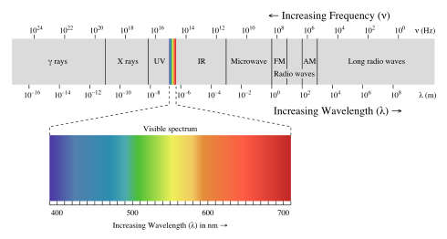
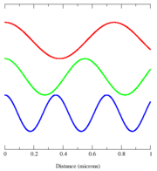
Light
Visible light is a form of electromagnetic radiation
We could think of it as a wave with a specific frequency
That is a useful way to think of sound
It seems sort of cumbersome for light
Color theorists have discovered that we can represent most visible colors as a combination of a small number of set colors

Slide 8
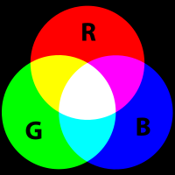
RGB
One system for representing color is RGB
With Red, Green, and Blue components, you can combine them to make most visible colors
Combining colors is an additive process:
With no colors, the background is black
Adding colors never makes a darker color
Pure Red added to pure Green added to pure Blue makes White
RGB is a good model for computer screens

Slide 9
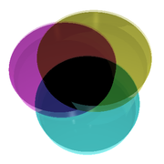
CMYK
CMYK stands for Cyan, Magenta, Yellow, and Key (Black)
CMYK is another color system, but it's a subtractive system
With no colors, the background is white
Adding colors never makes a lighter color
Pure Cyan added to pure Magenta added to pure Yellow makes Black
CMYK is useful for printing, not for computer screens

Slide 10
Color class
The Color class is how Java keeps track of colors, using an RGB model
To use it, you need to type
import java.awt.Color;
at the top of your program (before the class declaration)
Each Color object represents one of 16,777,216 different colors with a value between 0-255 each for Red, Green, and Blue

Slide 11
Example colors
Color | Red | Green | Blue
Black | 0 | 0 | 0
Red | 255 | 0 | 0
Green | 0 | 255 | 0
Blue | 0 | 0 | 255
Orange | 255 | 165 | 0
Gray | 128 | 128 | 128
Cyan | 0 | 255 | 255
Magenta | 255 | 0 | 255
Yellow | 255 | 255 | 0
White | 255 | 255 | 255

Slide 12
To use Color
To create a custom color:
Create colors using the constructor to specify RGB values
Get individual values using:
getRed()
getGreen()
getBlue()
Color c = new Color(255,165,0); //orange
int green = c.getGreen();

Slide 13
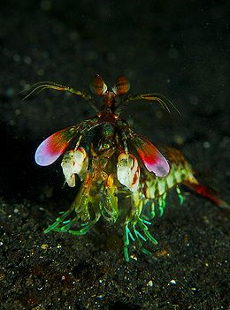
Luminance
If the R, G, B values happen to be the same, the color is a shade of gray
255, 255, 255 = White
128, 128, 128 = Gray
0, 0, 0 = Black
To convert a color to a shade of gray, use the following formula:
Value = .3R + .59G + .11B
Gray color: (Value, Value, Value)
Based on the way the human eye perceives colors as light intensities

Slide 14
Real world image formats
We will be thinking of images as 2D arrays or rectangular grids of pixels (each of which has a color stored in a Color object)
Bitmaps (.bmp files) are almost that simple
Most common image formats (.jpg, .png, and .gif files) are more complex
They use different forms of compression to keep the image size small
Otherwise, an 800 x 600 image is 3 bytes per pixel x 800 x 600 = 1,440,000 bytes > 1 MB

Slide 15
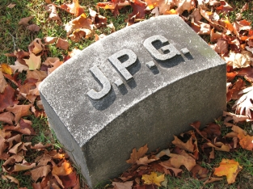

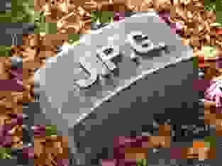
JPEG or JPG images
Stands for Joint Photographic Experts Group
Good for images without too much high contrast (sharp edges)
Photographs are often stored as JPEGs
Uses crazy math (discrete cosine transform) to reduce the amount of data needed
Lossy compression

Slide 16

PNG images
Good for images with low numbers of colors and high contrast differences
Has built-in compression sort of like zip files
Similar to the older GIF (.gif) images
GIFs are unpopular now because they only support 256 colors
GIFs also suffered from legal battles over the algorithm used for compression
Lossless compression

Slide 17
Purpose of the Picture class
Because JPEGs and PNGs are complex file types using compression, the authors of the old textbook provided us with the Picture class
It's an easy interface for doing routine things with an image
Loading/saving an image
Getting the height and width of an image
Changing the pixels of an image
Showing the image

Slide 18
Picture methods
Everything you'd want a picture to do:
Method | Use
Picture(String file) | Creates a Picture from a file
Picture(int w, int h) | Create a blank Picture with width w and height h
int width() | Return the width of the image
int height() | Return the height of the image
Color get(int x, int y) | Return the Color of the pixel at (x,y)
void set(int x, int y, Color c) | Set the Color of the pixel at (x,y) to c
void show() | Display the image
void save(String file) | Save the Picture to a file

Slide 19
Examples
Write code that will read user input for width and height
Make an image that is completely filled with the color blue with the specified width and height
Read in the name of an image file from the user
Darken the colors in it by 50%

Slide 20
Pop Quiz 11

Slide 21
Next time…
On Friday,
More on image manipulation
Searching
Sorting

