Slide 1
COMP 1600
Introduction to Programming
David J Stucki
Fall 2025

Slide 2

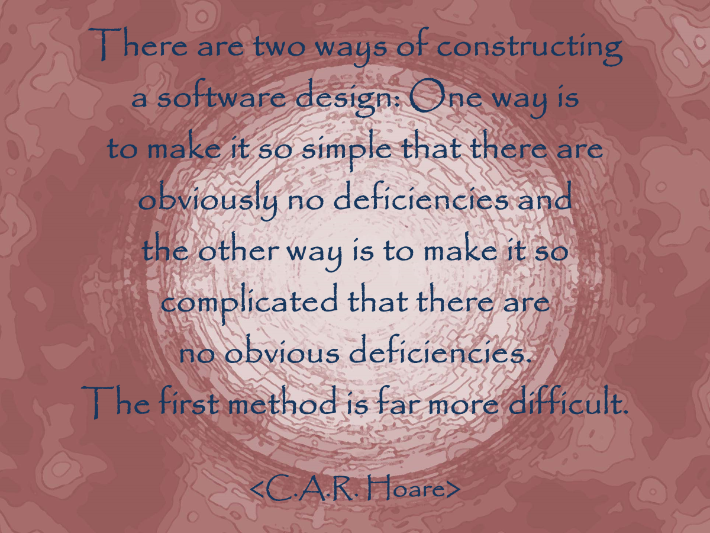

Slide 3
Alerts
Study for the midterm!
Project 4 is available
In-class Lab 11 tomorrow
Midterm II Friday
  Chapters 5, 6, 8, 9
  StdDraw & StdAudio
  Codingbat.com is a great place to study!

Slide 4
Review
Last time we talked about
  Midterm II review
  Questions?

Slide 5
Java types
There are two classifications of types in Java
Primitive types:
  int
  double
  boolean
  char
Object types:
  String
  arrays
  An infinite number of others…

Slide 6
Characteristics of primitive types
Primitive types:
Have a fixed amount of storage
Think of them as a box designed to hold a particular kind of data
Have basic operations used to manipulate them
  int, double (+, -, *, /, %)
  boolean (||, &&, ^, !)

Slide 7
Characteristics of object types
Object types
Hold arbitrarily complex kinds of data of any kind
Do not have a pre-specified amount of storage
Think of them as arrows pointing to some concrete thing that holds primitive data
Use methods for interaction instead of operators
  For example, String objects use length(), charAt(), etc.

Slide 8
Reference types are different
Variables that hold object types are called references
As we have previously discussed
  References do not work the same as primitive variables
  Up to this point, we have tried to ignore this difference
A primitive variable holds a value
A reference variable merely points to the location of the object

Slide 9
How does this affect you?
Picture a ham…
Imagine that this ham is actually a Java object
You may want a reference of type Ham to point at this ham
Let's call it ham1
ham1

Slide 10
How many hams?
ham2
Now, what if we have another Ham reference called ham2
What happens if we set ham2 to have the same value as ham1 using the following code?
Ham ham2 = ham1;
ham1

Slide 11
There is only one ham!
When you assign an object reference to another reference, you only change the thing it points to
This is different from primitive types
When you do an assignment with primitive types, you actually get a copy
x
y
int x = 37;
int y = x;
37
37

Slide 12
Reference vs. primitive variables
Since reference variables are only pointers to real objects, an object can have more than one name
These names are called aliases
If the object is changed, it doesn't matter which reference was used to change it

Slide 13
Ham solo
ham2
Thus, if we tell ham2 to take a bite away, it will affect the ham pointed at by ham1
Remember, they are the same ham
ham2.bite();
ham1

Slide 14
Remember that primitives make copies
We have ints x and y, both with value 37
If we change x, it only affects x
If we change y, it only affects y
int x = 37;
int y = x;
x++;
y--;
x
y
37
38
37
36

Slide 15
A reference is just an arrow
If you declare a lot of references, you have not created any objects, just lots of arrows
Eggplant aubergine;
DumpTruck truck1;
Idea thought;
aubergine
truck1
thought

Slide 16
Where do those arrows point?
When you first declare a reference variable, it doesn't point at anything, and you can't use it unless you point it somewhere
There is a special Java keyword null that just means nothingness
You can point a reference at null
However, if you try to do something with null, thinking it's a real object, you can crash your program

Slide 17
Constructors
To make those arrows point at a new object, you must call a constructor
A constructor is a kind of method that creates an object
Some constructors allow you to specify certain attributes of the object you are creating
The default constructor does not let you specify anything

Slide 18
Invoking the constructor
To call a constructor, you use the new keyword with the name of the class followed by parentheses:
Perhaps there is a Ham constructor that lets you take a double that is the number of pounds that the ham weighs:
Ham ham1 = new Ham(); // default constructor
Ham ham2 = new Ham( 4.2 ); // weight constructor

Slide 19
Strings are funny
The objects you are most familiar with by now are Strings
They break a few rules:
  It is possible to create them without explicitly using a constructor
  They can be combined using the + operator
You can still create a String object using a constructor:
String s = new String("Help me!");

Slide 20
Object methods
Previously we talked about static methods
Object methods are those methods called on objects
They are different from static methods because they can also use information inside the object to perform some task
Think of them as asking an object a question (for value returning methods) or telling an object to do something (for void methods)

Slide 21
Calling methods
You are already familiar with calling methods on Strings
Applying this knowledge to other objects should be a piece of cake
Simply type the name of the object, put a dot, then type the method name, with the arguments in parentheses:
String s = new String("Help me!");
char c = s.charAt(3); // c gets 'p'

Slide 22
Applied to other objects…
It's exactly the same for non-String objects:
You've learned lots of methods that work on String objects
Every kind of object has its own methods
You'll have to learn them (or look them up) if you want to use them
Ham h = new Ham(3.2);
h.bite(); // Takes bite out of ham
double weight = h.getWeight(); // current ham weight

Slide 23
Java API
It is possible to create your own classes and define your own methods for objects
However, Java has designed many, many useful objects that you can create
You can find them listed in the Java API: http://docs.oracle.com/javase/12/docs/api/
Or, you can type the name of the class you're interested in, like String, into Google
The API page is usually the first hit

Slide 24
How do you tell if two objects are the same?
If you have two primitive variables, you just use the == operator
However, with objects, this will only give you back true if the two references are pointing at exactly the same object
Sometimes you need to know that, but objects can be equivalent in other ways too

Slide 25
Equivalence confusion
In this example, the == operator will say they are different, but the equals() method will say that they are the same
Every object has an equals() method
String s1 = new String("identical");
String s2 = new String("identical");
if (s1 == s2)
System.out.println("Same!");
else
System.out.println("Different!");
if (s1.equals(s2))
System.out.println("Same!");
else
System.out.println("Different!");

Slide 26
Templates for objects
An object is the actual data that you can use in your code
A class is a template for creating objects of a certain kind
  Class = Car
  Object = Mitsubishi Lancer Evolution X
Just like int is a type and 34 is an instance of that type
A key difference is that you can define new classes

Slide 27
Contain members and methods
When designing classes, they contain two kinds of elements:
  Members
  Methods

Slide 28
Anatomy of a class definition
Class definition
public class Name {
private int member1;
private double member2;
private Hedgehog member3;
public Name(){
…
}
public int method1( double x ){
…
}
}
Member declarations
Constructor definition
Method
definition

Slide 29
Members are data inside an object
Members are the actual data inside an object
They can be primitive types or other object types
They are usually hidden (private) from the outside world
public class Point {
private double x; // member variable
private double y; // member variable
}

Slide 30
Data visibility
What do private and public mean?
These keywords allow you to specify the scope or permissions of members and methods
private means that only methods from the same class can access an item
public means that any method can access the item
Later, the modifier protected will come into play when you create child classes

Slide 31
Methods are ways to interact with objects
Methods allow you to do things
Object methods usually allow you to manipulate the members
They are usually visible (public) to the outside world
Methods can be static or non-static
Only non-static methods can interact with the members of an object

Slide 32
Constructors
Constructors are a special kind of method
They allow you to customize an object with particular attributes when it is created
public class Point {
private double x; // member variable
private double y; // member variable
// constructor
public Point( double newX, double newY ){
x = newX;
y = newY;
}
}

Slide 33
Constructor attributes
Constructors are almost always public (otherwise you couldn't create an object)
Constructors are not called like other methods
Constructors are invoked once, when an object is created
The new keyword is used to do this
Point p = new Point( 0.5, 0.25 );

Slide 34
Accessors
Because members are usually private, it is common to use methods specifically just to find out what their values are
A method that just returns the value of a member variable is called an accessor
public double getX() { //accessor for x
return x;
}
public double getY() { //accessor for y
return y;
}

Slide 35

Mutators
Again, because members are usually private, it is common to use methods specifically just to change their values
A method that just changes the value of a member variable is called a mutator
public void setX( double newX ) { //mutator for x
x = newX;
}
public void setY( double newY ) { //mutator for y
y = newY;
}

Slide 36
You don't need an object to use a static method
Remember, you need an object to call a non-static method, but you only need to know the name of the class to call a static method
We can put a static distance() method inside the Point class
public static double distance(double x1, double y1,
double x2, double y2) {
double xDelta = x1 – x2;
double yDelta = y1 – y2;
return Math.sqrt(xDelta*xDelta + yDelta*yDelta);
}
double d = Point.distance(0.4, 0.5, 0.3, 2.2);

Slide 37
Class roster
Let's create a Student class
Each Student will contain
  First Name: String
  Last Name: String
  GPA: double
  ID: int
We need a constructor specifying each of these things, accessors to read them later, and mutators to change GPA and ID

Slide 38
Roster
Using the Student class, we can create a roster of students
The roster is just an array of Student objects
We'll read in some student information from a file and create lots of Student objects
Then, with our array, we can do some operations:
  Print out a nicely formatted roster
  Find the average GPA of all students
  Determine the valedictorian

Slide 39
Next time…
On Friday,
  Midterm II

