Slide 1
COMP 1600 Introduction to Programming
David J Stucki
Fall 2025

Slide 2

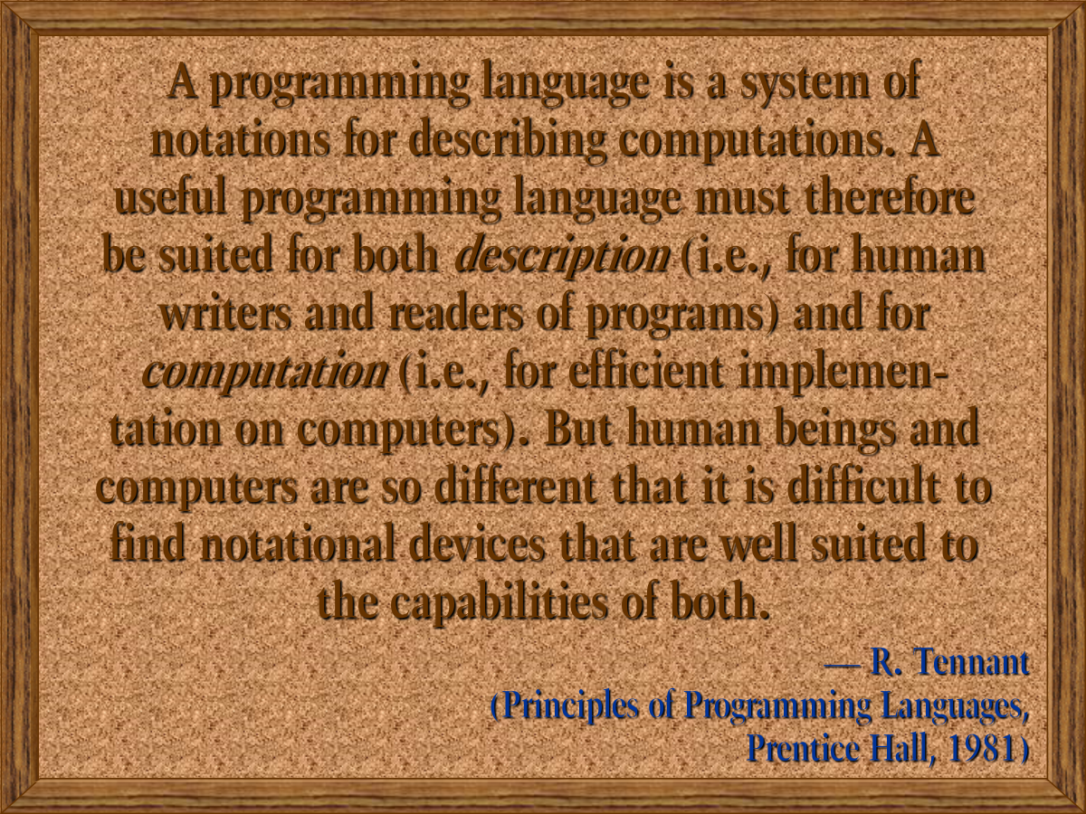

Slide 3
Review
Last time we talked about
Conway's Game of Life

Slide 4
Alerts
Study for the midterm!
Project 4 is available
Midterm II Friday (October 31)
Chapters 5, 6, 8, 9
StdDraw & StdAudio
Codingbat.com is a great place to study!
Try String 2 and Array 2

Slide 5
Conditions in Java
A condition is either true or false
boolean variables can store such a condition
Conditions can also be found by using comparison operators:
Equality: != == (Note: different from = )
Inequality: < <= > >=
Two conditions can be joined together using AND && or OR ||
Both conditions must be true to get true using AND, either one can be true for OR
A condition can be inverted using NOT !

Slide 6
Loops
Allow us to repeatedly execute code
Care must be taken to run exactly the right number of times
Not too many & Not too few
Not an infinite number
Not zero (unless that's what should happen)
Loops come in three flavors:
while loops
for loops
do-while loops

Slide 7
while loops
Used when you don't know how many times a loop will run
Runs as long as the condition is true
Syntax:
while( condition ) {
//statements
}

Slide 8
for loops
Used when you do know how many times a loop will run
Still runs as long as the condition is true
Syntax:
for(initialize; condition; increment) {
//statements
}

Slide 9
do-while loops
Used infrequently, mostly for input
Useful when you need the loop to run at least once
Runs as long as the condition is true
Syntax:
do {
//statements
} while ( condition );

Slide 10
Common loop errors
Infinite loops
Almost infinite loops (with overflow or underflow)
Fencepost errors (off by one)
Skipping loops entirely
Misplaced semicolon

Slide 11
Definition of an array
An array is a homogeneous, static data structure
Homogeneous means that everything in the array is the same type: int, double, String, etc.
Static (in this case) means that the size of the array is fixed when you create it

Slide 12
Declaration of an array
To declare an array of a specified type with a given name:
Example with a list of type int:
Just like any variable declaration, but with []
type[] name;
int[] list;

Slide 13
Instantiation of an array
When you declare an array, you are only creating a variable that can hold an array
To use it, you have to create an array, supplying a specific size:
This code creates an array of 100 ints
int[] list;
list = new int[100];

Slide 14
Accessing elements of an array
You can access an element of an array by indexing into it, using square brackets and a number
Once you have indexed into an array, that variable behaves exactly like any other variable of that type
You can read values from it and store values into it
Indexing starts at 0 and stops at 1 less than the length
list[9] = 142;
System.out.println(list[9]);

Slide 15
Length of an array
When you instantiate an array, you specify the length
You can use its length member to find out
int[] list = new int[42];
int size = list.length;
System.out.println("List has " + size +
" elements"); //prints 42

Slide 16
Two dimensional array
To declare a two dimensional array, we just use two sets of square brackets ([][]):
Doing so creates a variable that can hold a 2D array of ints
As before, we still need to instantiate the array to have a specific size:
int [][] table;
table = new int[5][10];

Slide 17
StdDraw
StdDraw is a library of Java code developed by Robert Sedgewick and Kevin Wayne
StdDraw allows you to draw output on the screen easily
You can draw points, lines, and polygons in various colors
You can clear and resize the drawing area and even save the results
StdDraw is not standard Java that everyone uses, but it's a nice tool for graphics

Slide 18
Lines and points
The simplest things you can draw with StdDraw are lines and points
The first thing you should be aware of is that the canvas is drawn like Quadrant I of a Cartesian plane
(0,1)
(1,1)
(0,0)
(1,0)

Slide 19
Line and point methods
The following methods can be used to draw lines and points
Method | Use
void line(double x0, double y0, double x1, double y1) | Draw a line from (x0,y0) to (x1,y1)
void point(double x, double y) | Draw a point at (x,y)

Slide 20
Shape methods
Here are some methods for drawing circles and squares and setting the color for doing so:
Method | Use
void circle(double x, double y, double r) | Draw a circle centered at (x,y) with radius r
void filledCircle(double x, double y, double r) | Draw a filled circle centered at (x,y) with radius r
void square(double x, double y, double r) | Draw a square centered at (x,y) with edges 2r
void filledSquare(double x, double y, double r) | Draw a filled square centered at (x,y) with edges 2r
void setPenColor(Color c) | Start drawing with color c

Slide 21
Colors
Eventually you will be able to define your own colors
For now you are limited to 13 presets
For example, to make something magenta, you would use the value StdDraw.MAGENTA
WHITE | BLUE | CYAN | DARK_GRAY | GRAY
GREEN | LIGHT_GRAY | MAGENTA | ORANGE | PINK
RED | BLACK | YELLOW

Slide 22
Purpose of the StdAudio class
Audio data on Windows machines is sometimes stored in a WAV file
A WAV file is much simpler than an MP3 because it has no compression
Even so, it contains two channels (for stereo) and can have many different sample rates and formats for recording sound
The StdAudio class lets you read and write a WAV file easily and always deal with a single array of sound, sampled at 44,100 Hz

Slide 23
StdAudio methods
Everything you'd want to do with sound:
To do interesting things, you have to manipulate the array of samples
Make sure you add StdAudio.java to your project before trying to use it
Method | Use
static double[] read(String file) | Read a WAV file into an array of doubles
static void save(String file, double[] input) | Save an array of doubles (samples) into a WAV file
static void play(String file) | Play a WAV file
static void play(double[] input) | Play an array of doubles (samples)

Slide 24
StdAudio example
Let's load a file into an array:
If the song has these samples:
Perhaps samples will contain:
String file = "song.wav";
double[] samples = StdAudio.read(file);
-.9 | -.7 | -.6 | -.4 | -.2 | -.1 | .1 | .2 | .3 | .4 | .5 | .6 | .6 | .5 | .4 | .3 | .2 | 0 | -.2 | -.4

Slide 25
Static Methods
Static methods allow you to break your program into individual pieces that can be called by each other repeatedly
Advantages:
More modular programming
Break a program into separate tasks
Each task could be assigned to a different programmer
Code reusability
Use code over and over
Even from other programs (like Math.sqrt())
Less code (and error) duplication
Improved readability
Each method can do a few, clear tasks
Well named method are self-documenting

Slide 26
Return type and parameters
A method takes in 0 or more parameters and returns 0 or 1 values
A method that doesn't return a value is declared as a void method
Definition syntax:
public static type name( type arg1, type arg2, … ) {
//statements
//braces are always required!
}

Slide 27
Calling syntax
Proper syntax for calling a static method gives first the name of the class that the method is in, a dot, the name of the method, then the arguments
If the method is in the same class as the code calling it, you can leave off the Class. part
If it is a value returning method, you can store that value into a variable of the right type
Class.name(arg1, arg2, arg3);

Slide 28
Binding example
int a = 10;
int x = 3;
int y = add( 5, a ); //y contains 15 now
No connection between the two different x's and y's
public static int add(int x, int y){
int z = x + y; //5 + 10
return z;
}

Slide 29
Binding
When a method is called, the arguments passed into the method are copied into the parameters
The names for the values inside the method can be different from the names outside of the method
Methods cannot change the values of the arguments on the outside for primitive types
Methods can change the values inside of arrays and sometimes inside of object types

Slide 30
Exam Review Questions

Slide 31
What is the output?
int a = 1, b = 2;
for (int i = 0; i < 5; i++) {
for (int j = 0; j < 2; j++) {
System.out.print(a + b + " ");
++a;
}
b *= 2;
}
3 4 7 8 13 14 23 24 41 42
12 22 34 44 58 68 716 816 932 1032
0 1 1 2 2 3 3 4 4 5
This code contains an infinite loop

Slide 32
What does the StdDraw screen look like after this code is executed?
A filled yellow square in the center of the screen
A filled yellow square in the center of a large filled blue square
A filled yellow square in the center of a larger filled red square in the center of a larger filled blue square
A large filled blue square in the center of the screen
StdDraw.setPenColor(StdDraw.RED);
StdDraw.filledSquare( .5, .5, .2 );
StdDraw.setPenColor(StdDraw.BLUE);
StdDraw.filledSquare( .5, .5, .3 );
StdDraw.setPenColor(StdDraw.YELLOW);
StdDraw.filledSquare( .5, .5, .1 );

Slide 33
What does method peter() return?
public static String peter( String s ) {
String temp = "";
while( s.length() > 0 ) {
temp += piper( s );
s = s.substring( 0, s.length() - 1 );
}
return temp;
}
public static char piper( String s ) {
return s.charAt( s.length() - 1 );
}
An empty String
A String containing a reversed version of s
A String containing a copy of s
Method peter() causes a run-time error

Slide 34
How many bytes of memory are allocated by the following code?
0
6
24
96
int[][][] thingy = new int[2][3][4];

Slide 35
Draw a quincunx
Complete the method below so that it draws a quincunx:
public static void quincunx() {
}

Slide 36
Count E's
Complete the method below that takes a String value and returns the number of uppercase and lowercase letter E's in it
public static int countEs(String word) {
}

Slide 37
Craps
Complete the method below that does the following:
Generates two random numbers, each between 1 and 6, representing dice
If they are both 1, print out "Snake eyes!"
Otherwise, print the sum of the two values
If both numbers are the same, also print "the hard way"
public static void craps() {
}
Potential sample output if craps() is run five times:
3
8 the hard way
Snake eyes!
11
6

Slide 38
Pop Quiz 9

Slide 39
Next time…
On Wednesday,
Calling methods on objects
Examples with classes and objects

