Slide 1
COMP 1600 Introduction to Programming
David J Stucki
Fall 2025

Slide 2

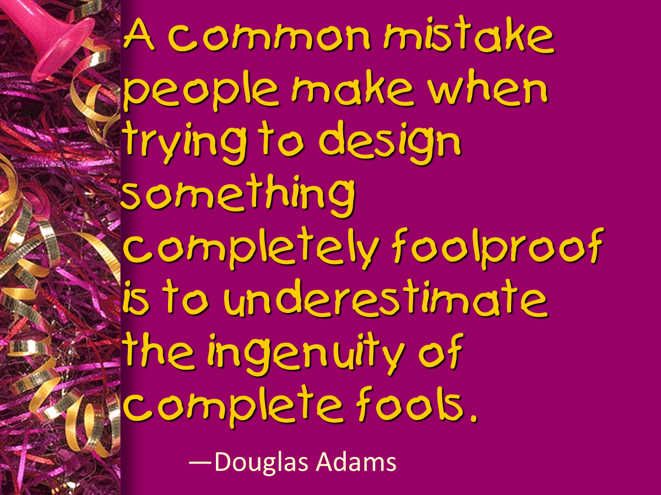

Slide 3
Alerts
Read chapter 9
Project 3: Due today
Project 4 is available
Midterm II next Friday (October 31)
Review Monday

Slide 4
Review
Last time we talked about
Multidimensional arrays
Overriding methods
Conway's Game of Life

Slide 5
Conway's Game of Life
A cell is represented by a block in a grid
Each cell has 8 neighbors
Simple rules for a cell "coming to life" or "dying":
A live cell with fewer than 2 live neighbors dies from loneliness
A live cell with more than 3 live neighbors dies from overcrowding
A live cell with exactly 2 or 3 neighbors keeps living
A dead cell with exactly 3 living neighbors comes to life

Slide 6
Implementing Conway's Game of Life
We can represent the grid of cells with a 2D array of boolean values
true means alive
false means dead
Each iteration, we draw the grid onto the screen with StdDraw
Black means alive
White means dead
Then, we update the grid to contain the new values
The grid stores the state of the game
We still have to use StdDraw to draw that state

Slide 7
Next time…
On Monday,
Calling methods on objects
Examples with classes and objects

