Slide 1
COMP 1600 Introduction to Programming
David J Stucki
Fall 2025

Slide 2

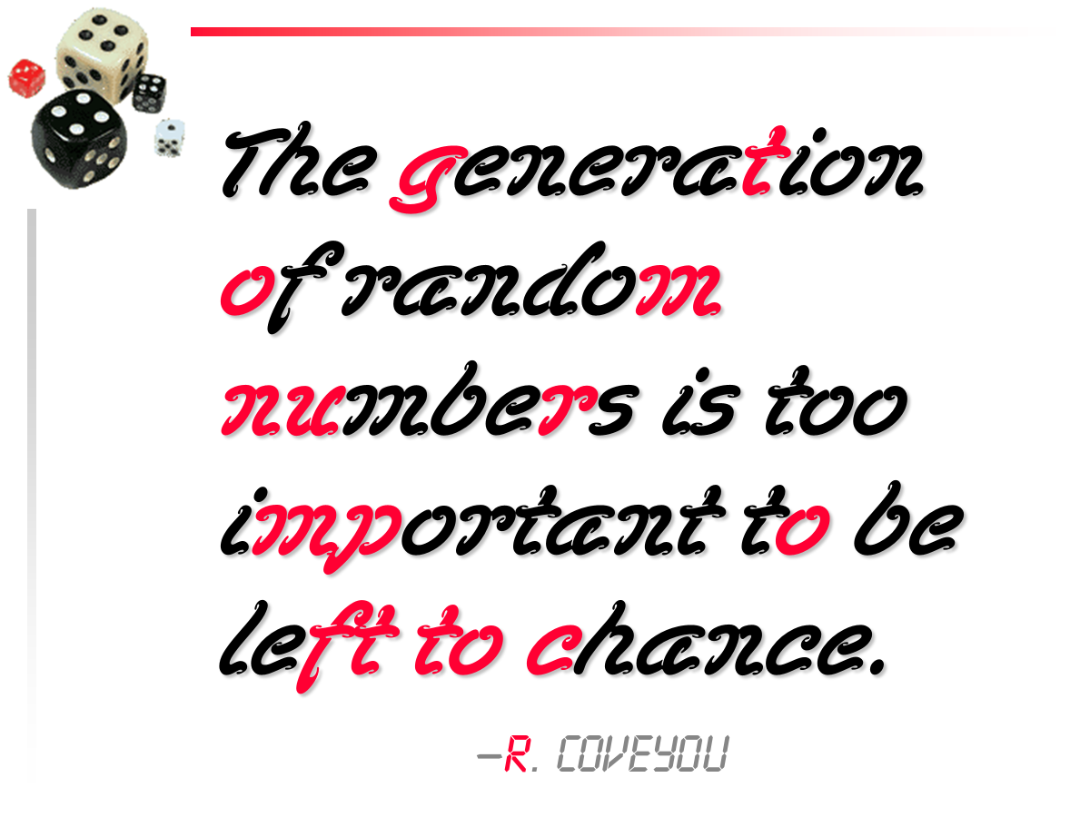

Slide 3
Alerts
Read chapter 9
Project 3: Due Friday
Midterm II a week from Friday (October 31)

Slide 4
Review
Last time we talked about
Drawing a star
2D Arrays
Queen attacking pawn

Slide 5
4th dimensional rocketships going up
It doesn't have to stop at 2 dimensions!
You can have 3 or more
Here's an example with 3 dimensions:
int[][][] rubiksCube = new int[3][3][3];
int count = 1;
for(int i = 0; i < 3; i++) {
for(int j = 0; j < 3; j++) {
for(int k = 0; k < 3; k++) {
rubiksCube[i][j][k] = count;
count++;
}}}

Slide 6
What does a 3D array look like?
It looks like whatever you want it to
You can visualize it in 3D if you want
There are other techniques
It's just a way to store data
It doesn't actually look like anything inside the computer

Slide 7
Why use a high dimensional array?
Sometimes you have data categorized in several different ways
For example, players in the MLB might be in different leagues, different teams, and play different positions
0 – Cubs
1 – Reds
2 – Pirates
3 – Cardinals
4 – Brewers
etc., ...
Reasonable candidate for a 3D array
0 – Pitcher
1 – Catcher
2 – 1st Base
3 – 2nd Base
4 – Short Stop
5 – 3rd Base
6 – Left Field
7 – Center Field
8 – Right Field
0 – Amerian
1 – National

Slide 8
Why not to use a high dimensional array
Too many brackets
Too much stuff
Total size used is the product of the length of all the dimensions
100 × 100 × 100 = 1,000,000
Hard to visualize, hard to imagine
Up as high as 4 is occasionally useful
Don't go beyond 2 on a regular basis

Slide 9
Overloading
By now, everyone should be familiar with the simple method that returns the maximum of two values:
public static int max( int a, int b ) {
if( a > b )
return a;
else
return b;
}

Slide 10
A rose by any other name…
What if we wanted to have a method with the same name that took three arguments and gave the maximum of them?
public static int max(int a, int b, int c) {
if (a >= b && a >= c) {
return a;
} else if (b >= a && b >= c) {
return b;
} else {
return c;
}
}

Slide 11
Is that allowed?
Yes!
All that we need is the parameters to be different so that the compiler can figure out which method to use
The number or types (or both) of the parameters must be different
A different return type is not enough!

Slide 12
Russian stacking dolls
We can even call one overloaded method from another:
public static int max(int a, int b, int c) {
return max(max(a,b), c);
}

Slide 13
Confusion!
Consider the following two methods:
Are they legally overloaded methods?
public static int flibble( int a, double b ) {
return 10;
}
public static int flibble( double a, int b ) {
return 20;
}

Slide 14
Which one?
But, which one gets called if I have a line of code that says:
No one knows!
int x;
x = flibble(4, 5);

Slide 15
Conway's Game of Life
A cell is represented by a block in a grid
Each cell has 8 neighbors
Simple rules for a cell "coming to life" or "dying":
A live cell with fewer than 2 live neighbors dies from loneliness
A live cell with more than 3 live neighbors dies from overcrowding
A live cell with exactly 2 or 3 neighbors keeps living
A dead cell with exactly 3 living neighbors comes to life

Slide 16
Implementing Conway's Game of Life
We can represent the grid of cells with a 2D array of boolean values
true means alive
false means dead
Each iteration, we draw the grid onto the screen with StdDraw
Black means alive
White means dead
Then, we update the grid to contain the new values
The grid stores the state of the game
We still have to use StdDraw to draw that state

Slide 17
Next time…
On Friday,
Implement the Game of Life
Reference types
Calling methods on objects
Classes

