Slide 1
COMP 1600
Introduction to Programming
David J Stucki
Fall 2025

Slide 2

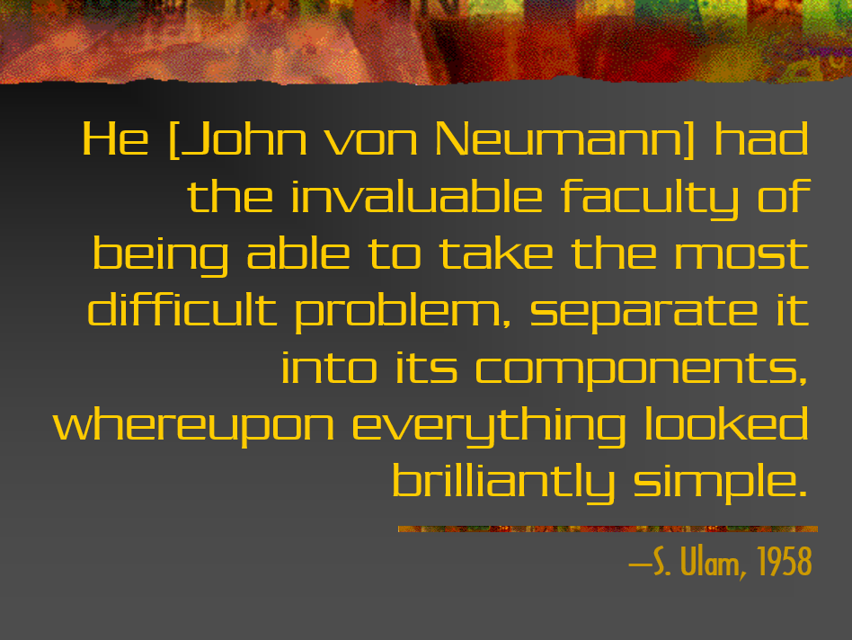

Slide 3
Alerts
Read chapter 9
Project 3: Due Friday
Midterm II a week from Friday (October 31)

Slide 4
Review
Last time we talked about
  More static methods

Slide 5
Star drawing
Drawing a star is more complicated than drawing a rectangle
For a five pointed star, we need 5 points
Let's put it into a method so that we can do it repeatedly
We want the method to take a scale, a starting point, and a color
108°

Slide 6
2D arrays
Just as it is possible to make a one dimensional list out of a single data type, it is also possible to make a table out of one data type
We can extend the arrays you know to have two dimensions with very similar syntax

Slide 7
Declaration
To declare a two dimensional array, we just use two sets of square brackets ([][]):
Doing so creates a variable that can hold a 2D array of ints
As before, we still need to instantiate the array to have a specific size:
int [][] table;
table = new int[5][10];

Slide 8
Visualization of 2D arrays
Like matrices, we usually visualize the first dimension as the rows and the second dimension as the columns
Second Dimension
0 1 2 3 4 5 6 7 8 9
0
1
2
3
4
First Dimension

Slide 9
Visualization of 2D arrays
Let's write a little code to put data into the table
int [][] table = new int[5][10];
int label = 1;
for( int i = 0; i < 5; i++ ) {
for( int j = 0; j < 10; j++ ) {
table[i][j] = label;
label++;
}
}

Slide 10
Visualization of 2D arrays
The result of that code is:
Second Dimension
0 1 2 3 4 5 6 7 8 9
0
1
2
3
4
1 | 2 | 3 | 4 | 5 | 6 | 7 | 8 | 9 | 10
11 | 12 | 13 | 14 | 15 | 16 | 17 | 18 | 19 | 20
21 | 22 | 23 | 24 | 25 | 26 | 27 | 28 | 29 | 30
31 | 32 | 33 | 34 | 35 | 36 | 37 | 38 | 39 | 40
41 | 42 | 43 | 44 | 45 | 46 | 47 | 48 | 49 | 50
First Dimension

Slide 11
Chessboard
We could represent a chessboard as an 8x8 array of chars
Use the following encoding:
  'P' = pawn
  'N' = knight
  'B' = bishop
  'R' = rook
  'Q' = queen
  'K' = king
Use upper case characters for black pieces and lower case characters for white ones

Slide 12
Checking a pawn for danger
Imagine there is a pawn randomly set on the board and a queen of the opposite color on the board
Write a program to see if the queen can capture the pawn in the next move
 |  |  |  | Q
 |  | p

Slide 13
Algorithm for chess problem
Find the row and column location of both the queen and the pawn
The pawn is in danger if:
  The queen and the pawn have the same row
  The queen and the pawn have the same column
  If the absolute value of the differences between their rows and the absolute value of the differences between their columns are the same

Slide 14
Pop Quiz 8

Slide 15
Next time…
On Wednesday,
  Multidimensional arrays
  Overloading methods
  Game of Life

