Slide 1
COMP 1600
Introduction to Programming
David J Stucki
Fall 2025

Slide 2

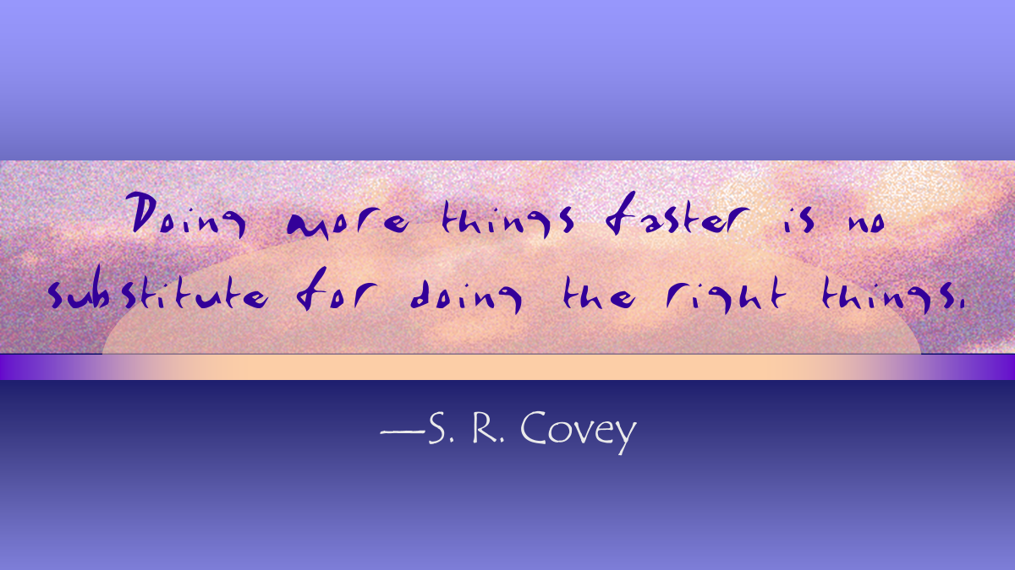

Slide 3
Alerts
Read chapter 8
Project 3: Due next Friday

Slide 4
Review
Last time we talked about
  More drawing
  Static methods

Slide 5
Calling methods
Defining a method is only half the game
You have to call methods to use them
Calling a method means giving a method the parameters (or arguments) it needs and then waiting for its answer
By now, you have done many method calls
  System.out.println()
  Math.sqrt()
You can call your own methods the same way

Slide 6
Calling syntax
Proper syntax for calling a static method gives first the name of the class that the method is in, a dot, the name of the method, then the arguments
If the method is in the same class as the code calling it, you can leave off the Class. part
If it's a value returning method, you can store that value into a variable of the right type
Class.name(arg1, arg2, arg3);

Slide 7
Methods from other classes
If a static method is in another class, you have to put the name of the class first, followed by a dot
We've seen a few of these already:
By convention, class names in Java always start with a capital letter
double length = Math.sin(angle);
double value = Math.random();
double[] samples = StdAudio.read(file);

Slide 8
Scope
Variables from outside of the method don't exist unless they've been passed in as parameters
No matter how complex a program is, inside this method, only x, y, and z variables matter
public static int add(int x, int y){
int z = x + y;
return z;
}

Slide 9
Binding
A magical process called binding happens which copies the values from the calling code into the parameters of the method
The calling code can use variables with the same names, with different names, or even just literals
The method does not change the values of the variables in the original code
Remember, it only has copies of the values

Slide 10
Binding example
int a = 10;
int x = 3;
int y = add(5, a); //y contains 15 now
No connection between the two different x's and y's
public static int add(int x, int y){
int z = x + y; //5 + 10
return z;
}

Slide 11
Static method rules
Start a method with the keywords public static
Next comes the return type
Then the name of the method
Then, in parentheses, the arguments you want to give to the method
Inside braces, put the body of the method
Include a return statement that gives back a value if needed

Slide 12
Palindrome?
A palindrome is a word or phrase spelled the same forwards and backwards:
  "bob"
  "radar"
  "satanoscillatemymetallicsonatas"
Write a method with the following header that returns true if a String is a palindrome and false otherwise
public static boolean isPalindrome(String phrase) {

Slide 13
Star drawing
Drawing a star is more complicated than drawing a rectangle
For a five pointed star, we need 5 points
Let's put it into a method so that we can do it repeatedly
We want the method to take a scale, a starting point, and a color
108°

Slide 14
Next time…
On Monday,
  Two-dimensional arrays

