Slide 1
COMP 1600 Introduction to Programming
David J Stucki
Fall 2025

Slide 2
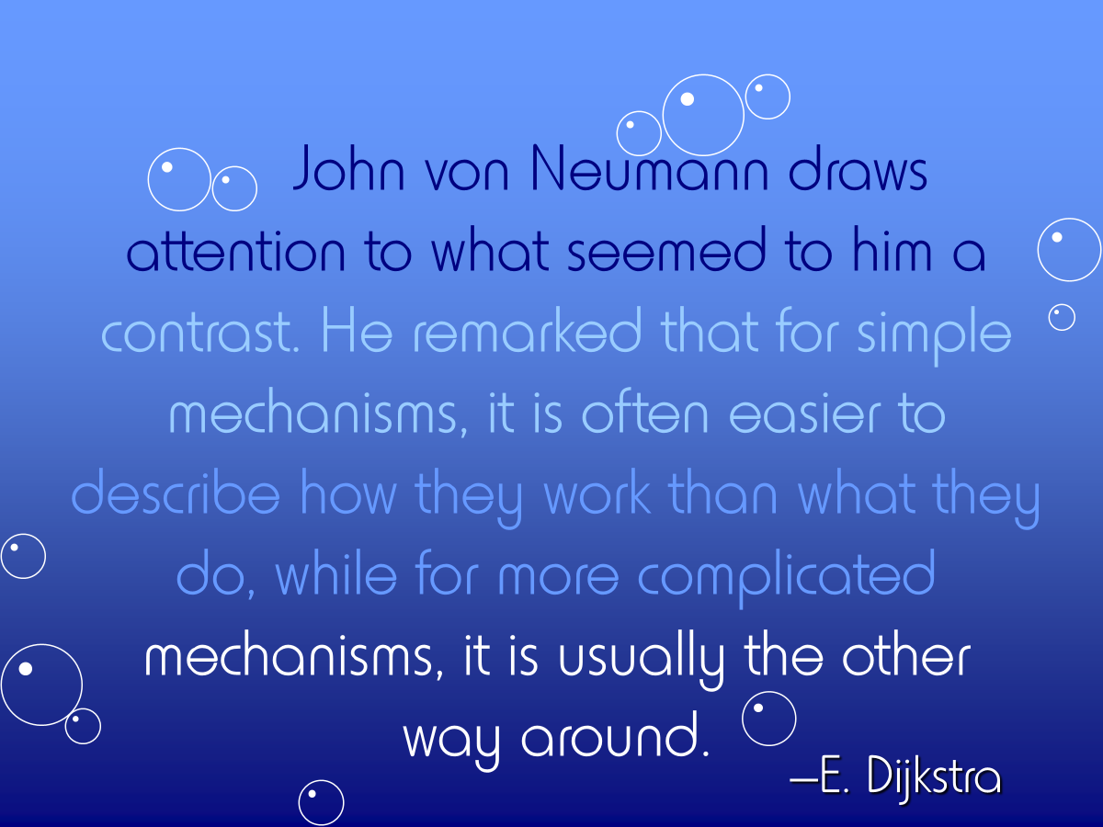

Slide 3
Alerts
Read chapter 8
Project 3

Slide 4
Review
Last time we talked about
StdDraw examples

Slide 5
Plotting functions
Plotting functions is really useful
Getting smooth curves is hard
Instead, we just pick a whole bunch of x points and figure out the function value
We can just draw dots to plot those values
We can connect them with lines for a more connected look
Let's write some code to draw cubic polynomials

Slide 6
Function plotting algorithm
Ask the user for the coefficients of the four terms (ax³ + bx² + cx + d)
Ask the user for an x range
Run through the function and find the minimum and maximum y values hit
Rescale the drawing area to show everything
Plot the function

Slide 7
Methods
We have written lots of code so far
It has all been inside of the main() method
What about a big program?
The main() method is going to get really long and hard to read
Sometimes you need to do similar things several times:
Read some input and check that it falls within certain values
Draw a green hexagon at several different locations
Find the square root of several different numbers

Slide 8
Idea of a method
Methods allow you to package up some code to run over and over
Methods usually take some input (like numbers or Strings) so that they can be customized
Methods often give back an answer (like the square root of a number)
Also called subroutines in some other languages

Slide 9
Advantages of methods
More modular programming
Break a program into separate tasks
Each task could be assigned to a different programmer
Code reusability
Use code over and over
Even from other programs (like Math.sqrt())
Less code duplication
Improved readability
Each method can do a few, clear tasks

Slide 10
Anatomy of a static method
Type of
answer
Type of
1st argument
Type of
last argument
Required syntax
public static type name(type arg1,…,type argn) {
statement1;
statement2;
…
statementm;
}
Name of
1st argument
Name of
last argument
Name of method
Body of method

Slide 11
Simple method example
Given two integers, find the smaller:
public static int min(int a, int b) {
if (a < b) {
return a;
}
else {
return b;
}
}

Slide 12
Why static?
static methods are methods that are not connected to a particular object
They are supposed to perform some simple task
We are going to focus on static methods for the next week or so
For now, just taken it as a given that the definition of every method will include the static keyword

Slide 13
Value returning methods
It is possible to divide methods into two types:
Value returning methods (aka functions)
Void methods
Value returning methods give an answer:
int small = min(x, y);

Slide 14
Void methods
Void methods are declared with void as their return type
Void methods do something (but give back no answer)
If you try to save the value they give back, there will be a compiler error
public static void help(int times) {
for (int i = 0; i < times; ++i){
System.out.println("Help!");
}
}

Slide 15
return statements
Like most code in Java, the code inside of a method executes line by line
Of course, you are allowed to put if statements and loops inside methods
You can also put in return statements
A method will stop executing and jump back to wherever it was called from when it hits a return
The return statement is where you put the value that will be given back to the caller

Slide 16
Pop Quiz 7

Slide 17
Next time…
On Friday,
More on methods

