Slide 1
COMP 1600 Introduction to Programming
David J Stucki
Fall 2025

Slide 2
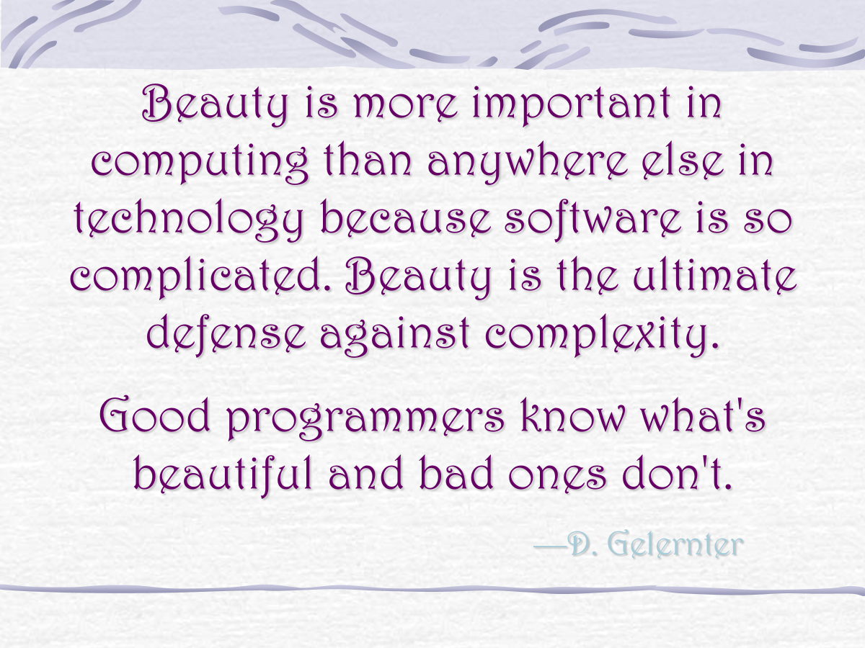

Slide 3
Alerts
Read chapter 8
Project 3
FALL BREAK NEXT MONDAY & TUESDAY!!

Slide 4
Review
Last time we talked about
StdDraw

Slide 5
Controls
A number of methods are given to give us more control over the display
Method | Use
void setXscale(double x0, double x1) | Set the x scale
void setYscale(double y0, double y1) | Set the y scale
void setPenRadius(double r) | Set the pen radius
void setCanvasSize(int w, int h) | Set canvas size
void clear() | Clear canvas to white
void clear(Color c) | Clear canvas to color c
void pause(int delay) | Delay for delay ms

Slide 6
Scales
As you have seen, the default scale of the canvas is in the range [0,1] for both x and y
We can use the setXscale() method to set the minimum and maximum x values
We can use the setYscale() method to set the minimum and maximum y values
Useful for plotting functions

Slide 7
Canvas size
Note that changing the scale doesn't change the size of the window, just what is shown in it
If you want to change the size of the window, use the setCanvasSize() method to set the width and the height of the canvas in terms of screen pixels

Slide 8
What is this pause() thing?
The pause() method lets you specify a delay in milliseconds before things are drawn on the screen
You can use it to slow down or speed up animations
To use it right, you need to first call StdDraw.enableDoubleBuffering()
Then, whenever you want to actually show all the drawing that's been done, you call StdDraw.show()
Doing so draws everything off-screen and then shows it all at once, which is both more efficient and more attractive for animations

Slide 9
What about a chessboard?
We want to make a pattern of black and white squares on the screen
Hint: We need two loops
Let's try it!

Slide 10
Cannon simulator
Can we simulate a cannon being fired?
Let the user enter an initial velocity in m/s
Let the user an angle between 0° and 90°
Assume each iteration takes 1/30 of a second
Assume an initial height of 20 m
We draw the path of the cannon ball as it flies through the air
Let's also set the x and y scales to both be [0,100]

Slide 11
Plotting functions
Plotting functions is really useful
Getting smooth curves is hard
Instead, we just pick a whole bunch of x points and figure out the function value
We can just draw dots to plot those values
We can connect them with lines for a more connected look
Let's write some code to draw cubic polynomials

Slide 12
Function plotting algorithm
Ask the user for the coefficients of the four terms (ax³ + bx² + cx + d)
Ask the user for an x range
Run through the function and find the minimum and maximum y values hit
Rescale the drawing area to show everything
Plot the function

Slide 13
Next time…
On Wednesday,
Static methods

