Slide 1
COMP 1600 Introduction to Programming
David J Stucki
Fall 2025

Slide 2
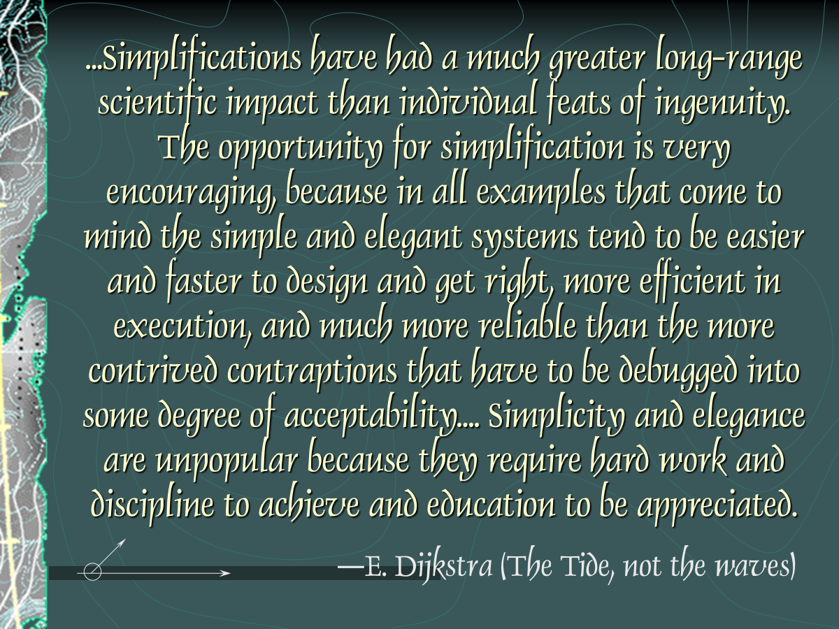

Slide 3
Alerts
Read chapter 8
Project 3: questions?
Lab-day tomorrow is for P3
Thursday will be In-class Lab 8

Slide 4
Review
Last time we talked about
sound

Slide 5
Statistics
Recently, we showed you how to add a set of numbers together as they were input by a user
Although this is a useful technique, not every operation is possible
We can find the sum or the average of the numbers because we only need to see the numbers once
What operation needs to see the numbers more than once?

Slide 6

Variance
Variance is a measurement of how spread out numbers are from their mean
One way to calculate it requires that we find the mean first
The formula is:
Where N is the number of elements, x_{i} is the i^{th} element, and $\overline{\text{x}}$ is the mean

Slide 7
Code for variance
Given an array of doubles called numbers, here's the code for finding their variance
double average = 0;
double variance = 0;
for (int i = 0; i < numbers.length; ++i)
average += numbers[i];
average /= numbers.length;
for (int i = 0; i < numbers.length; ++i) {
double temp = numbers[i] – average;
variance += temp*temp;
}
variance /= numbers.length;

Slide 8
Swapping values
Swapping the values of two variables is a fundamental operation in programming
The simplest way to swap two variables involves using a third variable as a temporary location
Think about what you would do if you had two flasks of chemicals and you wanted to switch their contents
temp
x
y
x
y
temp
y
temp
x

Slide 9
Three-line swap in code
We can implement this algorithm in code, using a temporary variable
This kind of swap is often referred to as a three-line swap
int temp = x;
x = y;
y = temp;

Slide 10
Pop Quiz 6

Slide 11
Next time…
On Wednesday,
More array examples
StdDraw

