Slide 1
COMP 1600 Introduction to Programming
David J Stucki
Fall 2025

Slide 2
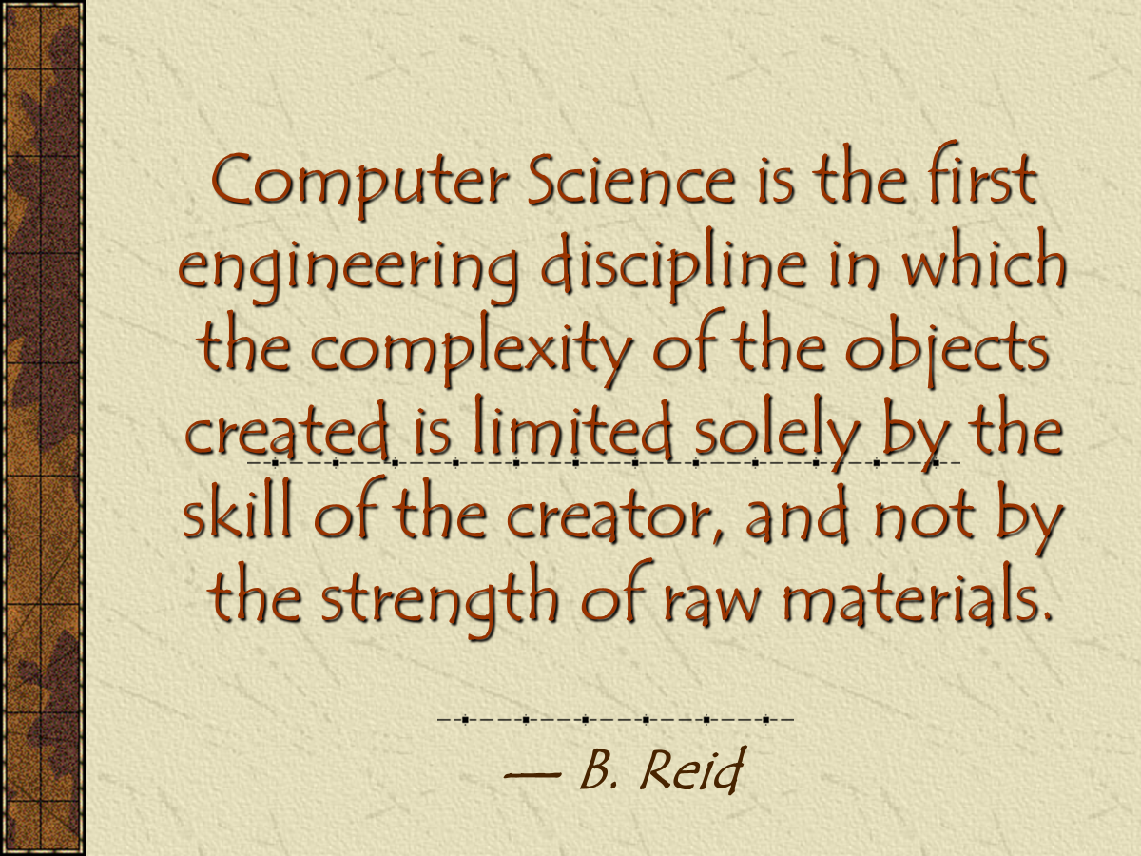

Slide 3
Alerts
Keep reading chapter 6
Read chapter 8
Project 2: due before midnight!
Project 3

Slide 4
Review
Last time we talked about
arrays

Slide 5
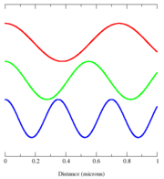
Sound
Like light, sound is a wave
Sounds have two properties relevant to working with them in a digital context
Frequency: how often does the wave pattern repeat
Amplitude: how tall is the wave

Slide 6
Frequency
The human ear can hear between about 12 Hz and 20,000 Hz
The higher the frequency of the wave, the higher the frequency of the note
Note (ha, ha) that the A an octave
above A440 has twice the
frequency
Each half-step is an increase in the
frequency by a factor of about 1.06
Note | Frequency
A | 440
B | 493.88
C | 523.25
D | 587.33
E | 659.26
F | 698.46
G | 783.99
A | 880

Slide 7
Example of frequency change
We can take a sound:
And reproduce that sound at double the frequency:
Note that we have to add twice as much information to have the sound fill the same amount of time

Slide 8
Amplitude
The amplitude of a wave is the distance from the trough of a wave to its peak
In sound, amplitude is a measure of volume
The larger the amplitude, the louder the sound
Amplitude

Slide 9
Example of amplitude change
We can take a sound:
And make the sound with half the amplitude:
The frequency is exactly the same, but the sound is half as loud

Slide 10
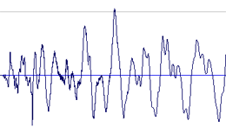
Real sounds
Something that looks like a sine wave is called a pure tone
No real instruments play anything like that
Even the purest real sound has overtones and harmonics
Real sound is the result of many messy waves added together:

Slide 11
Sampling
On a computer, we cannot record a wave form directly
As usual, we have to figure out a way to store a wave as a series of numbers
We are going to use these numbers to approximate the heights of the wave at various points

Slide 12
Sample rate
As we all know by now, Hertz (Hz) is a unit that means a number of times per second
We are going to break down the wave into lots of slices
We are going to have 44,100 slices in a second
Thus, we are slicing at 44,100 Hz

Slide 13
Sample values
We slice up a wave and record the height of the wave
Each height value is called a sample
By getting 44,100 samples per second, we get a pretty accurate picture of the wave

Slide 14
Sample format
There are many different formats for sampling audio
In our system, each sample will be recorded as a double
The minimum value of a sample will be -1.0 and the maximum value of a sample is 1.0
A series of samples with value 0.0 represents silence
Our samples will be stored in an array

Slide 15
The StdAudio class
Audio data on Windows machines is sometimes stored in a WAV file
A WAV file is much simpler than an MP3 because it has no compression
Even so, it contains two channels (for stereo) and can have many different sample rates and formats for recording sound
The StdAudio class lets you read and write a WAV file easily and always deal with a single array of sound, sampled at 44,100 Hz

Slide 16
StdAudio methods
Everything you'd want to do with sound:
To do interesting things, you have to manipulate the array of samples
Make sure you added StdAudio.java to your project before trying to use it
Method | Use
double[] read(String file) | Read a WAV file into an array of doubles
void save(String file, double[] input) | Save an array of doubles into a WAV file
void play(String file) | Play a WAV file
void play(double[] input) | Play an array of doubles (samples)

Slide 17
StdAudio example
Let's load a file into an array:
If the song has these samples:
Perhaps samples will contain:
String file = "song.wav";
double[] samples = StdAudio.read(file);
-.9 | -.7 | -.6 | -.4 | -.2 | -.1 | .1 | .2 | .3 | .4 | .5 | .6 | .6 | .5 | .4 | .3 | .2 | 0 | -.2 | -.4

Slide 18
StdAudio example
With the audio samples loaded into the array named samples, we can play them as follows:
StdAudio.play(samples);

Slide 19
Generating sound with StdAudio
Or, we could generate sound from scratch with StdAudio
This example from a book somewhere creates 1 second of the pitch A440:
double[] sound = new double[StdAudio.SAMPLE_RATE + 1];
for (int i = 0; i < sound.length; ++i) {
sound[i] = Math.sin(2 * Math.PI * i * 440 / StdAudio.SAMPLE_RATE);
}
StdAudio.play(sound);

Slide 20
Breaking a sound into parts
What if we wanted to play the second half of a sound followed by the first half?
I know, why would we want to do that?
double[] samples = StdAudio.read(file);
double[] switched = new double[samples.length];
for (int i = 0; i < samples.length/2; ++i)
switched[i + samples.length/2] = samples[i];
for (int i = samples.length/2; i < samples.length; ++i)
switched[i - samples.length/2] = samples[i];
StdAudio.play(switched);

Slide 21
Next time…
On Monday,
More on array exampes

