Slide 1
COMP 1600
Introduction to Programming
David J Stucki
Fall 2025

Slide 2

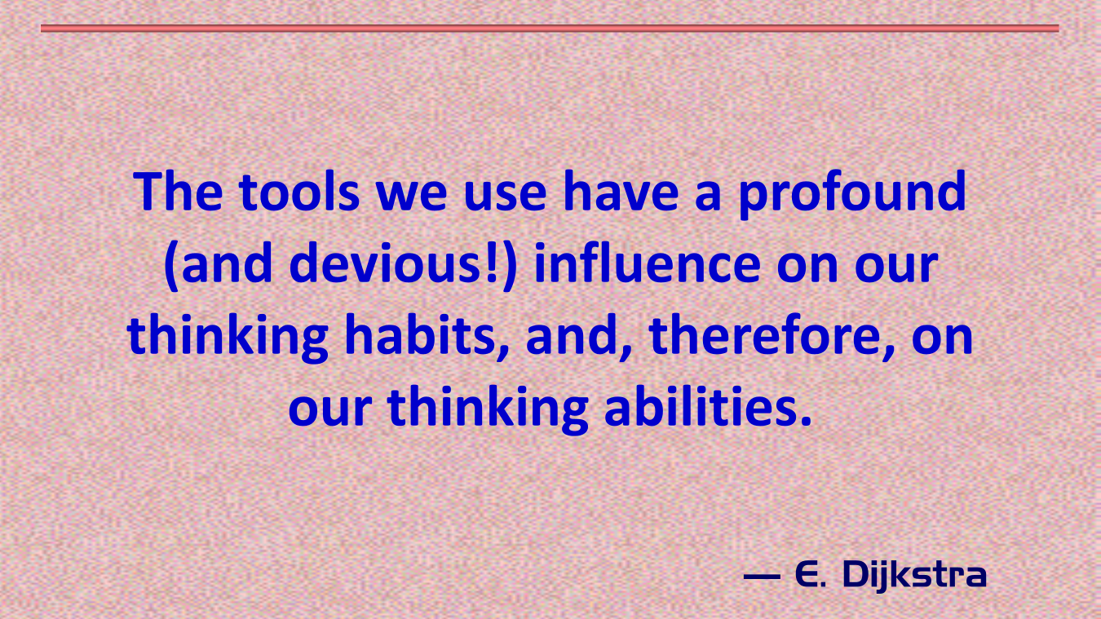

Slide 3
Alerts
Read chapter 6
Keep working on Project 2: due Friday before midnight!

Slide 4
Pop Quiz 5

Slide 5
Review
Last time we talked about
  for loops some more

Slide 6
Prime?
Write a program that prompts the user for a number n
Use a for loop to try to see if n can be evenly divided by numbers smaller than n
If it can't, then it is prime
You'll only know whether or not a number is prime after the loop runs
Print Prime if the number is prime and Composite if the number is not

Slide 7
Lists of primes
Now, ask the user to enter a number
Print out all the prime numbers from 2 up to the number
Using nested loops, you can use the loop from the previous problem to test if a given number is prime

Slide 8
Infinite for loops
Infinite for loops are unusual, but possible:
This situation is more likely:
for ( ; ; ) {
System.out.println("Hey!");
}
for (int i = 0; i < 10; i++){
System.out.println(i);
// Lots of other code
i--; // Whoops, maybe changed from while?
}

Slide 9
(Almost) infinite loops
Overflow and underflow will make some badly written loops eventually terminate
for (int i = 1; i <= 40; i-- ) {
// Whoops, should have been i++
System.out.println(i);
}

Slide 10

Fencepost errors
Being off by one is a very common loop error
// Runs 39 times
for (int i = 1; i < 40; ++i) {
System.out.println(i);
}

Slide 11
Skipping loops entirely
If the condition isn't true to begin with, the loop will just be skipped
// Oops, should be <=
for (int i = 1; i >= 40; ++i) { System.out.println(i);
}

Slide 12
Misplaced semicolon
A misplaced semicolon can cause an empty loop body to be executed
Everything looks good, loop even terminates
But, only one number will be printed: 41
Fortunately, this code wouldn't even compile if we declared i inside the loop
int i = 0;
for (i = 1; i <= 40; ++i); { // Semicolon is wrong
System.out.println(i);
}

Slide 13
do-while loops
They work just like while loops
The only difference is that they are guaranteed to execute at least once
Unlike a while loop, the condition isn't checked the first time you go into the loop
Sometimes this is especially useful for getting input from the user
The syntax is a little bit different

Slide 14
Anatomy of a do-while loop
do {
statement1;
statement2;
…
statementN;
} while( condition );

Slide 15
Menu with a do-while
I said that the do-while loop is rarely used, but certain kinds of input are well suited to a do-while
For example, what about a program that gives a menu of options
  Add two numbers
  Subtract two numbers
  Multiply two numbers
  Quit

Slide 16
Next time…
On Wednesday,
  Introduction to arrays

