Slide 1
COMP 1600 Introduction to Programming
David J Stucki
Fall 2025

Slide 2
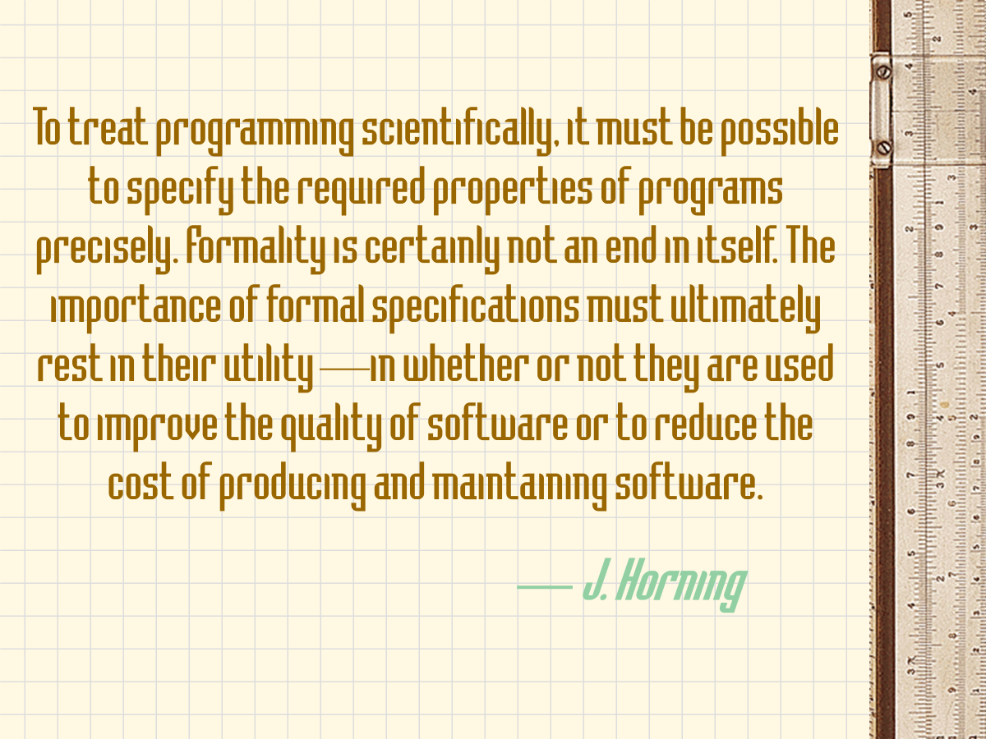

Slide 3
Alerts
Read chapter 5
Lab 5 tomorrow
READY DAY is on Wednesday
Attendance is required of all students (for graduation)
Download the app and decide on your schedule
You must have your phone with you for attendance

Slide 4


Slide 5

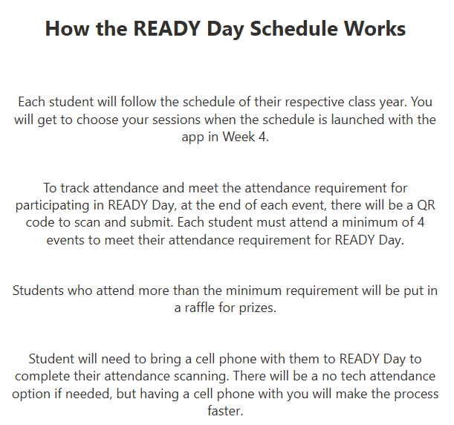
READY DAY Website for more Information

Slide 6
Review
Last time we talked about
while loops

Slide 7
Summing numbers
We can also use while loops to help us deal with input
What if we wanted to sum all of the numbers that a person entered?
How would we know when to stop?
One solution is to keep adding numbers until the person enters a negative number
This is called using a sentinel value

Slide 8
Summing numbers
Solution:
int i = 0;
int sum = 0;
Scanner in = new Scanner(System.in);
while (i >= 0) {
sum += i;
System.out.print("Enter number: ");
i = in.nextInt();
}
System.out.println("Sum: " + sum);

Slide 9
Finding the average
We could also find the average:
int i = 0;
double sum = 0;
int count = 0;
Scanner in = new Scanner( System.in );
while (i >= 0) {
sum += i;
count++;
System.out.print("Enter number: ");
i = in.nextInt();
}
count--; // Fixes extra count for sentinel
System.out.println("Average: " + (sum / count));

Slide 10
Tracking the biggest input
What if we wanted to find the biggest input?
Somehow we would have to check each input and see if it were larger than the current largest
Solution: use an if-statement inside of a while loop
Let's look at IntelliJ

Slide 11
Guessing game
Let's say that you wanted to write a program to guess a number that a person had come up with
The number is between 1 and 100
Every time the computer guesses a number, the person enters:
H if the number is too high
L if the number is too low
F if the number was found

Slide 12
Guessing game algorithm
Start with the minimum and maximum of the range
Find the midpoint
Ask the user if the midpoint is correct
If the answer is too high, go to Step 1 using the minimum and the midpoint as the new range
If the answer is too low, go to Step 1 using the midpoint and the maximum as the new range
If the midpoint is correct, you're done!

Slide 13
Infinite loops
Loops can go on forever if you aren't careful
int n = 40;
int i = 1;
while( i <= 40 ) {
System.out.println(i);
// Supposed to print all the numbers
// less than 40, but i never increases
}

Slide 14
(Almost) infinite loops
Overflow and underflow will make some badly written loops eventually terminate
int n = 40;
int i = 1;
while( i <= 40 ) {
System.out.println(i);
i--; // Whoops, should have been i++
}

Slide 15

Fencepost errors
Being off by one is a very common loop error
int n = 40;
int i = 1;
// Won't reach 40
while( i < 40 ) {
System.out.println(i);
i++;
}

Slide 16
Skipping loops entirely
If the condition isn't true to begin with, the loop will just be skipped
int n = 40;
int i = 1;
while( i >= 40 ) { // Oops, should be <=
System.out.println(i);
i++;
}

Slide 17
Misplaced semicolon
A misplaced semicolon can cause an empty loop body to be executed (often infinitely)
int n = 40;
int i = 1;
while( i <= 40 ); { // Semicolon is wrong
System.out.println(i);
++i;
}

Slide 18
Things to remember
The condition of the while loop is not followed by a semicolon
Be careful about starting and ending conditions
Always use braces
The print statement must be inside the loop in order to get printed multiple times
There's no magic formula; you have to think it through

Slide 19
Pop Quiz 4

Slide 20
Next time…
On Friday,
for loops
More loop examples

