Slide 1
COMP 1600 Introduction to Programming
David J Stucki
Fall 2025

Slide 2

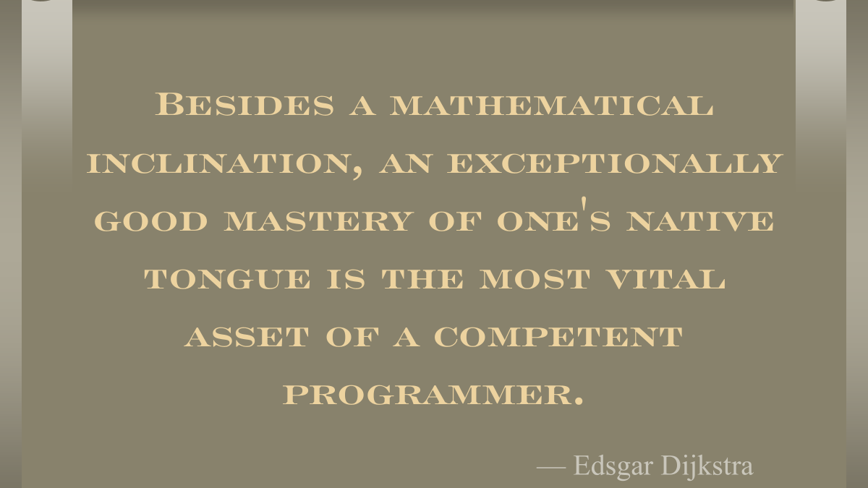

Slide 3
Alerts
Read chapter 5
Lab 5 next Tuesday
READY DAY is on Wednesday
Attendance is required of all students (for graduation)
Download the app and decide on your schedule
You must have your phone with you for attendance

Slide 4


Slide 5

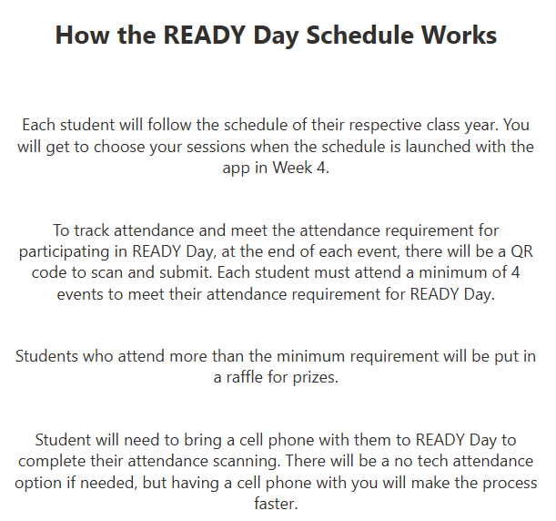
READY DAY Website for more Information

Slide 6
Review
Last time we had an exam!
Max: 90.5; Mean: 64.5; Median: 67.5
A/B/C = 12
D/F = 12
Your current course grade is at the top of page 2
Let's go over the solution key

Slide 7
How to think about programming
All the little pieces of Java syntax are confusing
I have tried hard to tell you exactly what you need to know (and no more)
Java seems like it has an unlimited amount of stuff to learn, but you can already do a lot
They designed Java so that you have just enough tools, but they don't like to have redundant functionality
The key is to think about how to put together the pieces
It's like a puzzle

Slide 8
Think about values and types
Focus on the values you have and how to turn them into the values you want
Let's look at this example of incorrect code and see how to fix it:
char letter = in.nextChar();
if (letter >= 'a' && <= 'z')
System.out.println("Lowercase letter!");

Slide 9
Think about values and types
char letter = in.nextChar();
if (letter >= 'a' && <= 'z')
System.out.println("Lowercase letter!");
Scanner can't read a char value in directly
We have to read a String
String word = in.next(); // We can do this!
char letter = word.charAt(0);
// And get a char from the String
if (letter >= 'a' && <= 'z')
System.out.println("Lowercase letter!");

Slide 10
Think about values and types
String word = in.next(); // We can do this!
char letter = word.charAt(0);
// And get a char from the String
if (letter >= 'a' && <= 'z')
System.out.println("Lowercase letter!");
The && operator only works between two boolean values
<= 'z' isn't a boolean, it's only part of a comparison
String word = in.next(); // We can do this!
char letter = word.charAt(0);
//and get a char from the String
if (letter >= 'a' && letter <= 'z') // Fixed!
System.out.println("Lowercase letter!");

Slide 11
Operations
You're only allowed to do certain operations:
Try to think of everything in terms of these operations
Methods are useful too (for manipulating String values or doing advanced math), but there are too many to list here
First Operand | Operator | Second Operand | Result
int | +, -, *, /, % | int | int
double | +, -, *, /, % | double | double
number | ==, !=, <, <=, >, >= | number | boolean
boolean | &&, || | boolean | boolean
String | + | any value | String

Slide 12
The rules
Java works on a set of arbitrary rules
Some regular people invented them
They are internally consistent, but they are not based on reality
They don't make any deep sense
Don't waste time trying to find meaning in the rules!
Just use the rules as a set of tools you can use to solve your problem
Like MacGuyver

Slide 13
The past
"Those who cannot remember the past are condemned to repeat it." —George Santayana
What is our past?
Basic data types
Mathematical and String operations
Input and output
Conditional execution

Slide 14
Repetition
To these tools, we add repetition, the ability to do something over and over again
With repetition in the mix, we can solve practically any problem that can be solved with a computer
Repetition leverages the most famous ability of the computer: speed

Slide 15
Mechanics
The main way that repetition works in Java is through loops
A loop is a block of code that will be executed repeatedly some number of times (perhaps even zero)
As the statements are executed, the variables change
It isn't just repeating the same thing over and over (unless a mistake was made)

Slide 16
while loop
The simplest loop in Java is the while loop
It looks similar to an if statement
The difference is that, when you get to the end of the while loop, it jumps back to the top
If the condition in the while loop is still true, it executes the body of the loop again

Slide 17
Anatomy of a while loop
while( condition ) {
statement1;
statement2;
…
statementN;
}
A whole bunch of statements

Slide 18
A while loop with only one statement
A while loop will usually have multiple statements in its body
However, it is possible to make a while loop with only a single statement
Then, like an if-statement, the braces are optional (not really)
while( condition )
statement;

Slide 19
Printing numbers
Let's print the numbers from 1 to 100
We could do this with lots of copy/paste, or:
int i = 1;
while( i <= 100 ) {
System.out.println(i);
i++;
}

Slide 20
Rules for while
The while loop executes each statement one by one
When execution gets to the bottom, it jumps to the top
If the condition is still true
(i.e., i <= 100), it repeats the loop

Slide 21
Workings of a while loop
//line A
while( condition ) {
//line B
statement1;
statement2;
//line C
…
statementN;
}
//line D
Line | Condition
A
B
C
D
Line | Condition
A | Unknown
B
C
D
Line | Condition
A | Unknown
B | True
C
D
Line | Condition
A | Unknown
B | True
C | Unknown
D
Line | Condition
A | Unknown
B | True
C | Unknown
D | False

Slide 22
Summing numbers
We can also use while loops to help us deal with input
What if we wanted to sum all of the numbers that a person entered?
How would we know when to stop?
One solution is to keep adding numbers until the person enters a negative number
This is called using a sentinel value

Slide 23
Summing numbers
Solution:
int i = 0;
int sum = 0;
Scanner in = new Scanner(System.in);
while (i >= 0) {
sum += i;
System.out.print("Enter number: ");
i = in.nextInt();
}
System.out.println("Sum: " + sum);

Slide 24
Finding the average
We could also find the average:
int i = 0;
double sum = 0;
int count = 0;
Scanner in = new Scanner( System.in );
while (i >= 0) {
sum += i;
count++;
System.out.print("Enter number: ");
i = in.nextInt();
}
count--; // Fixes extra count for sentinel
System.out.println("Average: " + (sum / count));

Slide 25
Next time…
On Monday,
More loop examples
Loop pitfalls

