Slide 1
COMP 1600 Introduction to Programming
David J Stucki
Fall 2025

Slide 2
It goes against the grain of modern education to teach students to program. What fun is there to making plans, acquiring discipline, organizing thoughts, devoting attention to detail, and learning to be self critical.
— A. Perlis

Slide 3
Alerts
Read chapter 5 for next week
Project 1
Due today!
Project 2 is available
Midterm I is next Wednesday (review on Monday)
True/False
Multiple Choice
Short Answer
Problems
Essays

Slide 4
Review
Last time we learned a little about
Conditionals
Best practices
if-else
Nesting control structures
else if

Slide 5
Watch out!
Now you are controlling the flow of execution in your program
There is a wider range of mistakes you can make when giving instructions
Huge chunks of code can be executed or skipped by mistake
Here are a few things to watch out for

Slide 6
Empty statements
Remember that an if-statement is not a regular statement
It does not end with a semicolon
if (balance < 0); // empty statement
{ // this block always runs
System.out.println("You owe a fee!");
balance -= 15;
} // you also don't need ; after }

Slide 7
Confusing indentation
In some languages, indentation actually matters
Java ignores whitespace
"Fight!" prints no matter what
Another reason to always use curly braces!!
if (enemies > 2)
System.out.println("Run away!");
else
defense = true;
System.out.println("Fight!");

Slide 8
Imprecise conditions
It's easy to make logical errors when writing conditions
If an airline allows two or fewer bags on the plane, someone might code that as:
But this is too restrictive. It should be:
if (bags < 2) { // only allows 1 or 0
boarding = true;
}
if (bags <= 2) {
boarding = true;
}

Slide 9
Reversed conditions
Sometimes it's easy to get a condition backwards
Try not to assume you wrote the condition correctly
Always double check
if (number % 3 == 0) { // Wrong!
System.out.println("Not divisible by 3!");
}
else {
System.out.println("Divisible by 3!");
}

Slide 10
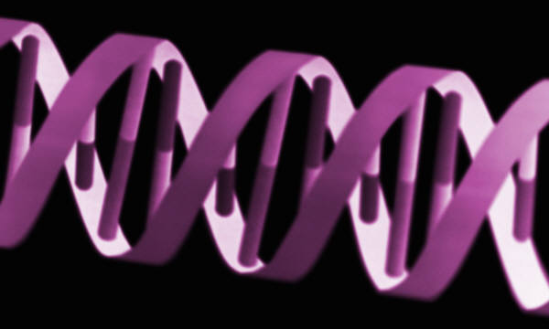
DNA
Assume that you have a variable called base of type char
Let base contain one of: 'A', 'C', 'G', 'T'
Write a series of if- and else-statements that will print out the chemical name of the base denoted by the corresponding character
A -> Adenine
C -> Cytosine
G -> Guanine
T -> Thymine

Slide 11
Printing DNA bases
if( base == 'A' )
System.out.println("Adenine");
else if( base == 'C' )
System.out.println("Cytosine");
else if( base == 'G' )
System.out.println("Guanine");
else if( base == 'T' )
System.out.println("Thymine");
else
System.out.println("Your base doesn't belong to us");
What if you want to take care of upper and lower cases?

Slide 12
Upper and lower case bases using logic
if( base == 'A' || base == 'a' )
System.out.println("Adenine");
else if( base == 'C' || base == 'c' )
System.out.println("Cytosine");
else if( base == 'G' || base == 'g' )
System.out.println("Guanine");
else if( base == 'T' || base == 't' )
System.out.println("Thymine");
else
System.out.println("Your base doesn't belong to us");
Is there a simpler way?

Slide 13
using character conversion
base = Character.toUpperCase( base );
if( base == 'A' )
System.out.println("Adenine");
else if( base == 'C' )
System.out.println("Cytosine");
else if( base == 'G' )
System.out.println("Guanine");
else if( base == 'T' )
System.out.println("Thymine");
else
System.out.println("Your base doesn't belong to us");

Slide 14
if statements are okay…
But, didn't that DNA example seem a little clunky?
Surely, there is a cleaner way to express a list of possibilities
Presenting: the switch statement

Slide 15
Anatomy of a switch statement
switch( data ){
case value1:
statements 1;
case value2:
statements 2;
…
case valueN:
statements N;
default:
default statements;
}

Slide 16
DNA hittin' switches
switch( base ) {
case 'A': System.out.println("Adenine");
break;
case 'C': System.out.println("Cytosine");
break;
case 'G': System.out.println("Guanine");
break;
case 'T': System.out.println("Thymine");
break;
default: System.out.println("Your base " +
"doesn't belong to us");
break; // unnecessary
}
Notes:
Go to SwitchMonth

Slide 17
Peculiarities of switch
Both "Three" and "Four" are printed
int data = 3;
switch( data ) {
case 3: System.out.println("Three");
case 4:
System.out.println("Four");
break;
case 5:
System.out.println("Five");
}
The break is optional
The default is optional too
Notes:
Go to SwitchAge

Slide 18
Rules for switch
The data that you are performing your switch on must be an int, a char, or a String
The value for each case must be a literal
Execution will jump to the case that matches
If no case matches, it will go to default
If there is no default, it will skip the whole switch block
Execution will continue until it hits a break

Slide 19
DNA with upper and lower case
switch( base ) {
case 'A': case 'a':
System.out.println("Adenine");
break;
case 'C': case 'c':
System.out.println("Cytosine");
break;
case 'G': case 'g':
System.out.println("Guanine");
break;
case 'T': case 't':
System.out.println("Thymine");
break;
default: System.out.println("Your base doesn't " +
"belong to us");
break; // unnecessary
}
Notes:
Go to SwitchDays

Slide 20
A caution about switch
Using if-statements is usually safer
if-statements are generally clearer and more flexible
switch statements are only for long lists of specific cases
Be careful about inconsistent use of break

Slide 21
POP Quiz 3

Slide 22
Next time…
On Monday,
Exam review session

