Slide 1
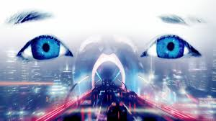
The Imitation Game
INST 4200
David J Stucki
Spring 2015

Slide 2
What is the Turing Test?
Activity 1…
Reflections
“I believe that in about fifty years’ time it will be possible to programme computers, with a storage capacity of about 10⁹, to make them play the imitation game so well that an average interrogator will not have more than 70 per cent chance of making the right identification after five minutes of questioning.”
—Alan Turing —

Slide 3
A brief history…
1936 Turing first describes modern computers
1941 Konrad Zuse’s Z3 – 1st electromechanical, programmable, fully automatic, digital computer
1943 Colossus: 1st electronic digital programmable computer
1946 ENIAC: made in the USA by Eckert & Mauchly
1950 Turing’s Computing Machinery and Intelligence
1954 Turing’s death
1956 Dartmouth Conference: A.I. is born
For thirty years the motivating question driving A.I. research was “Can the Turing Test be passed?”
1980 John Searle publishes the Chinese Room

Slide 4
Chinese Room
Activity 2…
Reflections
Turing himself had suggested some possible objections to machine intelligence. He gave them the following titles:
  Theological, “Heads in the Sand”, Mathematical, Consciousness, Various Disabilities, Lady Lovelace’s Objection (originality), Continuity in the Nervous System, Informality of Behaviour, and ESP.
Searle’s argument appeared to be new, and was a death knell for interest in the Turing Test, at least for a decade.

Slide 5
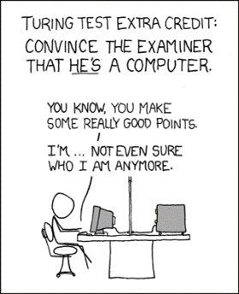
Hugh Loebner & Beyond
Loebner Prize
  1991-present: Brian Christian participated in 2009 in Brighton, UK
  2014: held at Bletchley Park in honor of Turing centenary
In recent years, an increasing dissatisfaction with the TT has led many researchers to seek an alternative
  RoboCup 2013 Teaser Bloopers
  Winograd Schema Challege
  Beyond Turing 2015

Slide 6
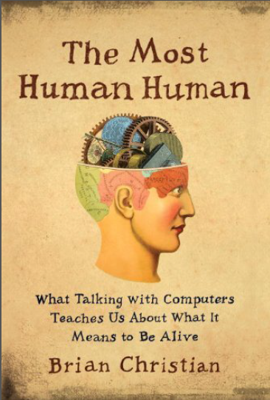
The Most Human Human
Activity 3…
Reflections

Slide 7
Next Time…
Levesque, Chapter 2 (A Procedure for Thinking)
Research Paper details…

