Slide 1
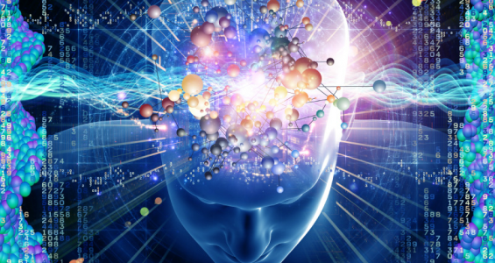
Thinking & Computation
INST 4200
David J Stucki
Spring 2017

Slide 2
SyMBoLIc
REPRESENTaTIoN
“When some thing is allowed to stand for another”
  What does this mean?
Examples
  Corporate Logos Flags Mathematics
  Road Signs Music Facial Expressions
  Language Mascots Art
    Others?
Every aspect of human culture relies on the power of symbolic representation:
  Communication Education Business/Commerce
  History Government Technology
    Others?
Notes:
Marriott, Shell, Nike, Playboy, Pepsi, Atari
, Toyota, Prudential, AT&T, Plymouth, Adobe
John Deere, McDonalds, United, Honda, Cubs, Yahoo

Slide 3
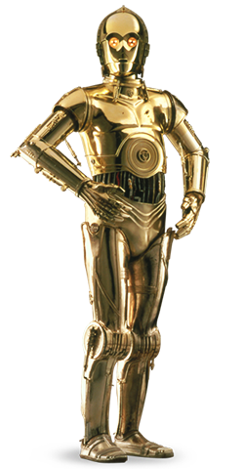

ABSTRacTIoN
A process of simplification that proceeds by
ignoring irrelevant detail while focusing on
what is important
One of the fundamental concepts in
computer science
It is itself a by-product of symbolic representation,
since symbols allow abstraction to take place
A road sign serves only as a compact
abstraction of the law

Slide 4
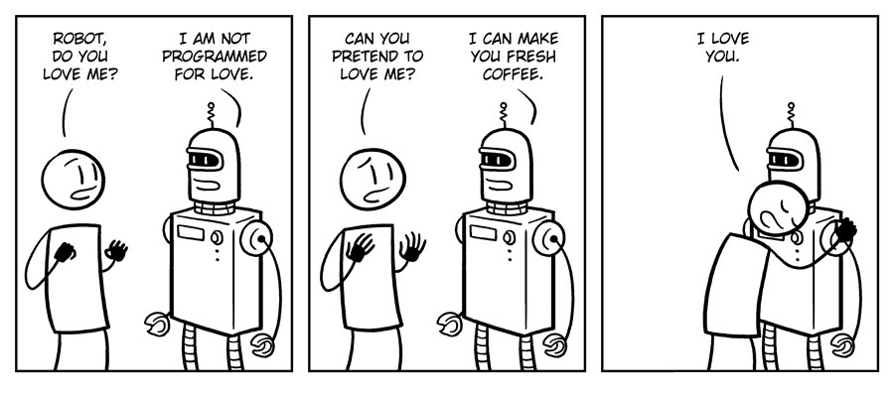
THoUgHT
Without symbolic representation would these be possible?
  Imagination
  Creativity
  Love
  Faith
  Thought
In other words, symbolic representation appears to be central to what it means to be human…

Slide 5
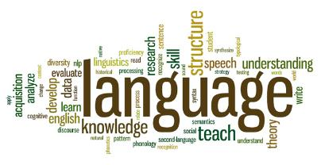
Perhaps the most important, and certainly one of the most sophisticated forms of symbolic representation
  Phonology : Sound, Stress, & Intonation
  Syntax : Structure or Form
  Semantics : Meaning
  Pragmatics : Use or Intention
Since the dawn of recorded history, until the middle of the 20th century, symbolic representation & language have been artifacts of living creatures, most notably humans.
Only recently has this monopoly been broken….

Slide 6
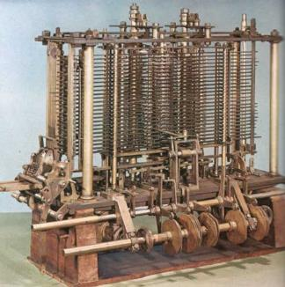
CoMPUTaTIoN
Machines historically have been designed with a specific purpose, which they are then dedicated to for as long as they function.
It wasn’t until Charles Babbage and Ada Lovelace worked on the Analytic Engine in the 1830s that this changed.
The Analytical Engine represents the simultaneous birth of general purpose computing and programming!
Unfortunately, it would be another 100 years
before Alan Turing would resurrect this idea
Today there are almost as many artificial
computer languages as there are natural
human languages.

Slide 7
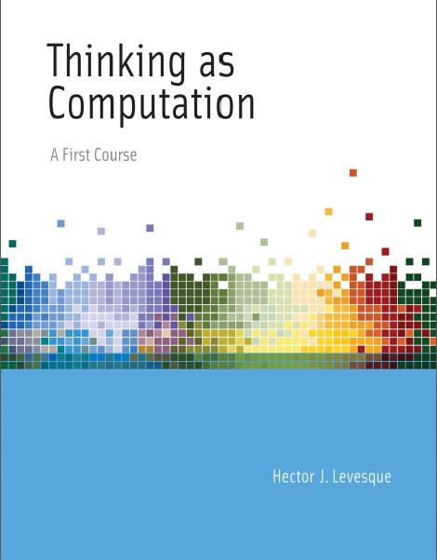
Questions?
What questions do you have after reading Chapter 1 of Levesque?
What was the most interesting thing you learned?
What is Levesque’s argument for the relation between Thinking & Computing?

Slide 8
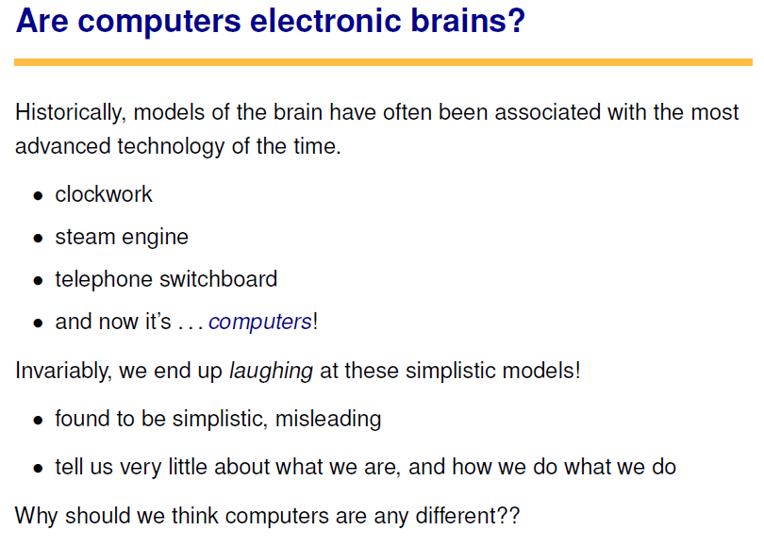

Slide 9
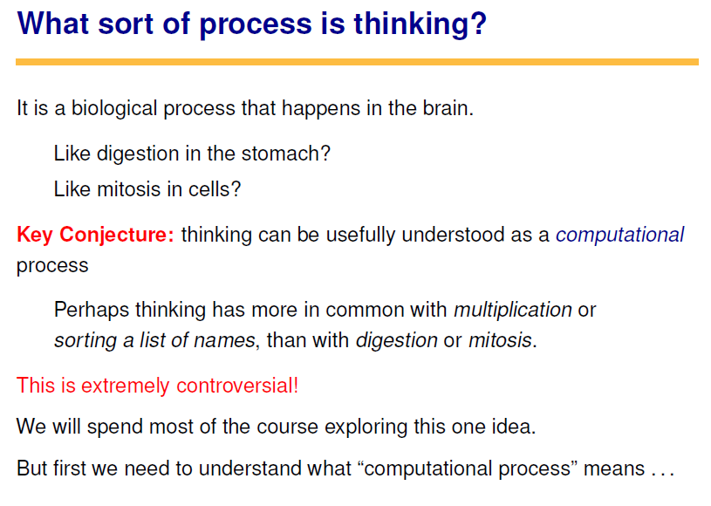

Slide 10
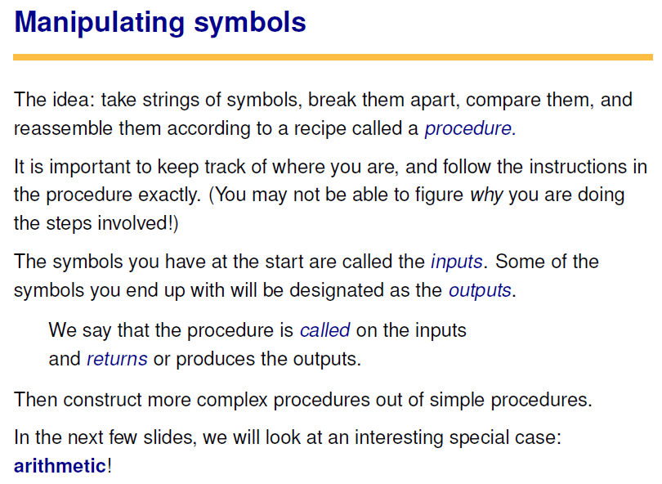


Slide 11
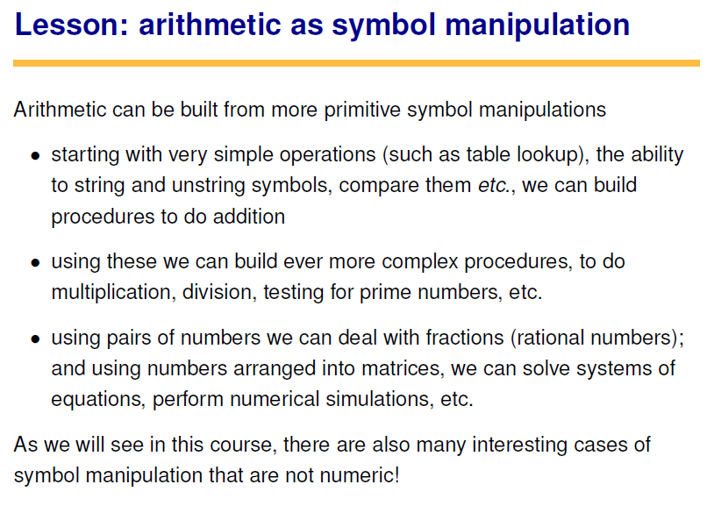

Slide 12
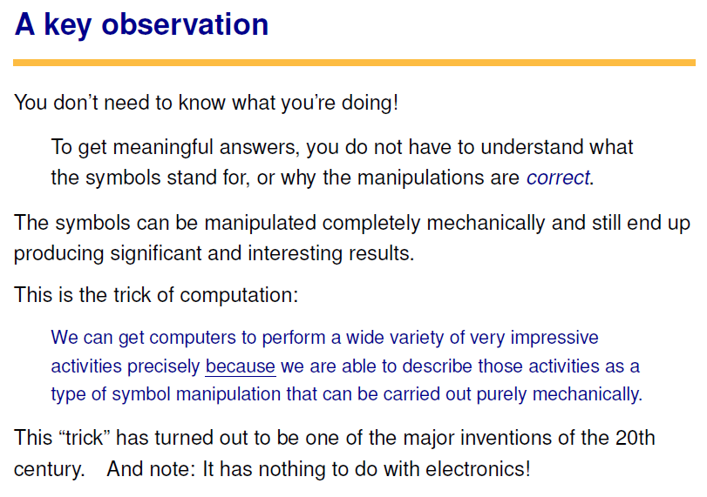

Slide 13
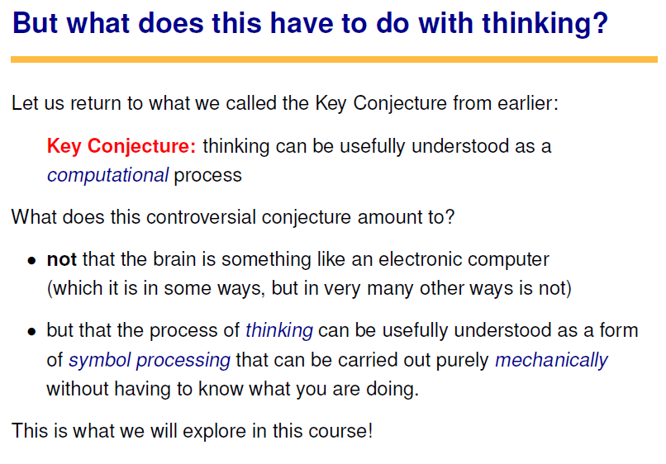

Slide 14
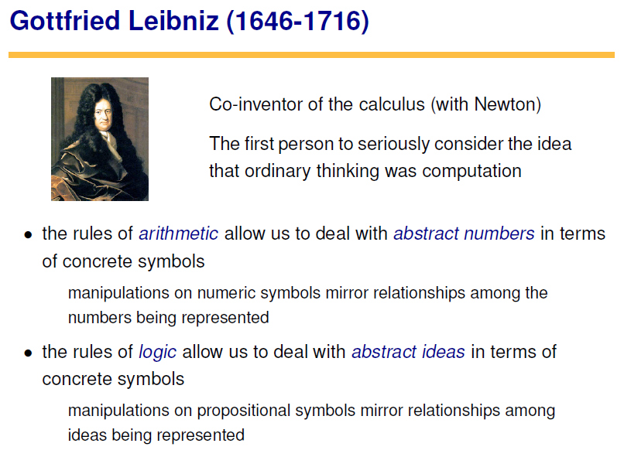
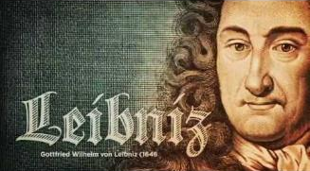

Slide 15
NEXT TIME…
The Most Human Human, Chapter 1
Movie Assignment Handout

