Slide 1

The Game of Kings
INST 4200
David J Stucki
Spring 2017

Slide 2

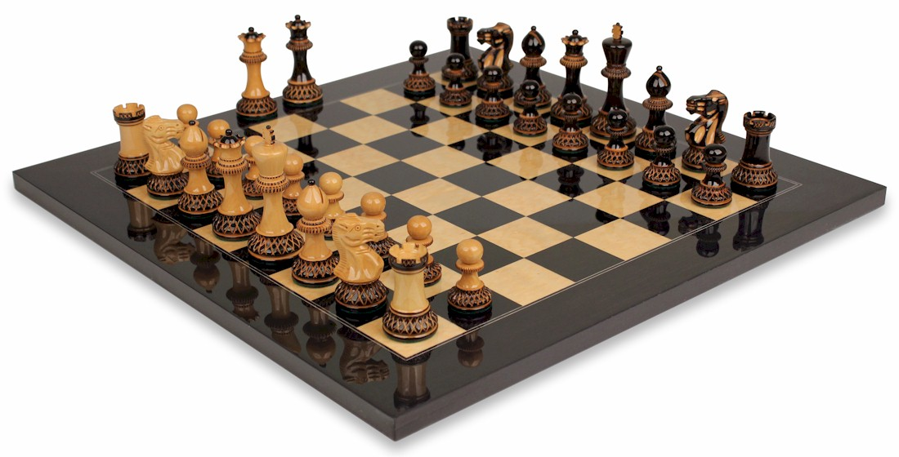
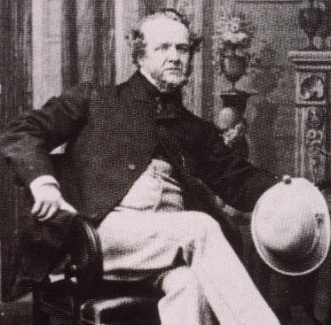
Chess
Originated in India more than 1500 years ago
Modern game established in Europe circa 1500
Chess Pieces
Howard Staunton standardized pieces in 1849

Slide 3
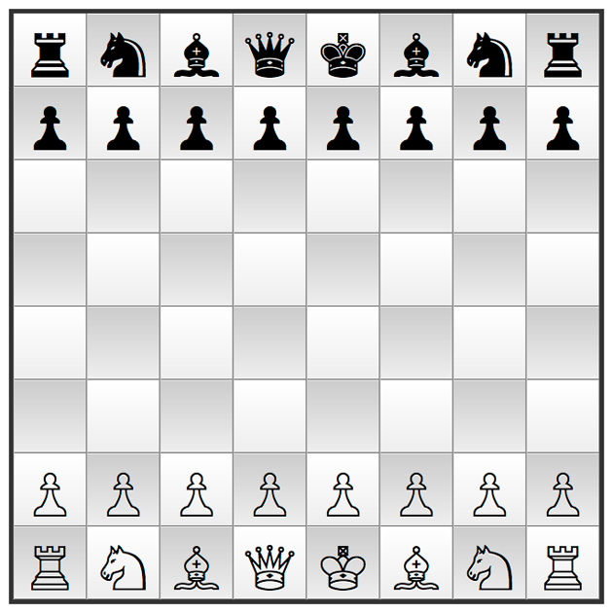
Chess Overview

Slide 4
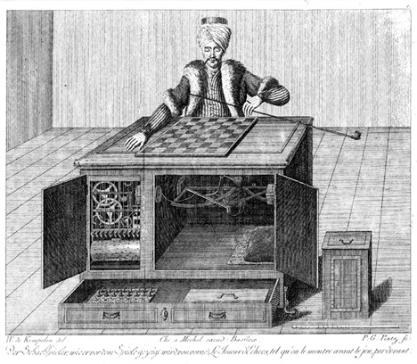
Wolfgang von Kempelen’s
Mechanical Turk
Constructed in 1770 to impress the Austro-Hungarian Empress
Toured Europe and America for 80+ years
Destroyed by fire in 1852
Video

Slide 5
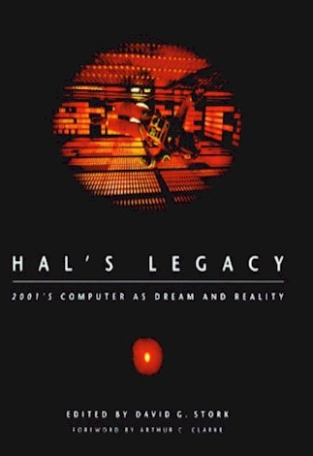
HAL-9000
Foreword by Arthur C. Clarke
1 The Best-Informed Dream: HAL and the Vision of 2001
by David G. Stork
2 Scientist on the Set: An Interview with Marvin Minsky
by David G. Stork
3 Could We Build HAL? Supercomputer Design by David J. Kuck
4 "Foolproof and Incapable of Error?" Reliable Computing and Fault Tolerance by Ravishankar K. Iyer
5 "An Enjoyable Game": How HAL Plays Chess
by Murray S. Campbell
6 "The Talking Computer": Text to Speech Synthesis
by Joseph P. Olive
7 When Will HAL Understand What We Are Saying? Computer Speech Recognition and Understanding by Raymond Kurzweil
8 "I'm sorry, Dave, I'm afraid I can't do that": How Could HAL Use Language? by Roger C. Schank

Slide 6
HAL-9000
9 From 2001 to 2001: Common Sense and the Mind of HAL
by Douglas B. Lenat
10 Eyes for Computers: How HAL Could "See"
by Azriel Rosenfeld
11 "I could see your lips move": HAL and Speechreading
by David G. Stork
12 Living in Space: Working with the Machines of the Future
by Donald A. Norman
13 Does HAL Cry Digital Tears? Emotions and Computers
by Rosalind W. Picard
14 "That's something I could not allow to happen": HAL and Planning by David E. Wilkins
15 Computers, Science, and Extraterrestrials: An Interview with Stephen Wolfram by David G. Stork
16 When HAL Kills, Who's to Blame? Computer Ethics
by Daniel C. Dennett

Slide 7
How Important is Chess To A.I.?
“This … raises the question ‘Can a machine play chess?’ It could fairly easily be made to play a rather bad game. It would be bad because chess requires intelligence.” –Alan Turing (1946)
“…profoundly insightful chess-playing draws intrinsically on central facets of the human condition.” –Douglas Hofstadter
“Chess, the Drosophila Melanogaster (fruit fly) of Artificial Intelligence.” –Donald Michie
“You know, I can remember being at Harvard and back then AI was the Greenblatt Chess Program and Maxima and Eliza and people literally felt that within five to ten years that some of these tough problems would be solved.” –Bill Gates

Slide 8
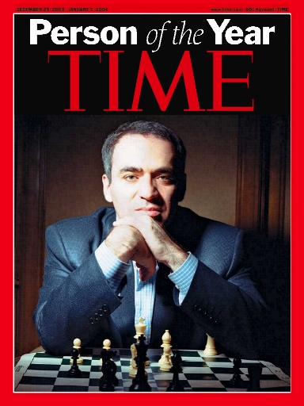
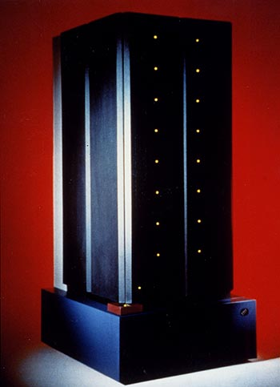
Kasparov vs. Deep Blue
Endgame (documentary)
Game Over (documentary)

Slide 9
What Does It Mean?
Everything?
Nothing?
“Chess is dead.”
“The handwriting is on the wall.”
“Deep Blue passed the TT.”
“Be afraid.”
“Deep Blue is not actually intelligent.”
“It was a bug, Dave…”
“The hysteria is misplaced.”
“Deep Blue suffers from the same brittleness as any other expert system…”

Slide 10
The Most Human Human…
Getting out of the book
  Chess, Dating, & the Turing Test
  Openings & Endings vs. the Gap
    Pure Technique vs. Site-specificity?
    Mechanical humans vs. Intelligent machines?
  “Doc, I’m a corpse…”

Slide 11
And now for something completely different…
  Rubik’s Cube Robot

