Slide 1
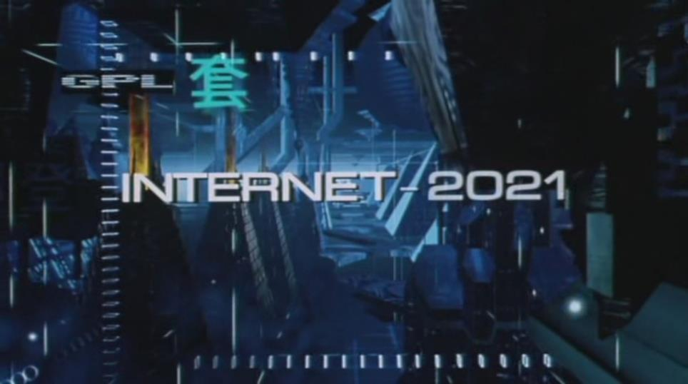
The Limits of Computation
INST 4200
David J Stucki
Spring 2015

Slide 2
Computability vs. Complexity
Computability: Can it be done?
Is there any algorithm, model, program, method, etc. that will solve the problem, perform the task, or compute the result?
Do different sorts of machines have different answers to this question?
Complexity: How much will it cost? Time? Space? Money?
Are there algorithms that solve the problem in different ways, and therefore have different run-time profiles?
What trade-offs are necessary to get the job done at reasonable cost?

Slide 3
Hard Problems
Conceptually Hard: We don’t have an algorithm to solve it because we don’t understand it well enough.
Analytically Hard: We have an algorithm, but we don’t know how to analyze its costs.
Computationally Hard: We have an algorithm, and we know what it will cost to use, but those costs are prohibitive.
Intrinsically Hard: We don’t have an algorithm, because no algorithm can exist to solve it.

Slide 4
Intrinsically Hard = Unsolvable
Warm up: self-referential paradox
This sentence is false.
Barber of Seville
Douglas Hofstadter
The Halting Problem
Infinite loop detection is unsolvable
Scooping the Loop Snooper
The bad news…

Slide 5
Intractability
Algorithms that require time or space that is exponential are intractable.
Running these algorithms on any computer is not feasible.
Example: The traveling salesman problem
The bad news…

