Slide 1

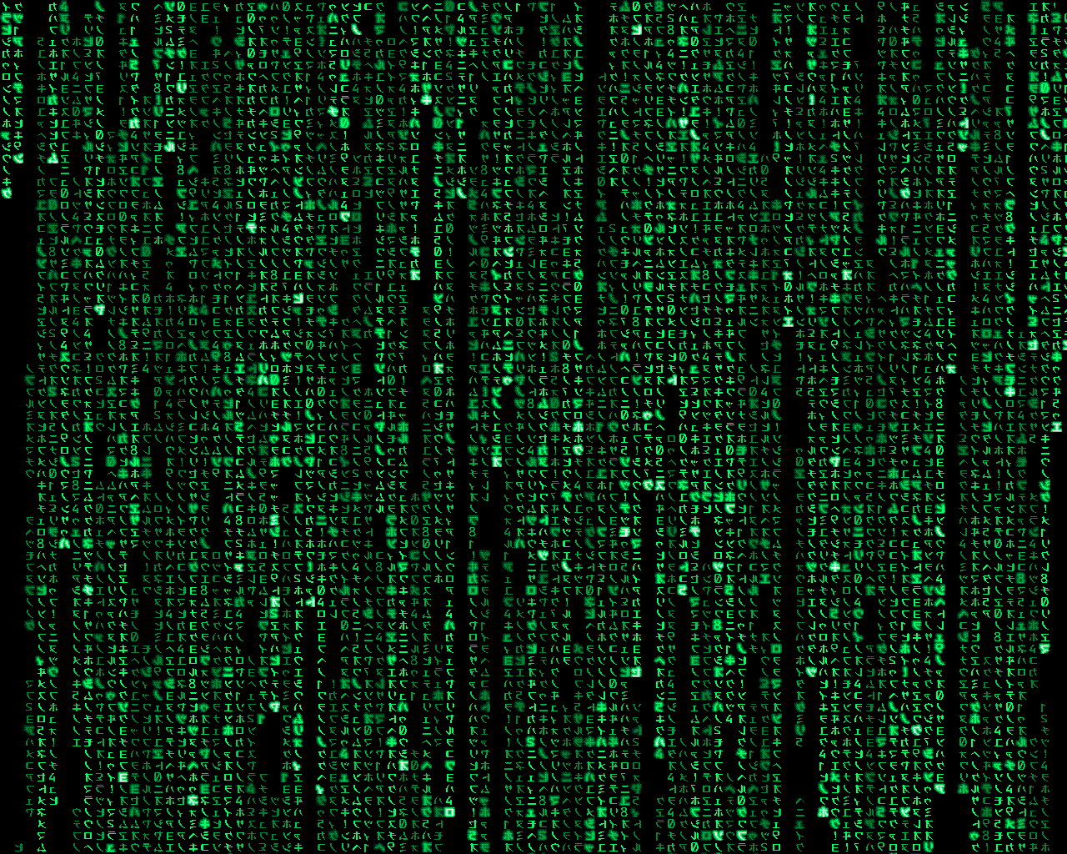
An Introduction To Prolog, part 2
INST 4200
David J Stucki
Spring 2017

Slide 2
Quick Review
A program in prolog IS a knowledge base of sentences.
Sentences are atomic or conditional.
Queries are questions presented to the knowledge base. Using back-chaining Prolog will find the query’s answer.
A query can be simple: an atomic sentence, with or without variables.
A query can be conjunctive: a sequence of atoms separated by commas.
An atom can be negated using \+.

Slide 3
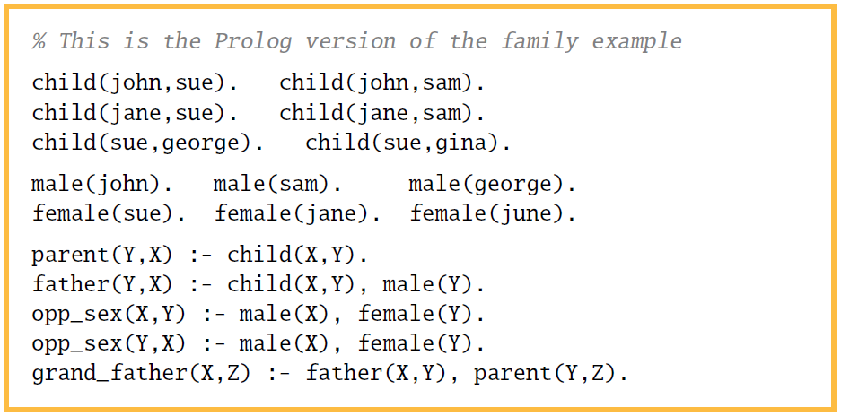

Slide 4
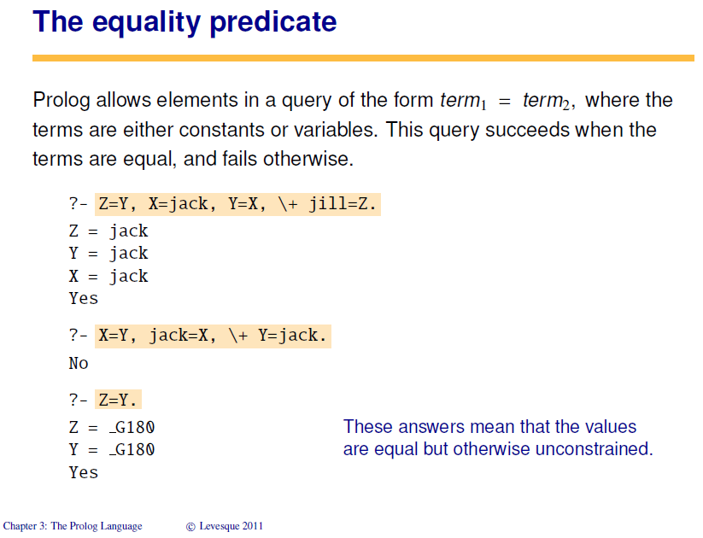

Slide 5
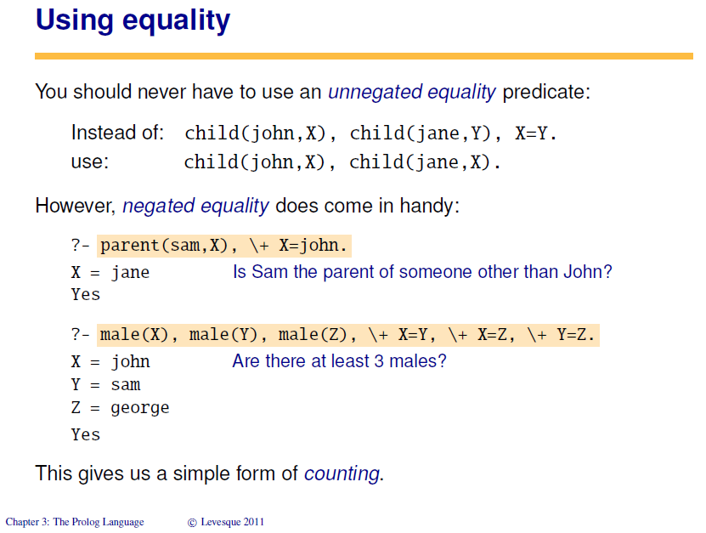

Slide 6
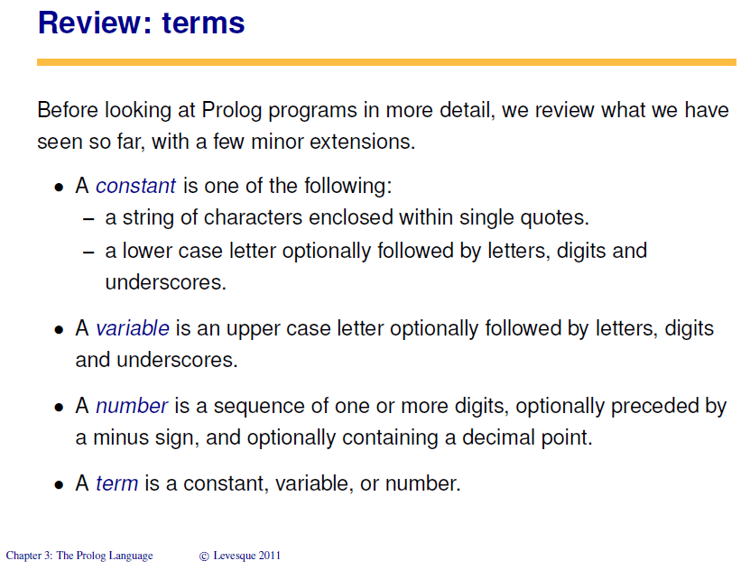

Slide 7
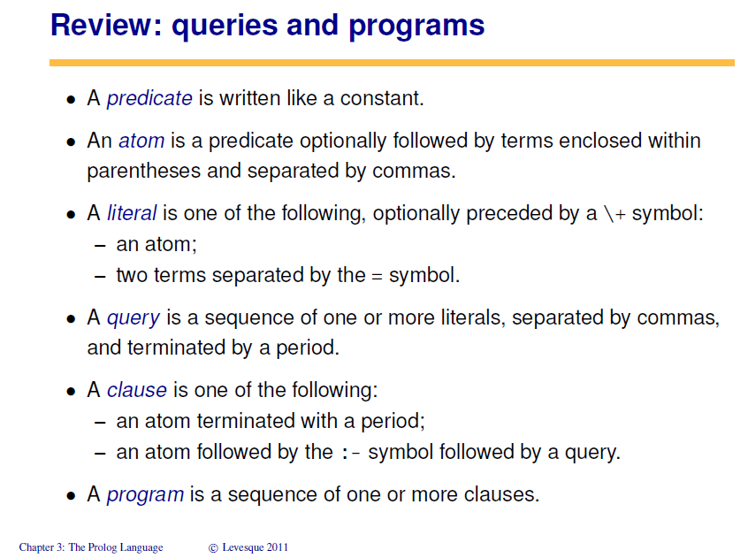

Slide 8
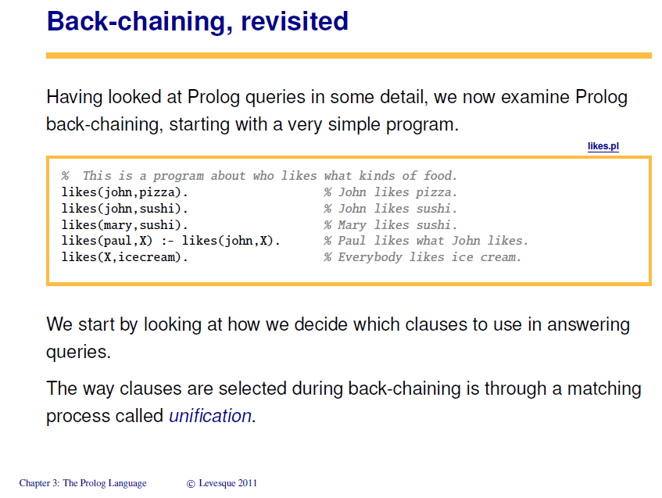

Slide 9
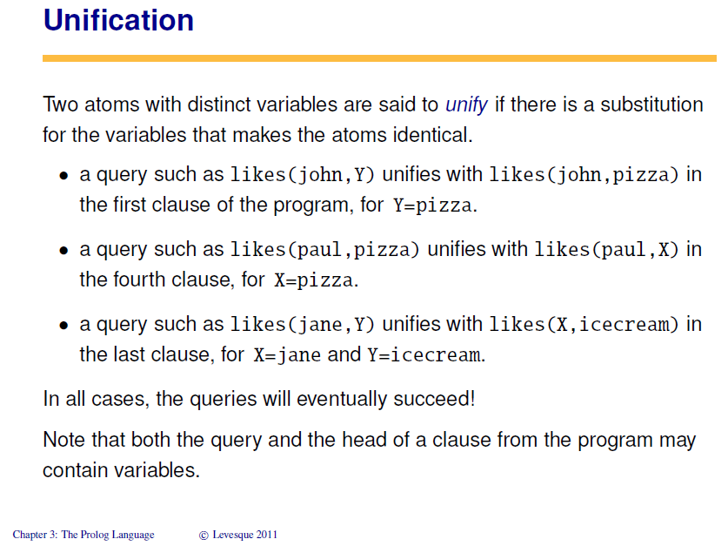

Slide 10
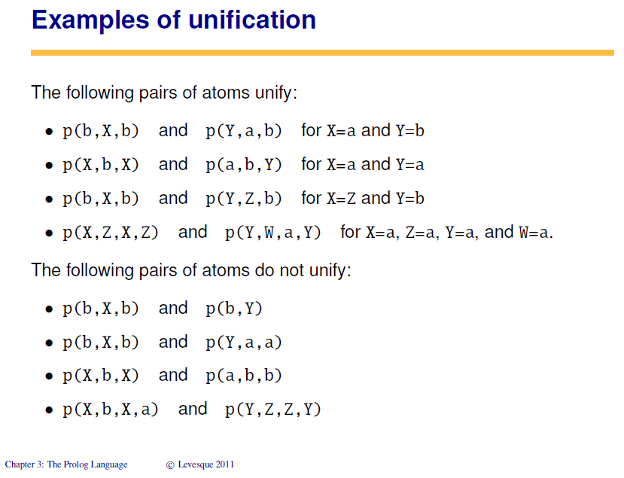

Slide 18
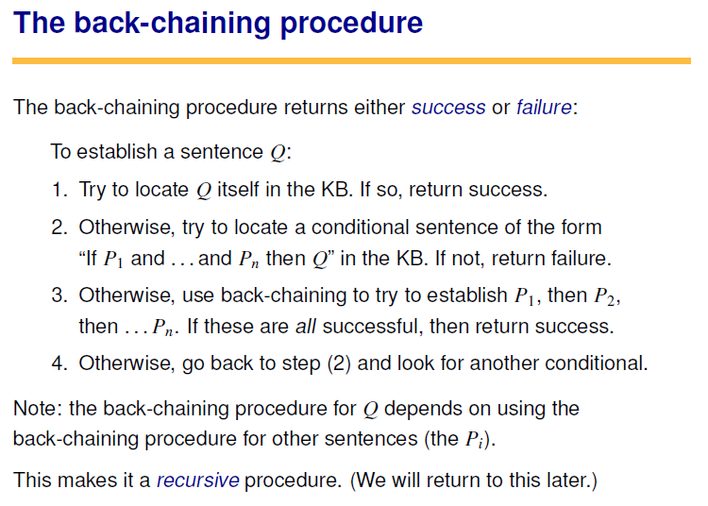

Slide 19
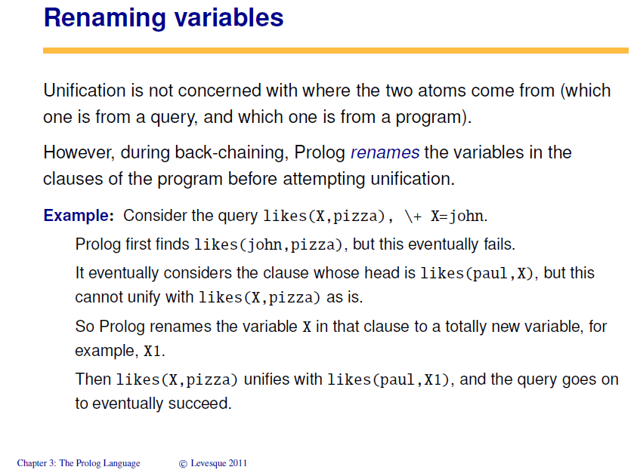

Slide 20
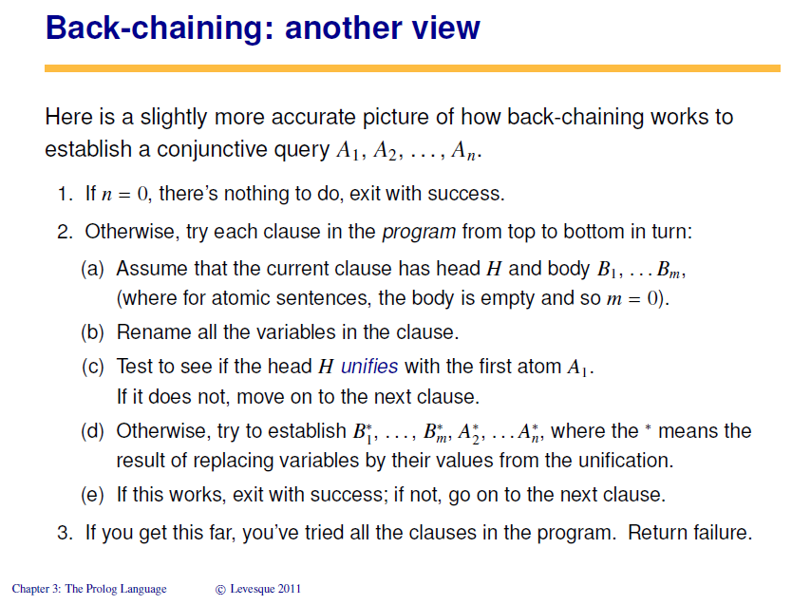

Slide 21
NEXT TIME…
The Most Human Human, Chapter 3b

