Slide 1
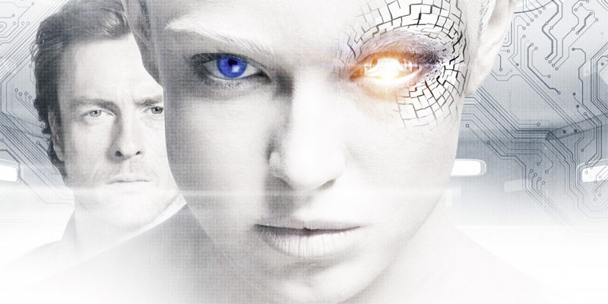
Information & Communication
INST 4200
David J Stucki
Spring 2017

Slide 2
Languages
Natural Language (Human)
  Roughly known to exist

Slide 3
Languages
Natural Language (Human)
  Roughly 7000 known to exist
  Fluency vs. Literacy
    Spoken language is spontaneously acquired
    Written language must be intentionally acquired
Artificial Language (Computer)
  More than in existence

Slide 4
Languages
Natural Language (Human)
  Roughly 7000 known to exist
  Fluency vs. Literacy
    Spoken language is spontaneously acquired
    Written language must be intentionally acquired
Artificial Language (Computer)
  More than 2500 in existence
  Types:
    Programming: Encoding algorithms & processes
    Mark-up: Encoding documents
    Protocol: Encoding communication mechanisms
Machine Language (native/hard-wired)

Slide 5
Binary
0 and 1 are the universal alphabet of all digital electronics
  Numbers (including sign (+/-), decimal point, etc.)
  Text (including all natural language alphabets)
  Images
  Sounds
  Video
  Programs
  Everything else!!!
So what?

Slide 6
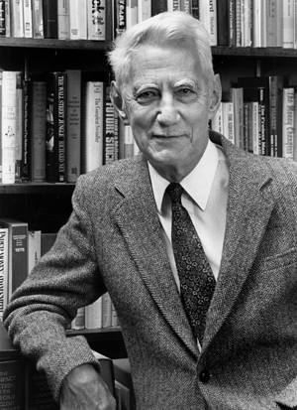

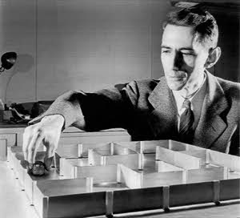
Shannon (1948) The Mathematical Theory of Communication
Claude Elwood Shannon: April 30, 1916 - February 24, 2001

Slide 7
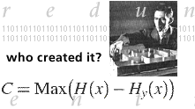
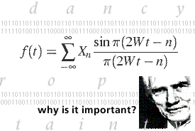
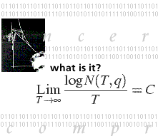
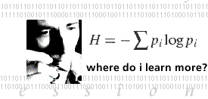
Information Theory
In 1948, Bell Labs scientist Claude Shannon developed
Information Theory, and the world of communications
technology has never been the same.

Slide 8
Information Theory
Two issues:
How do we represent analog data in a digital system?
  Modeling & Sampling techniques
  Compression issues
How do we reliably transmit digital data over an analog channel?
Error recovery
Bandwidth issues

Slide 9
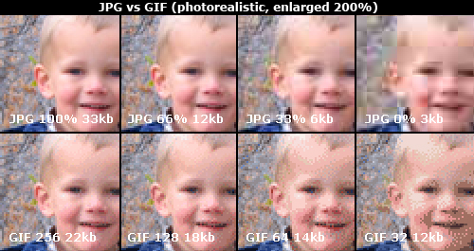
Example of Lossy Compression

Slide 10
Entropy
Definition: lack of order or predictability (complexity)
  While not the familiar definition from thermodynamics, it is closely related, and can be transformed mathematically into an equivalent form
Steve Mould
The complexity of a string of symbols can be measured in terms of the length of the smallest program that will generate it.
  The interesting consequence of this for both computer science and machine intelligence is that both highly ordered or predictable strings and completely random strings have low entropy, whereas high entropy lies in the middle, on the border of chaos.

