Slide 1
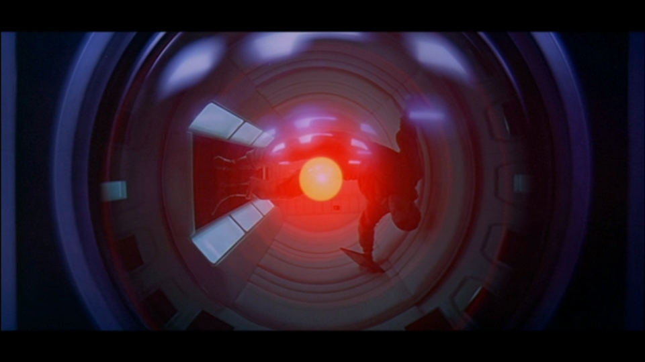
Hollywood – Part I
INST 4200
David J Stucki
Spring 2015

Slide 2
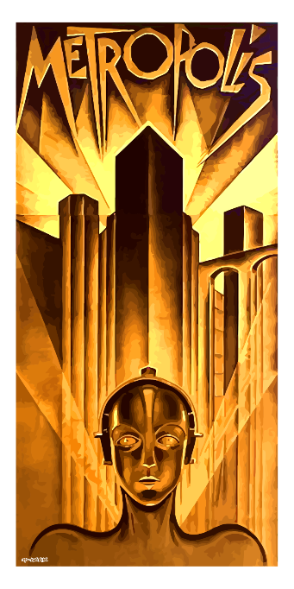
Metropolis: Its Influence
Stanley Kubrick, Steven Spielberg, George Lucas, Ridley Scott, James Cameron, Tim Burton, Chris Nolan, many more…
Blade Runner, Batman, The Matrix, Dark City, The Fifth Element, Dr. Strangelove, Joe Versus the Volcano, Close Encounters, Bride of Frankenstein, Brazil, C3P0, Cybermen, etc., etc., …
Queen, Madonna, Beyoncé, Lady Gaga
Apple (1984)

Slide 3
Forbidden Planet: Its Influence
Star Trek
Lost in Space
Dr. Who
Star Wars
Babylon 5
The Outer Limits
The Jetsons

Slide 4
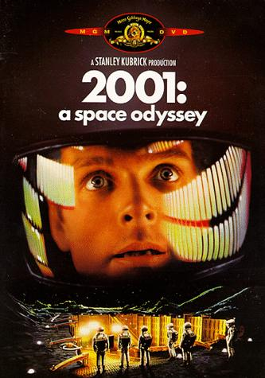
2001: Its Influence
Star Trek
Star Wars
Alien
Essentially every space film since 1968
Ridley Scott, George Lucas, Steven Spielberg, James Cameron
Apple (Y2K)

