Slide 1
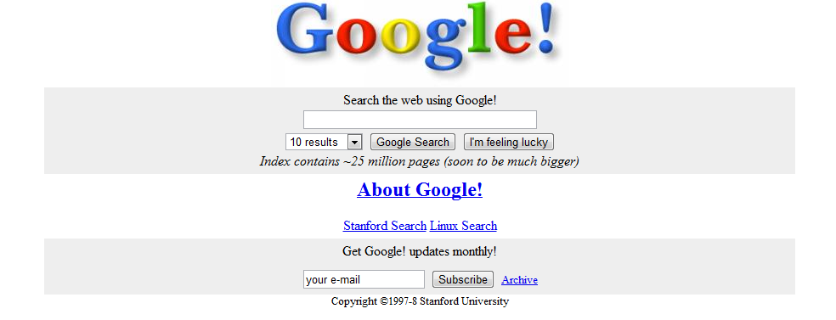
INST 4200
David J Stucki
Spring 2017

Slide 2
How Google Works (& Netflix too…)
The Evolution of Search
Google Data Center
How Search Works
Google Nose
Algorithms as Gatekeepers
Google Starts War
Google Books Controversy
Netflix Million Dollar Prize
How Algorithms Shape Our Lives

Slide 4
Bot Traffic Report 2015 (Humans take back the web)
Bot Traffic Report 2016

