Slide 1
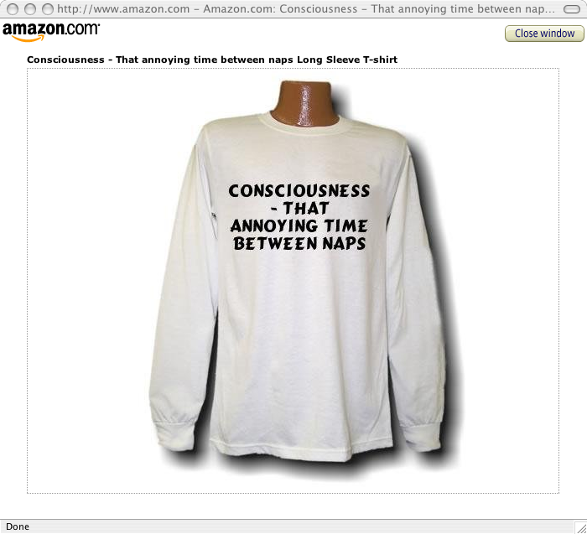
Consciousness: The Hard Problem
INST 4200
David J Stucki
Spring 2017
Adapted from Dr. Kelly Inglis’s
Consciousness presentation

Slide 2
selective attention test

Slide 3

Easy and hard problems of consciousness
Distinction proposed by David Chalmers
The easy problems:
finding the neural correlate of consciousness
explaining the ability to apply information to thinking and behavior
explaining the ability to focus attention, recall items from memory, integrate perceptions, etc.
The hard problem:
Why does consciousness feel the way it does? Why does it feel like anything?

Slide 4
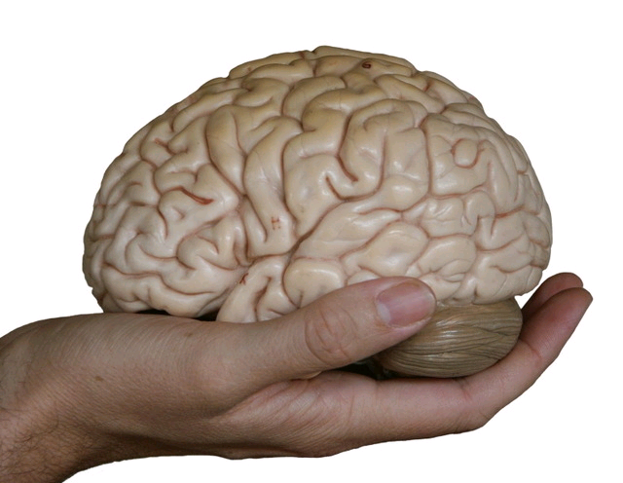
Why the problem is hard
“You can look into your mind until you burst, and you will not discover neurons and synapses and all the rest; and you can stare at someone’s brain from dawn till dusk and you will not perceive the consciousness that is so apparent to the person whose brain you are so rudely eye-balling.“ (McGinn 1999)
“The problem of consciousness, simply put, is that we cannot understand how a brain, qua gray, granular lump of biological matter, could be the seat of human consciousness, the source or ground of our rich and varied phenomenological lives. How could that ‘lump’ be conscious – or, conversely, how could I, as conscious being, be that lump?” (Akins 1993)

Slide 5
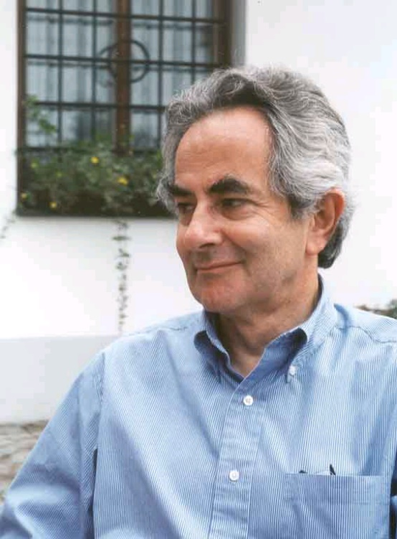
What is it like to be a bat?
Thomas Nagel
One of the most famous
papers in all of philosophy!
(1974)
We can never know what it feels like to be a bat.

Slide 6
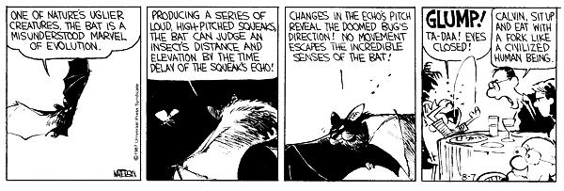


Slide 7

Why a bat?
There is something
it is like to be a bat.
Compare:
Cloud, rock, tree – nothing it is to be like
Mosquito, frog, computer – who knows? People have different intuitions.

Slide 8
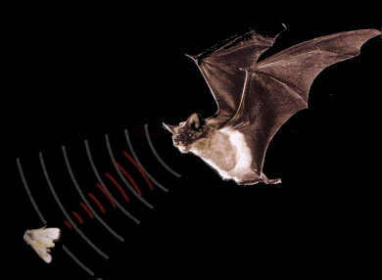
Bats are mammals. Most people agree they have experiences – they are conscious.
But, their consciousness is alien to us:
They “see” by sonar.
They fly and hang upside-down.
They lust for other bats.
We might be able to imagine what it would be like for us to live and behave like a bat.
But we can’t imagine what it is like for a bat to be a bat.

Slide 9

Bat’s experience is subjective.
Consciousness = having a point of view
Scientific knowledge is objective.
“The view from nowhere.”
Example: lightning
  subjective: looks like a flash of light
  objective: electrical discharge
Study of objective science can never reveal the character of subjective experience.

Slide 10

Is this the same as the problem of other minds?
Not quite.
What is it like to be an eskimo?
What is it like to be Tom Cruise?
Nagel: we can answer these questions fairly well by using our imagination. But, the answer is accessible to us only because we base our imagination on our own experiences. We need the subjective experience of being human to imagine the experience of others.
Objective science alone could not give us these answers.
A Martian could not learn from objective facts what it is like to be human.

Slide 11
Science cannot explain consciousness in physical terms.
“I have not defined the term 'physical'. Obviously it does not apply just to what can be described by the concepts of contemporary physics, since we expect further developments. Some may think there is nothing to prevent mental phenomena from eventually being recognized as physical in their own right. But whatever else may be said of the physical, it has to be objective.” (Nagel 1974)
Physical facts are objective.
Consciousness is subjective.
So consciousness can never be explained by physical facts.
Question: Is this right? Are only objective facts physical? Are the objective and the subjective irreconcilable?

Slide 12

Is physicalism about mental states wrong?
Nagel: not necessarily
“It would be a mistake to conclude that physicalism must be false…. It would be truer to say that physicalism is a position we cannot understand because we do not at present have any conception of how it might be true.” (Nagel 1974)
Example: we saying “mind is brain” is like pre-Socratic philosopher saying: “matter is energy”
“Strangely enough, we may have evidence for the truth of something we cannot really understand.” (Nagel 1974)
Example: caterpillar → butterfly

Slide 13
Approaches to the hard problem
Declare that it is insoluble, because
a) dualism is true – dualists; or
b) we don’t have the mental capacity to understand it – the “New Mysterians”, e.g. Nagel, Colin McGinn
Quote from Colin McGinn:
“consciousness is indeed a deep mystery. . . . The reason for this mystery, I maintain, is that our intelligence is wrongly designed for understanding consciousness.” (McGinn, 1999)

Slide 14

2) Concentrate on the “easy” problems and believe that the answers to the hard problem will come eventually
The typical cognitive science approach.
Francis Crick, in a work about visual consciousness:
“I have said almost nothing about qualia – the redness of red – except to brush it to one side and hope for the best” (Crick 1994)

Slide 15

Mary the Color Scientist
Lives in far far future, when everything there is to know about the physical processes in the brain and how they produce behavior is known.
Knows absolutely everything about : color perception, the optics of the eye, the properties of colored objects in the world, the processing of color info.in the visual system, etc.
BUT she has been brought up all her life in a black and white room, observing the world through a b/w TV monitor…
She has never seen any colors at all
Suddenly she is let out of her black and white room and sees colors for the first time….

Slide 16
The Mary Thought Experiment
Developed by Frank Jackson; devised the Mary thought experiment as an argument against physicalism
SURPRISED:
When Mary sees color, she will obviously learn something fundamentally new – what red is like.
She now has qualia as well as the physical facts about color
No amount of information could have prepared her for the raw feel of what it is like to see color (Chalmers)
You believe that consciousness,subjective experience, or qualia are something additional to knowledge of the physical world.
NOT SURPRISED:
  Dennett argues that we fail to allow Mary to know everything there is not know about color.
  She already knew what kind of impressions color would induce.
  You believe that knowing all the physical facts tells you everything there is to know– including what it is like to experience something.

Slide 17
Concepts of Consciousness
Whether we can solve “the hard problem” of consciousness or not, we need to be clear about what the term “consciousness” refers to.
Consciousness is a “mongrel” concept (Ned Block).
The terms “conscious” or “consciousness” are used by many different people in many different ways.
It is the job of philosophers to clarify concepts that have become confused.
Example: Aristotle used the same word for average velocity and instantaneous velocity

Slide 18
Intransitive vs. transitive consciousness
Transitive: conscious of …
He was conscious of the sound of the traffic.
Such consciousness is consciousness of something, e.g. an image, a thought, a sound (usually several things at once).

Slide 19
Intransitive consciousness
Something/someone is conscious: e.g. it is awake and aware.
Tom has come out of his coma and is now conscious.
“By consciousness I simply mean those subjective states of awareness or sentience that begin when one wakes in the morning and continue through the period that one is awake until one falls into a dreamless sleep, into a coma, or dies or is otherwise, as they say, unconscious” (Searle 1990).

Slide 20
Intransitive consciousness breaks down further into:
Creature consciousness: an agent (person/animal/alien) is conscious.
2) State consciousness: a mental state is conscious when an agent is aware of it, e.g. a conscious desire, a conscious pain.

Slide 21

Phenomenal vs. Access Consciousness
Ned Block
“On a confusion about a
function of consciousness” (1995)
His “Some Concepts of Consciousness” (2002)
is a shortened and revised version of that paper.

Slide 22
Phenomenal Consciousness
P-Consciousness
Cannot define, can only point to it:
Qualia
Raw feels
“What it is to be like”
Whatever is experienced
e.g. sensations, feelings, perceptions, thoughts, wants, emotions

Slide 23
Access Consciousness
A-Consciousness
All items of access consciousness are representational
A state is A-Conscious when its content is:
Informationally promiscuous (available to other parts of the brain for use in reasoning)
Poised for rational control of action
A-Consciousness is usually reportable.
e.g. perception, sensation, etc. as information that can be used in modifying behavior

Slide 24
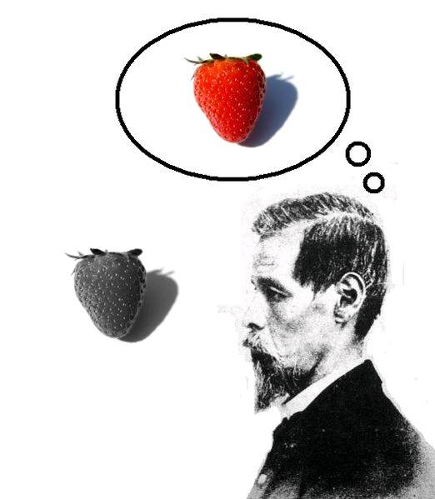
Differences between A-Consciousness and P-Consciousness
A-Consciousness
functional
system-relative
represents information
P-Consciousness
non-conceptual
a type of state
not necessarily representational

Slide 25
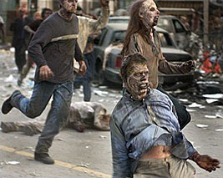
Can A-Consciousness and
P-Consciousness come apart?
Coming apart conceptually:
Philosophical “zombies”
‘Computationally’ identical to people
act like people, talk like people
No P-consciousness
dead inside, have no experience
There is nothing it is like to be a zombie
Note: Many people would say that zombies have no consciousness

Slide 26
Coming apart in reality:
A-Consciousness without P-Consciousness
Blindsight
Patients claim to be blind: they perceive no visual images
Cannot use information for rational action, e.g. will not reach for a glass of water in front of them
But can guess:
Is it an ‘X’ or an ‘O’?
It is a vertical slot or a horizontal slot?

Slide 27
“Superblindsight”
Imagine someone with blindsight asks themselves questions, e.g. “is it an ‘X’?”
Eventually, the answer just pops into his head spontaneously, like some people know which way is north, without any mental image.
Superblindsight person has access to some information, but no visual details, e.g. he knows there’s an ‘X’, but doesn’t know the color or font.
Superblindsighter is a “partial zombie”: has
A-consciousness of sight without P-Consciousness

Slide 28
Classification of Philosophical Zombie
Qualia-Experience
Information-Control
Consciousness
contain
contain
P-Consciousness
A-Consciousness
has
has
Philosophical Zombie
negation
subClassOf

Slide 29

P-Consciousness without A-Consciousness
Brain damaged animal, or person, who has
free-floating mental experiences, but cannot
integrate experiences for rational action.
2) Mental processing of background noise
e.g. pneumatic drill outside your window
You are involved in a conversation and don’t notice the noise of a pneumatic drill outside. At noon, you become aware of the drill and realize that you have been hearing it for a long time.
“You were aware of the noise all along, but only at noon are you consciously aware of it” (Block)
You were P-conscious of the noise, but not A-conscious.
Philosophical “floaters” (for the lack of a better term) generalize 1) and 2).

Slide 30
Classification of Philosophical Floater
Qualia-Experience
Information-Control
Consciousness
contain
contain
P-Consciousness
A-Consciousness
has
has
Philosophical Floater
negation
subClassOf

Slide 31
Objections to P and A distinction
1) Objections to P-Consciousness without A-Consciousness
If you are P-conscious but not A-conscious, you have an experience, e.g. you experience seeing a red square, but you don’t know you have the experience (you cannot report it, you cannot even think about it). Cf. drill noise
Are free-floating raw feels coherent? Do they equal consciousness?
Note: in background noise example, Block states: “You were aware of the noise all along, but only at noon are you consciously aware of it.”
Aware, but not consciously aware – is this a contradiction in terms? Or does it illustrate how notions of A- and P-Consciousness have become conflated? Perhaps this can be resolved via “Fringe Consciousness”: http://www.theassc.org/files/assc/2543.pdf

Slide 32
2) Objections to A- without P-Consciousness
Blindsight: is it really true that the patient has no P-consciousness of stimuli (e.g. ‘X’ or ‘O’), or do they have a little P-consciousness (a vague feeling that it is an ‘X’, for example), which corresponds to the little A-consciousness that they exhibit.
“Superblindsight”: doesn’t superblindsighter have
P-consciousness of the answer popping into his head?
If you are A-conscious but not P-conscious, you can use information for rational thought, but you don’t experience knowledge of this information. Does this differ from unconscious information processing?
Why say that a zombie or a computer that has no experience
(no qualia) has A-consciousness but not P-consciousness?
Why not just say that they are not conscious?

Slide 33
Problem cases
Are the following phenomena cases of P-Consciousness or
A-Consciousness, or both, or neither?
Sleepwalking
Sleepwalkers have their eyes open and use vision to navigate the world. Visual information is poised for use in action. Sleepwalkers can eat, drink, even drive a car. But if you speak to them, they are slow or unresponsive and seemingly unaware of what they are doing. Are they A-conscious? P-Conscious? Is there anything it is like to sleepwalk.
Change blindness, see:
http://nivea.psycho.univ-paris5.fr/ECS/kayakflick.gif
http://www2.psych.ubc.ca/~rensink/
More at: http://www2.psych.ubc.ca/~rensink/flicker/
3) Attention video, see:
http://viscog.beckman.uiuc.edu/grafs/demos/15.html

Slide 34
Readings
Focus:
Jackson, Frank (1982) “Epiphenomenal Qualia”, Philosophical Quarterly, 32, 127-36. http://instruct.westvalley.edu/lafave/epiphenomenal_qualia.html
Extra:
Nida-Rümelin, Martine “Qualia: The Knowledge Argument”, The Stanford Encyclopedia of Philosophy. http://plato.stanford.edu/entries/qualia-knowledge/
More about bats:
Dennett, Daniel (1991 ), “What it is like to be a bat” in Consciousness Explained, 441-448.
More about zombies:
Chalmers, David, “Zombies on the web”. http://consc.net/zombies.html

