Slide 1
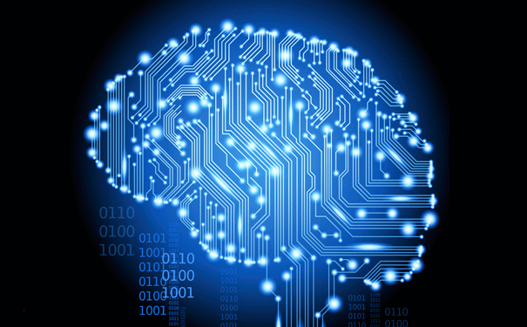
An Overview of
Connectionism
INST 4200
David J Stucki
Spring 2017

Slide 2
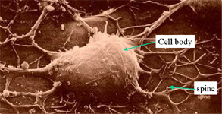
Neural Networks a.k.a. PDP or Parallel Distributed Processing a.k.a. Connectionism
Based on an abstract view of the neuron
Artificial neurons are connected to form large networks
The connections determine the function of the network
Connections can often be formed by learning and do not need to be ‘programmed’
    Electron Micrograph
    of a Neuron

Slide 3
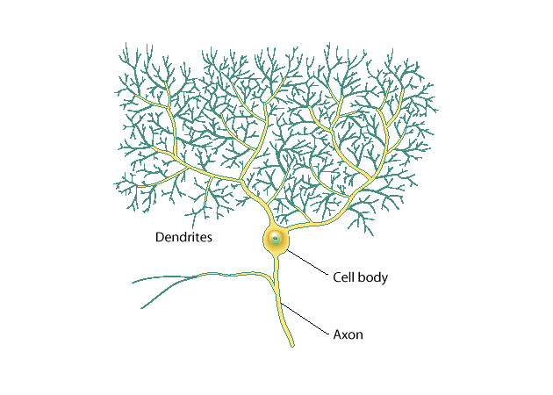
Many neurons have elaborate arborizations

Slide 4
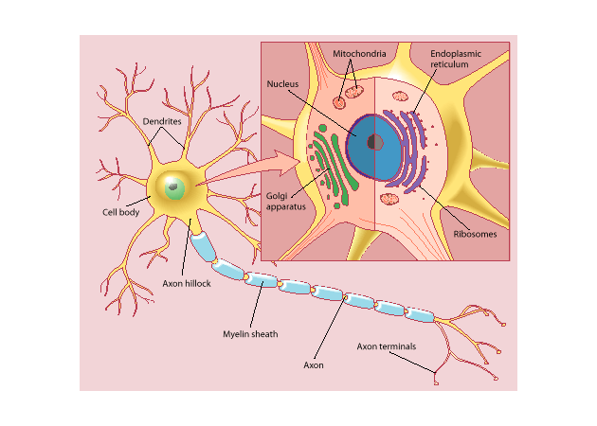
The axon is covered with myelin sheaths for faster conductivity

Slide 5
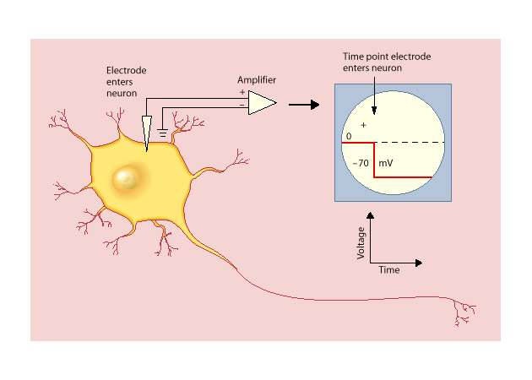
With single-cell recordings, action potentials (spikes) can be recorded

Slide 6
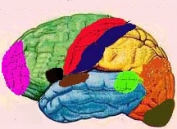
Major Functional Areas
Primary motor: voluntary movement
Primary somatosensory: tactile, pain, pressure, position, temp., mvt.
Motor association: coordination of complex movements
Sensory association: processing of multisensorial information
Prefrontal: planning, emotion, judgement
Speech center (Broca’s area): speech production and articulation
Wernicke’s area:
comprehension of speech
Auditory: hearing
Auditory association: complex
auditory processing
Visual: low-level vision
Visual association:
higher-level vision

Slide 7
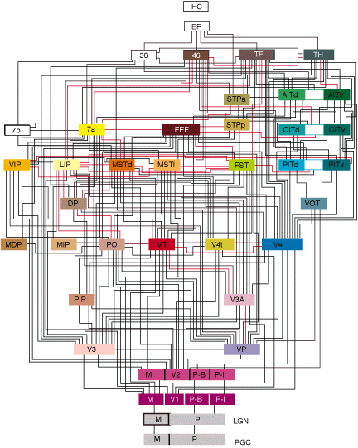
Interconnect
Felleman & Van Essen, 1991

Slide 8
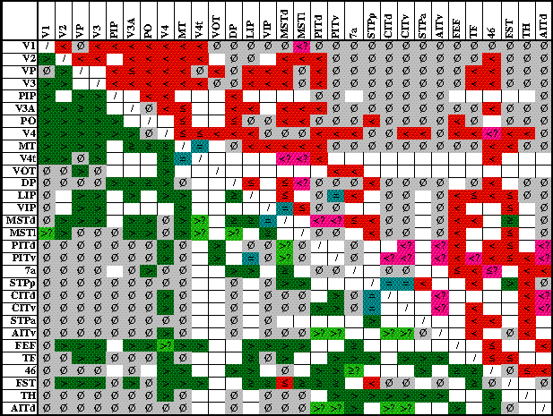
More on Connectivity
Which brain area is connected to which other one,
And in which directions?

Slide 9
McCulloch-Pitts (1943) Neuron. A direct quote:
1. The activity of the neuron is an “all-or-none” process
2. A certain fixed number of synapses must be excited within the period of latent addition in order to excite a neuron at any time, and this number is independent of previous activity and position of the neuron
3. The only significant delay within the nervous system is synaptic delay
4. The activity of any inhibitory synapse absolutely prevents excitation of the neuron at that time
5. The structure of the net does not change with time
From: A logical calculus of the ideas immanent in nervous activity. Bulletin of Mathematical Biophysics, 5, 115-133.

Slide 10
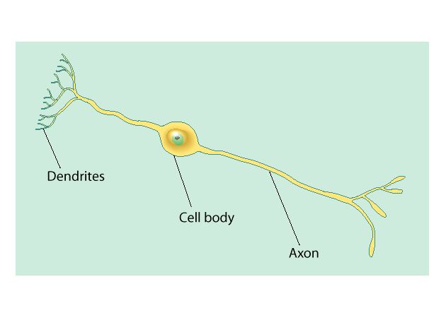
Neural networks abstract from the details of real neurons
Conductivity delays are neglected
An output signal is either discrete (e.g., 0 or 1) or it is a real-valued number (e.g., between 0 and 1)
Net input is calculated as the weighted sum of the input signals
Net input is transformed into an output signal via a simple function (e.g., a threshold function)

Slide 11
Artificial ‘neuron’

Slide 12
How to ‘program’ neural networks?
The learning problem
Selfridge (1958):
evolutionary or
‘shake-and-check’ (hill climbing)
Other approaches
  Unsupervised or regularity detection
  Supervised learning
  Reinforcement learning has ‘some’ supervision

Slide 13
Neural networks and David Marr’s model (1969)
Marr’s ideas are based on the learning rule by Donald Hebb (1949)
Hebb-Marr networks can be auto-associative or hetero-associative
The work by Marr and Hebb has been extremely influential in neural network theory

Slide 14
Hebb (1949)
“When an axon of cell A is near enough to excite a cell B and repeatedly or persistently takes part in firing it, some growth process or metabolic change takes place in one or both cells such that A’s efficiency, as one of the cells firing B, is increased”
From: The organization of behavior.

Slide 15
Hebb (1949)
Also introduces the word connectionism in its current meaning
“The theory is evidently a form of connectionism, one of the switchboard variety, though it does not deal in direct connections between afferent and efferent pathways: not an ‘S-R’psychology, if R means a muscular response. The connections server rather to establish autonomous central activities, which then are the basis of further learning” (p.xix)

Slide 16
Hebb-rule sound-bite:
Neurons that fire together, wire together

Slide 17
William James (1890)
Let us assume as the basis of all our subsequent reasoning this law:
When two elementary brain-processes have been active together or in immediate succession, one of them, on re-occurring , tends to propagate its excitement into the other.
From: Psychology (Briefer Course).

Slide 18
Two main forms of learning
Associative (Hebbian) learning
Error-correcting learning
  Perceptron
  Error-backpropagation
    aka generalized delta rule
    aka multilayer perceptron

Slide 19
The Perceptron by Frank Rosenblatt (1958, 1962)
Two-layers
binary nodes (McCulloch-Pitts nodes) that take values 0 or 1
continuous weights, initially chosen randomly

Slide 20
Very simple example
0
net input = 0.4 × 0 + -0.1 × 1 = -0.1
0.4
-0.1
0
1

Slide 21
Learning problem to be solved
Suppose we have an input pattern (0 1)
We have a single output pattern (1)
We have a net input of -0.1, which gives an output pattern of (0)
How could we adjust the weights, so that this situation is remedied and the spontaneous output matches our target output pattern of (1)?

Slide 22
Answer
Increase the weights, so that the net input exceeds 0.0
E.g., add 0.2 to all weights
Observation: Weight from input node with activation 0 does not have any effect on the net input
So we will leave it alone

Slide 23
Perceptron algorithm in words
For each node in the output layer:
  Calculate the error, which can only take the values -1, 0, and 1
  If the error is 0, the goal has been achieved. Otherwise, we adjust the weights
  Do not alter weights from inactivated input nodes
  Decrease the weight if the error was 1, increase it if the error was -1

Slide 24
Perceptron convergence theorem
If a pattern set can be represented by a two-layer Perceptron, …
the Perceptron learning rule will always be able to find some correct weights

Slide 25
The Perceptron was a big hit
Spawned the first wave in ‘connectionism’
Great interest and optimism about the future of neural networks
First neural network hardware was built in the late fifties and early sixties

Slide 26
Limitations of the Perceptron
Only binary input-output values
Only two layers

Slide 27
Only binary input-output values
This was remedied in 1960 by Widrow and Hoff
The resulting rule was called the delta-rule
It was first mainly applied by engineers
This rule was much later shown to be equivalent to the Rescorla-Wagner rule (1976) that describes animal conditioning very well

Slide 28
Only two layers
Minsky and Papert (1969) showed that a two-layer Perceptron cannot represent certain logical functions
Some of these are very fundamental, in particular the exclusive or (XOR)
Do you want coffee XOR tea?

Slide 29
Exclusive OR (XOR)
In Out
0 1 1
1 0 1
1 1 0
0 0 0
1
0.4
0.1
0
1

Slide 30
An extra layer is necessary to represent the XOR
No solid training procedure existed in 1969 to accomplish this
Thus commenced the search for the third or hidden layer

Slide 31
Minsky and Papert book caused the ‘first wave’ to die out
GOFAI was increasing in popularity
Neural networks were very much out
A few hardy pioneers continued
Within five years a variant was developed by Paul Werbos that was immune to the XOR problem, but few noticed this
Even in Rosenblatt’s book many examples of more sophisticated Perceptrons are given that can learn the XOR

Slide 32
Error-backpropagation
What was needed, was an algorithm to train Perceptrons with more than two layers
Preferably also one that used continuous activations and non-linear activation rules
Such an algorithm was developed by
  Paul Werbos in 1974
  David Parker in 1982
  LeCun in 1984
  Rumelhart, Hinton, and Williams in 1986

Slide 33
Error-backpropagation by Rumelhart, Hinton, and Williams
Meet the hidden layer

Slide 34
The problem to be solved
It is straightforward to adjust the weights to the output layer, using the Perceptron rule
But how can we adjust the weights to the hidden layer?

Slide 35
The backprop trick
To find the error value for a given node h in a hidden layer, …
Simply take the weighted sum of the errors of all nodes connected from node h
i.e., of all nodes that have an incoming connection from node h:
To-nodes of h
δ₁
δ₂
δ₃
δ_{n}
This is backpropgation of errors
w₁
w₂
w₃
w_{n}
δ_{h} = w₁δ₁ + w₂δ₂ + w₃δ₃ + … + w_{n}δ_{n}
Node h

Slide 36
Characteristics of backpropagation
Any number of layers
Only feedforward, no cycles (though a more general versions does allow this)
Use continuous nodes
  Must have differentiable activation rule
  Typically, logistic: S-shape between 0 and 1
Initial weights are random
Total error never decreases (gradient descent in error space)

Slide 37
The gradient descent makes sense mathematically
It does not guarantee high performance
It does not prevent local minima
The learning rule is more complicated and tends to slow down learning unnecessary when the logistic function is used

Slide 38
Weight change and momentum
backpropagation algorithm often takes a long time to learn
So, the learning rule is often augmented with a so called momentum term
This consist in adding a fraction of the old weight change
The learning rule then looks like:
  weight change = some small constant × error × input activation + momentum constant × old weight change

Slide 39
NetTalk: Backpropagation’s ‘killer-app’
Text-to-speech converter
Developed by Sejnowski and Rosenberg (1986)
Connectionism’s answer to DECTalk
Learned to pronounce text with an error score comparable to DECTalk
Was trained, not programmed
Input was letter-in-context, output phoneme

Slide 40
Despite its popularity backpropagation has some disadvantages
Learning is slow
New learning will rapidly overwrite old representations, unless these are interleaved (i.e., repeated) with the new patterns
This makes it hard to keep networks up-to-date with new information (e.g., dollar rate)
This also makes it very implausible from as a psychological model of human memory

Slide 41
Good points
Easy to use
  Few parameters to set
  Algorithm is easy to implement
Can be applied to a wide range of data
Is very popular
Has contributed greatly to the ‘new connectionism’ (second wave)

Slide 42
Conclusion
Error-correcting learning has been very important in the brief history of connectionism
Despite its limited plausibility as a psychological model of learning and memory, it is nevertheless used widely (also in psychology)

Slide 43
Applications: Classification
Business
  Credit rating and risk assessment
  Insurance risk evaluation
  Fraud detection
  Insider dealing detection
  Marketing analysis
  Mailshot profiling
  Signature verification
  Inventory control
Security
  Face recognition
  Speaker verification
  Fingerprint analysis
Medicine
  General diagnosis
  Detection of heart defects
Engineering
  Machinery defect diagnosis
  Signal processing
  Character recognition
  Process supervision
  Process fault analysis
  Speech recognition
  Machine vision
  Speech recognition
  Radar signal classification
Science
  Recognising genes
  Botanical classification
  Bacteria identification

Slide 44
Applications: Modelling
Business
  Prediction of share and commodity prices
  Prediction of economic indicators
  Insider dealing detection
  Marketing analysis
  Mailshot profiling
  Signature verification
  Inventory control
Engineering
  Transducer linerisation
  Colour discrimination
  Robot control and navigation
  Process control
  Aircraft landing control
  Car active suspension control
  Printed Circuit auto routing
  Integrated circuit layout
  Image compression
Science
  Prediction of the performance of drugs from the molecular structure
  Weather prediction
  Sunspot prediction
Medicine
  . Medical imaging and image processing

Slide 45
Applications: Forecasting
  Future sales
  Production Requirements
  Market Performance
  Economic Indicators
  Energy Requirements
  Time Based Variables

Slide 46
Applications: Novelty Detection
  Fault Monitoring
  Performance Monitoring
  Fraud Detection
  Detecting Rate Features
  Different Cases

Slide 47
NEXT TIME…
Writing Prolog Programs (Levesque, Chapter 4)

