Slide 1
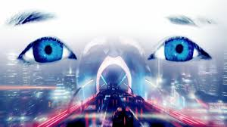
A.I.: Artificial Intelligence
INST 4200
David J Stucki
Spring 2015

Slide 2
Alternate Reality Game: The Beast
Microsoft Team in collaboration with Spielberg’s production company
12 weeks during the spring of 2001
Rabbit holes: entry points to the game
  Trailer 1: Jeanine Salla, Sentient Machine Therapist
  Trailer 2: Flashing lights & markings during credits
  Poster: “Evan Chan was murdered. Jeanine is the key.”
30 complete in-game web-sites that were fully developed and inter-linked
CloudMakers

Slide 3
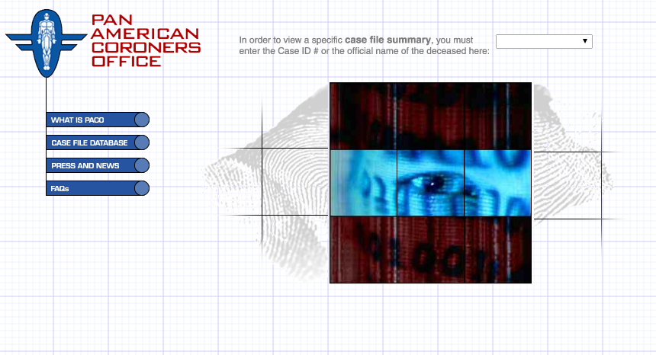

Slide 4


Slide 5
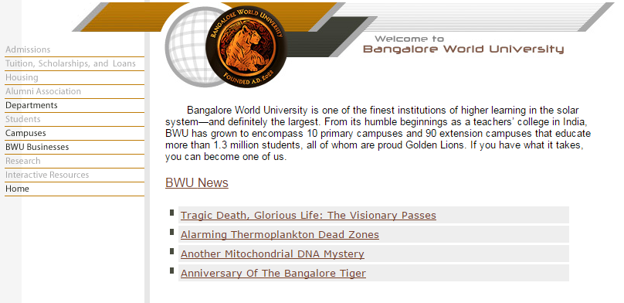

Slide 6


Slide 7
