Slide 1
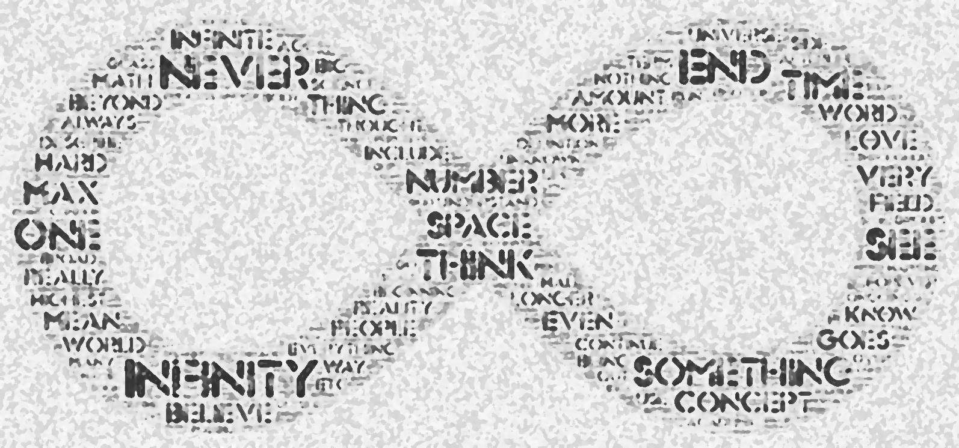
$$ℵ_{ω}$$
To Infinity and Beyond...
FYS 1023

Slide 2
Alerts
Final Exam
Final exam will be December 13 at 10:15am
Final review session will be next Wednesday
December 11, 2:30 in Comm 142
Final journal is due no later than 10:15am, Fri., December 13
Early submissions are welcome

Slide 3
Seek not to understand that you may believe, but believe that you may understand.
—Saint Augustine
For I do not seek to understand that I may believe, but I believe in order to understand. For this I believe - that unless I believe, I should not understand.
— Saint Anselm

Slide 4
Transfinite Cardinals
Power Sets
The power set of a set is made up of all of the subsets of that set.
Example: if $A = \{p, q, r\}$, then $2^{A}=\left\{∅, \left\{p\right\}, \left\{q\right\}, \left\{r\right\}, \left\{p,q\right\},\left\{p,r\right\},\left\{q,r\right\},\{p,q,r\}\right\}$
Cantor’s Theorem:
$$\left|A\right|<\left|2^{A}\right|$$
In other words, the power set of a set always has a larger cardinality than the set itself

Slide 5
Transfinite Cardinals
Recall: $ℕ=\left\{0, 1, 2, 3, 4, …\right\}$ and $\left|ℕ\right|=ℵ_{0}$
Then $\left|2^{ℕ}\right|>ℵ_{0}$
This confirms what we already saw with Cantor’s diagonal argument about real numbers, since $\left|ℝ\right|=\left|2^{ℕ}\right|$
So what about $\left|2^{ℝ}\right|?$
Cantor’s Theorem requires $\left|2^{ℝ}\right|>\left|ℝ\right|>ℵ_{0}$
In general $ℵ_{0}<ℵ_{1}<ℵ_{2}<ℵ_{3}<⋯$

Slide 6
Cantor’s Theorem
No set can be placed in one-to-one correspondence with its power set
So Reals have a smaller cardinality than the power set of the reals
Which is smaller than the power set of the power set of the reals
Which is smaller than the power set of the power set of the power set of the reals
Etc., ...

Slide 7
Continuum Hypothesis
$\left|ℕ\right|=ℵ_{0}$
$\left|ℝ\right|=𝔠=2^{ℵ_{0}}$
Cantor’s Theorem says that there are an infinite number of infinities:
$$ℵ_{0}<ℵ_{1}<ℵ_{2}<ℵ_{3}<⋯$$
But which one of these $ℵ$’s is $𝖈$?
The CH claims that $𝔠=ℵ_{1}$
In other words, that if the natural numbers represent the ‘smallest’ infinity, that the reals represent the next ‘smallest’
Cantor died not knowing
Gödel (1940) and Cohen (1963) solved the problem in a surprising way

Slide 8
The C-H Is Independent
The mathematics of set theory can not prove that the CH is true; it can also not prove that the CH is false!
The Continuum Hypothesis is undecidable in standard set theory.

Slide 9
Course Themes
Beauty
We have considered a variety of notions that connect aesthetically to the infinite
Examples?
Unity of Knowledge
We have seen how academic disciplines bleed into one another: mathematics, art, theology, literature, philosophy, physics, etc.
Thought
Infinity has provided a vehicle for exploring how to think about the world
We’ve also stepped up to the abyss and peeked over the edge

Slide 10
Ordinals
Cardinal numbers capture the notion of size or quantity over sets, which are unordered collections
When dealing with a sequence, in which order matters, cardinal numbers are not enough
first
second
third
fourth
fifth
sixth
seventh
eighth
...

Slide 11
Finite Ordinals
For finite numbers, cardinals and ordinals are the same
Cardinals: 0, 1, 2, 3, 4, 5, 6, 7, 8, 9, 10, ...
Ordinals: 0, 1, 2, 3, 4, 5, 6, 7, 8, 9, 10, ...
red, blue, green, yellow, orange, black, purple
0, 1, 2, 3, 4, 5, 6

Slide 12
Transfinite Ordinals
1, 2, 3, 4, 5, 6, 7, 8, 9, ..., 0
0, 1, 2, 3, 4, 5, 6, 7, 8,
Cantor named the first transfinite ordinal ω
0, 2, 4, 6, 8, ..., 1, 3, 5, 7, 9, ...
0, 1, 2, 3, 4, ω,ω+1,ω+2, ω+3, ω+4, ω+5, ...
3,6,9,..., 4, 7, 10, ..., 5, 8, 11, ..., 0
0,1,2,ω,ω+1,ω+2,ω+3,ω*2,ω*2+1,ω*2+2,ω*2+3, ω*3,ω*3+1
ω
?

Slide 13
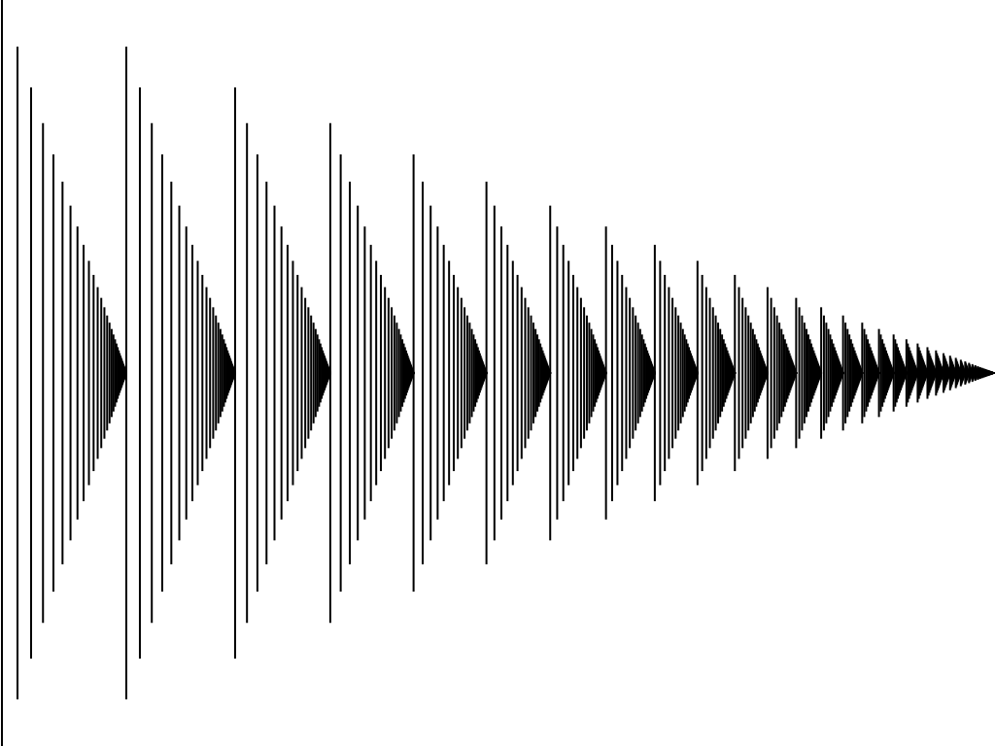
Transfinite Ordinals
The transfinite ordinals are closely related to the puzzle of Hilbert’s Hotel.
In fact we can visualize all of the transfinite ordinals up to ω² with a graphic that plots them on the real number line between 0 and 1
0
ω
ω*2
ω*3
ω*4

Slide 14
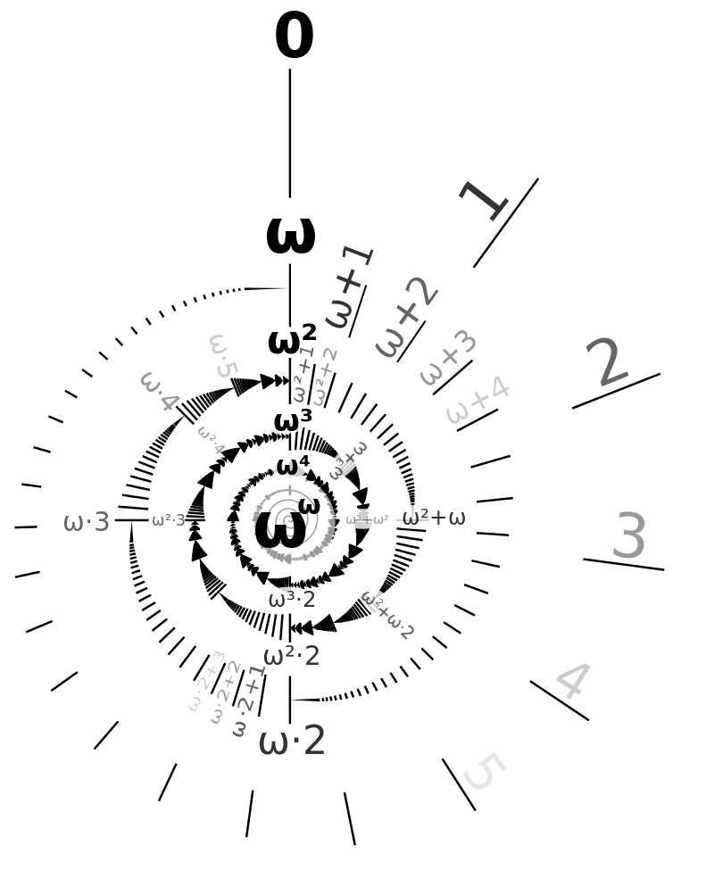
Transfinite Ordinals
In fact, we can also visualize up to $ω^{ω}$
Each rotation of the spiral is another factor of $ω$

Slide 15
Ordinals & Cardinals
So previously when we concluded that there were an infinite number of infinite cardinals, we actually we being too modest:
$$ℵ_{0}<ℵ_{1}<ℵ_{2}<⋯<ℵ_{ω}<ℵ_{ω+1}<⋯$$
$$<ℵ_{ω∗2}<⋯<ℵ_{ω^{ω}}<⋯$$
It appears that Cantor opened Pandora’s box when it comes to the infinite!
How to Count Past Infinity (Vsauce)
Numbers from 0 to Absolute Infinity (Mathis R.V)

Slide 16
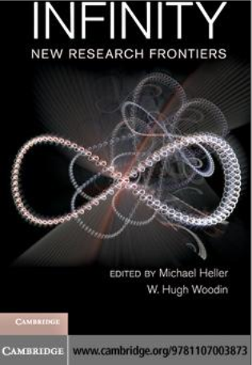
New Research Frontiers
Introduction, by Rudy Rucker
Mathematical
Physical
Metaphysical
Theological
Psychological
Artistical
Actual Infinity
in Deo — Absolute
Contingent, Created World
in abstracto — Mathematics

Slide 17
and Beyond...
Call for a Non-Euclidean, Post-Cantorian Theology, by Saburo Matsumoto, Journal of the ACMS, 2006
Shabbat: Imitating Creation, by Rabbi Ari Kahn
Infinity and the Nostalgia of the Stars, by Marco Bersanelli

