Slide 1
To $ℵ_{0}$ and Beyond...
FYS 1023

Slide 2
Infinity is where things happen that don’t.
Anonymous Schoolboy

Slide 3
Infinity meets Art: M.C. Escher
David J. Stucki
FYS 1023

Slide 4
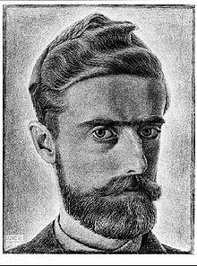
Brief Bio
Born in Leeuwarden, Holland in 1898
Was a sickly child, did poorly in school (failed 2nd grade), but always excelled in drawing
In 1919 enrolled in the Haarlem School of Architecture and Decorative Arts, and dropped out in 1922 to pursue art after traveling through Italy and Spain.
He married and settled down in Rome until the political climate became too difficult in 1935.
Lived for a while in Switzerland, and then Belgium, before returning to the Netherlands in 1941.
He died in 1972.

Slide 5
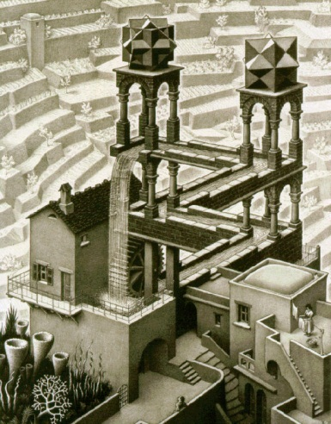
Background
Mathematics was undergoing upheaval during Escher’s early life
Cantor’s set theory and transfinite numbers
Rigorization of Calculus and Analysis
Non-Euclidean Geometry
Infinity was central to all of these
A Pandora’s box of paradox had been opened

Slide 6
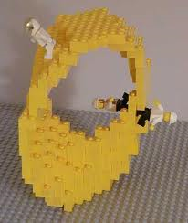
Escher’s Work
According to Maor (p. 166), Escher’s work relating to infinity can be divided into three categories:
Endless cycles
Tilings of the plane
Limits
These each reflect some aspect of the aftermath of these mathematical crises.

Slide 7
Möbius I
Endless Cycles
The Möbius Strip (1858) is named for August Möbius, who was a mathematician and astronomer, due to his discovery of its unusual properties. The shape itself was known and used in ancient times as a mystical symbol.
The Möbius strip is amazing because it has only one continuous edge. A ladybug could go from any point on the ribbon to another point without ever crossing an edge.
The Möbius strip has been used commercially in conveyor belts, continuous loop recording devices, playground equipment, clothing, etc.

Slide 8
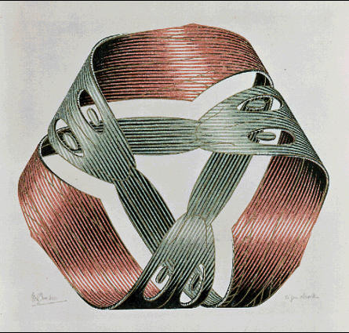
Möbius II
Endless Cycles
Moebius Strip I (1961) wood engraving and woodcut in red, green, gold and black, printed from 4 blocks
Möbius Strip II (1963) woodcut in red, black and grey-green, printed from 3 blocks

Slide 9
Möbius III
Endless Cycles
The recycling symbol was introduced in conjunction with the first Earth Day in 1970.
Gary Anderson, a student at USC entered this design in a contest sponsored by the Container Corporation of America.

Slide 10
Strange Loops
Endless Cycles
Ascending and Descending 1960 Lithograph
Waterfall 1961 Lithograph
Hands
Notes:
youtube video: a day in the file of MC Escher

Slide 11
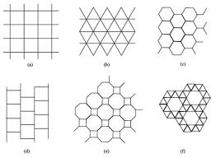
Patterns in the Plane
Tilings
A tessellation is a regular shape, or collection of shapes that fill the infinite plane.
Escher was inspired by tilings and other geometric patterns he saw in the architecture of the Alhambra, a fourteenth-century Moorish castle in Granada, Spain

Slide 12
The Alhambra
Tilings

Slide 13
How to Create a Tiling
Tilings
Start with a regular shape:
Perturb one edge:
Then compensate:
Then tile away:

Slide 14
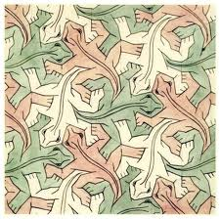
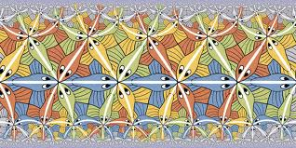
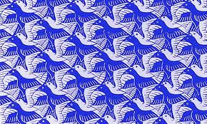
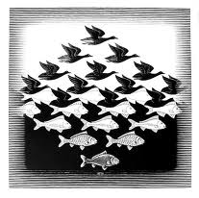
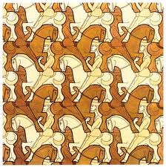
Escher Tilings
Tilings
Shepard/Escher on Youtube

Slide 15
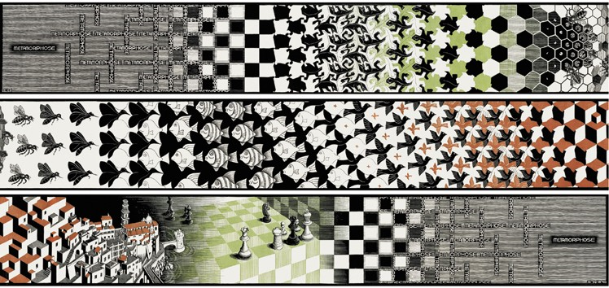
Synthesis
Endless Cycles & Tilings
Metamorphosis III (1967-1968) woodcut, second state, in red, green and reddish-brown, printed from 33 blocks on 6 combined sheets, mounted on canvas partly colored by hand

Slide 16
Infinite Geometry
Limits
Smaller and Smaller (1956) wood engraving and woodcut in black and brown, printed from 4 blocks

Slide 17
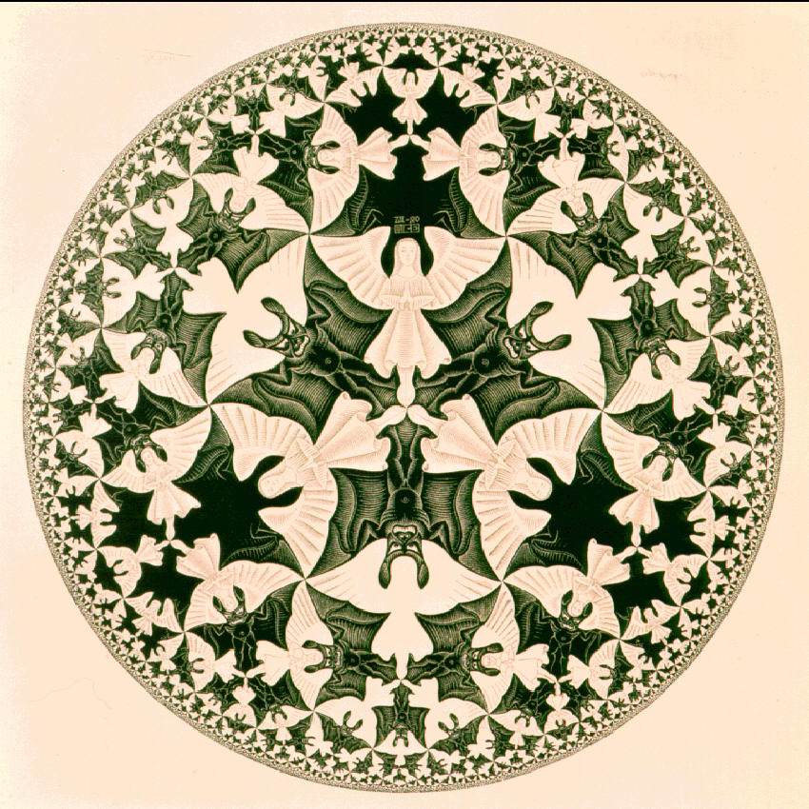
Infinite Geometry
Limits
Circle Limit IV (1960) woodcut in black and ocre, printed from 2 blocks
Modeled after Hyperbolic Geometry, in which the angle sum of a triangle is less than 180°.

Slide 18
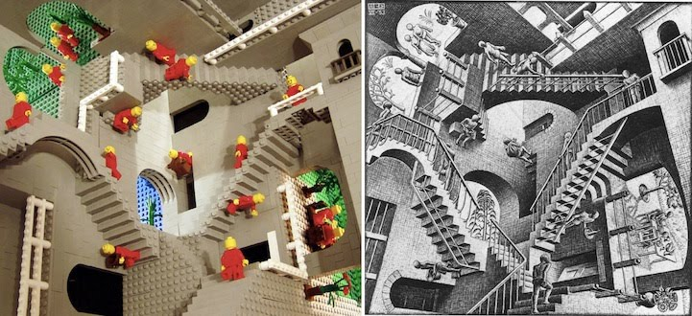
Infinite Lego
Lego
Labyrinth, 1986 (David Bowie, Jennifer Connelly)

Slide 19
http://daltongallery.agnesscott.edu/ A Curator’s Statement, by Lisa Alembik
FYS 1023
To Infinity & Beyond…

Slide 21
Painting as a noun takes on limitless form and attitude. It can arouse visual pleasure, support a manifesto, tell a story and speak of ideas. It is carved out of history.

Slide 22
As a verb, painting is a suggestive practice that unfolds and is often self-reflexive. It is about color and shape and the senses extraordinaire.
A rich process of exploration can take place through the goop of the medium, the blending of pigments and energetic eye movement.

Slide 23
In action, the painter’s scope of vision will enclose the picture plane like a web—or like the hot pinball machine of life.
This process has the power to capture a point of view, cracking open space to produce new galaxies, often delving into the personal and unknown.

Slide 24
Articulated and raw,
restrained or whatever,
painting at its best
is
a commitment
that constantly poses questions.

Slide 25
The processes employed when painting can play a significant role in the development of any artistic work, infiltrating composition and method.
This exhibit was inspired by this belief, that a painting sensibility, the dug-in knowledge developed through an intentional, prolonged experience of painting, can be expressed through a variety of forms and media.

Slide 26
It is a way of thinking, of looking at the world that rests in composition.
This idea allows for the making and exploration of culture with a focus on fluid form, light and material.

Slide 27
As this exhibition evolved, a certain sensation emerged from within the early gathering of artists, nothing out of the ordinary or uncommon, but a very strong binding sensibility.
The exhibit’s founding premise, of bringing together artists working in a variety of media through a painter’s lens (or brush), became less of a priority than fostering this sensation, identified as the artists’ consideration of a limitless, never-ending continuum of space that changes with perspective, over time.

Slide 28
The title, The Possibility of Framing Infinity, is meant to be open-ended as not to describe the artwork but the act of making.

Slide 29
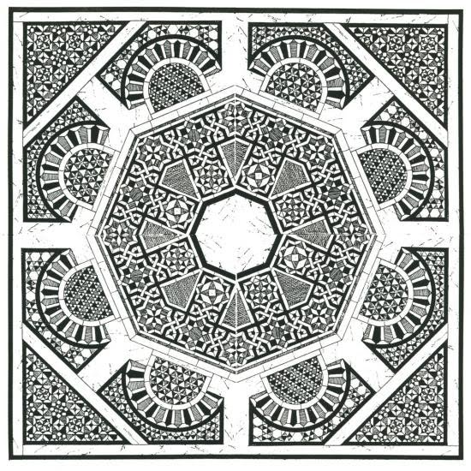
The Possibility of Framing Infinity
For centuries artists have been working to express space and time—whether for a specific narrative or as a means to an end. Grounding this within the history of art, three artists or works of art are brought to mind.
“Creating Visual Narratives: Exhibitions in Space and Time”
Dr. Kathryn Floyd, Auburn University
http://cmdcah.blogspot.com/2011/01/dr.html

Slide 30
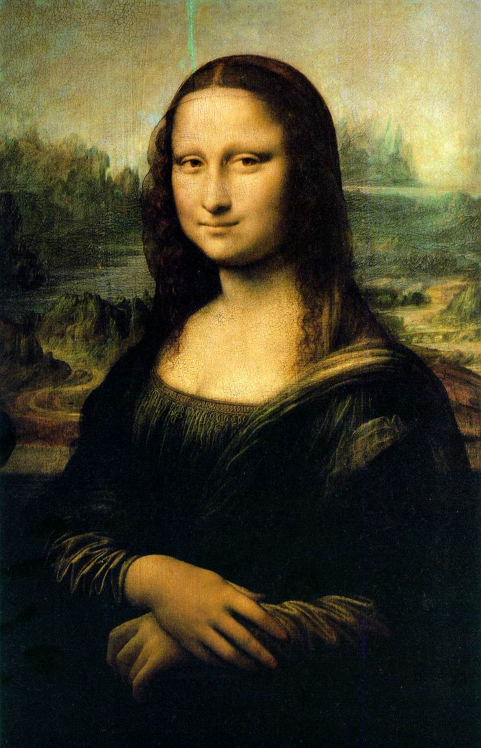
The Possibility of Framing Infinity
Consider the painting Mona Lisa (1503-1506) by Leonardo da Vinci (1452-1519). The sitter, with her enigmatic smile, is front and center, with rolling, misty hills disappearing into a diffuse background of atmospheric perspective.
It has a sense of continuum, of forever, not only in the landscape but also within her visage.

Slide 31
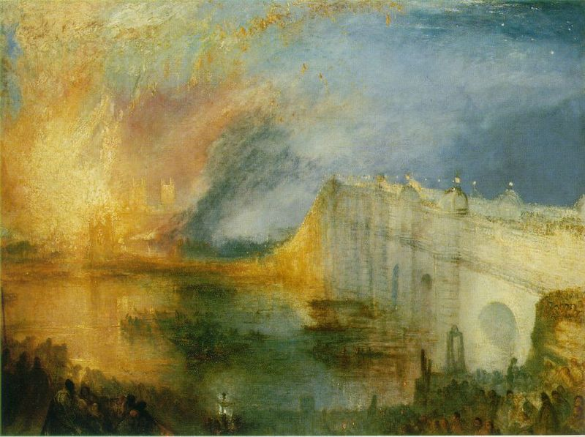
The Possibility of Framing Infinity
In the painting by J. W. M. Turner (1775-1851), The Burning of the Houses of Lords and Commons, October 16, 1834 (1835), which is exemplary of his work, the scene breaks into an intuitive deconstruction of the moment, with color and light telling the tale rather than an exact rendering of a historical incident.

Slide 32
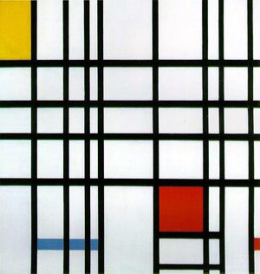
The Possibility of Framing Infinity
To Barnett Newman (1905-1970) whose paintings with “zips,” as he called them, begun in the 1940s, embedded the sublime into vibrating planes of color where the splits simultaneously break and hold his work into dense motion.

Slide 33
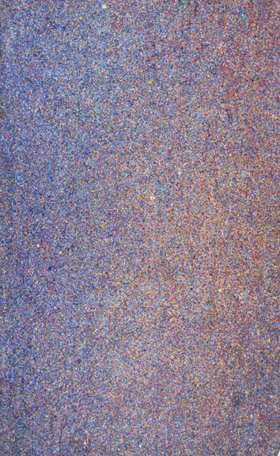
The Possibility of Framing Infinity
This framing of a place or body, whether it is a literal figurative point of view or a formless and intangible space can be experienced throughout this exhibit.

Slide 34
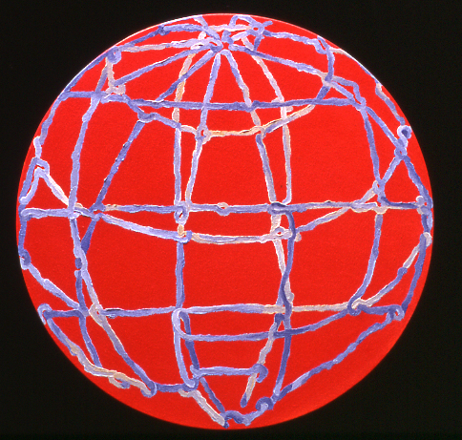
The Possibility of Framing Infinity
This framing of a place or body, whether it is a literal figurative point of view or a formless and intangible space can be experienced throughout this exhibit. In Colleen Lynch’s, Marcia Cohen’s and Caomin Xie’s paintings, a world is abstracted to come together into a meditative or ocular whole.

Slide 35
The Possibility of Framing Infinity
This framing of a place or body, whether it is a literal figurative point of view or a formless and intangible space can be experienced throughout this exhibit. In Colleen Lynch’s, Marcia Cohen’s and Caomin Xie’s paintings, a world is abstracted to come together into a meditative or ocular whole.

Slide 36
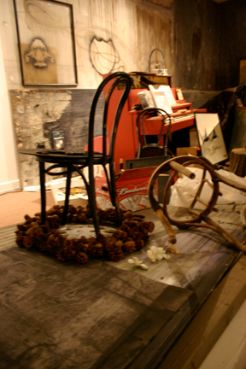
The Possibility of Framing Infinity
A happening is described and re-scripted as it repeats through history—as the flood of Katrina is riffed and swelling in the sensory installation by John Otte.

Slide 37
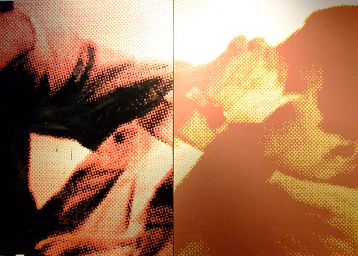
The Possibility of Framing Infinity
Jeremy Chance strives to disassociate himself from the potentially personal, emotional process of painting by honing in on headshots of actors portraying various expressions connected with depression, utilizing the distancing processes of printmaking to further himself from emotional stimulus. The picture plane, broken into a wake of formlessness, is reinvented and pulled together by the artist.

Slide 38
The Possibility of Framing Infinity
Sally Heller creates environments of overgrown fuzzy and plastics stuffs that explode in space, with trees of PVC pipe, grass and mosses of pipe cleaners and Mylar pools of water. By framing these moments, space is re-shaped and transformed.

Slide 39
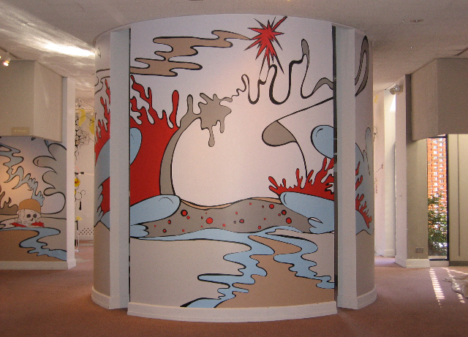
The Possibility of Framing Infinity
For Sarah Emerson, the threshold of mortality is highlighted next to the unending unraveling coil of infinity in her existential explorations.

Slide 40
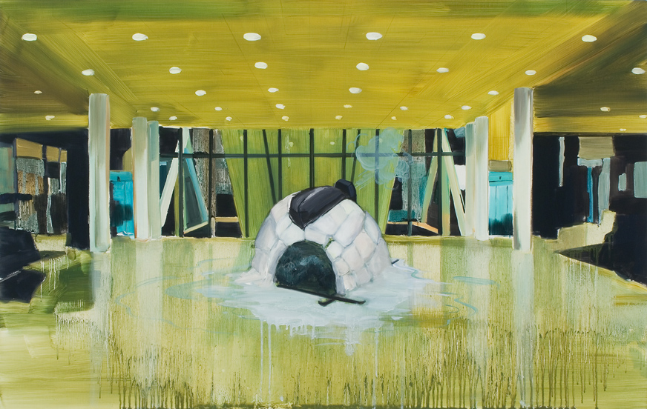
The Possibility of Framing Infinity
Kristine Moran’s overflowing, unfolding worlds are empty of living human presence, where remnants of abandoned warehouses are overgrown with unbridled nature—flooded, iced over—still lit by the artificial glow of florescent lights.

Slide 41
The Possibility of Framing Infinity
Framing usually showcases something in its best light, possibly at its most effective essence.
To frame infinity, to square off the limitless and timeless, is a bold endeavor.

