Slide 1
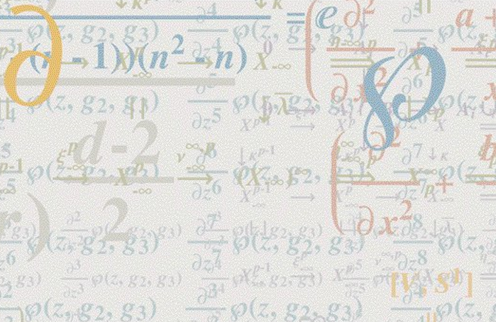


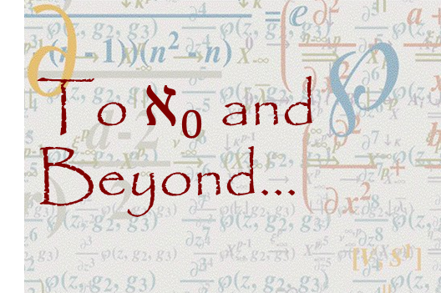
To $ℵ_{0}$ and Beyond...
FYS 1023

Slide 2
Alerts
New reading assignment
Essay assignment, due next Monday
Schedule
  Monday, 12/2: Final Exam Speed Dating
  Wednesday, 12/4: Infinity in Art
  Friday, 12/6: ...and Beyond!
  Optional Review: Wednesday, 12/11 @ 2:30
  Final Exam: Friday, 12/13 @10:15

Slide 3
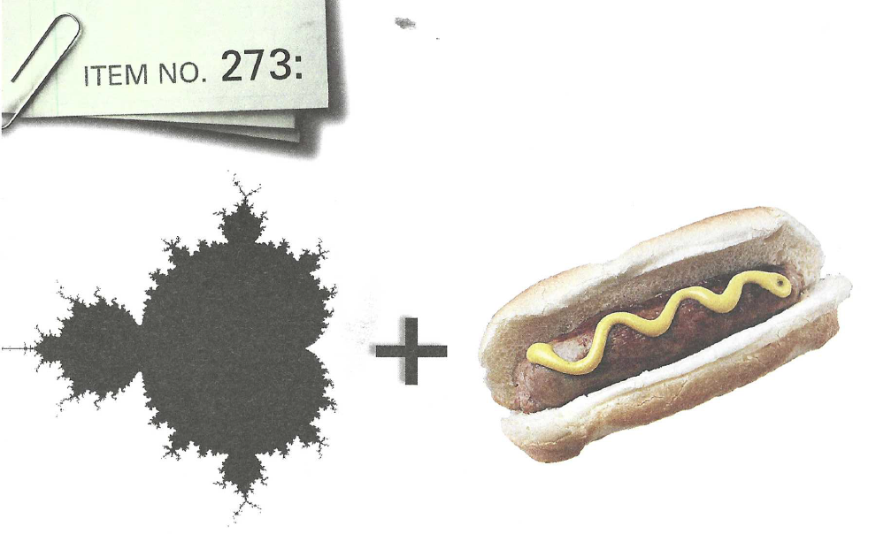

What is this?
A Mandelbr$ö$twurst
(University of Chicago Scavenger Hunt)

Slide 4
Life is full of
infinite absurdities,
which, strangely enough,
do not even need
to appear plausible,
since they are true.
  Luigi Pirandello
Reality is not always
probable, or likely.
  Jorge Luis Borges

Slide 5
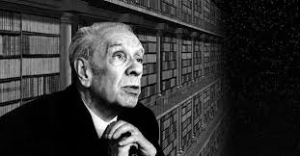
Jorge Luis Borges (1899-1986)
Argentinian author
His stories marked the
beginning of the magical realism
movement in 20th century Latin
American literature
The Library of Babel
  What did you think?
The Aleph
  What about this one?

Slide 6
Jorge Luis Borges (1899-1986)
I arrive now at the ineffable core of my story. And here begins my despair as a writer. All language is a set of symbols whose use among its speakers assumes a shared past. How, then, can I translate into words the limitless Aleph, which my floundering mind can scarcely encompass? Mystics, faced with the same problem, fall back on symbols: to signify the godhead, one Persian speaks of a bird that somehow is all birds; Alanus de Insulis, of a sphere whose center is everywhere and circumference is nowhere; Ezekiel, of a four-faced angel who at one and the same time moves east and west, north and south. (Not in vain do I recall these inconceivable analogies; they bear some relation to the Aleph.) Perhaps the gods might grant me a similar metaphor, but then this account would become contaminated by literature, by fiction. Really, what I want to do is impossible, for any listing of an endless series is doomed to be infinitesimal. In that single gigantic instant I saw millions of acts both delightful and awful; not one of them occupied the same point in space, without overlapping or transparency. What my eyes beheld was simultaneous, but what I shall now write down will be successive, because language is successive. Nonetheless, I'll try to recollect what I can.

Slide 7
Discussions
Borges: short stories
π: faith in chaos
  Everyone name one thing that stood out to you in the movie that related to this class (no repeats)
  What did it mean (to you)?
  What questions did it leave you with?
Fractals documentary
  How did it connect to infinity?
  Questions?

Slide 8
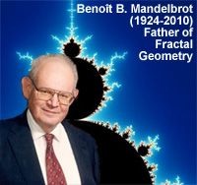
Benoît Mandelbrot
(1924-2010)
Why is geometry often described as cold and dry? One reason lies in its inability to describe the shape of a cloud, a mountain, a coastline or a tree.
Bottomless wonders spring from simple rules, which are repeated without end.
A fractal is a way of seeing infinity.

Slide 9
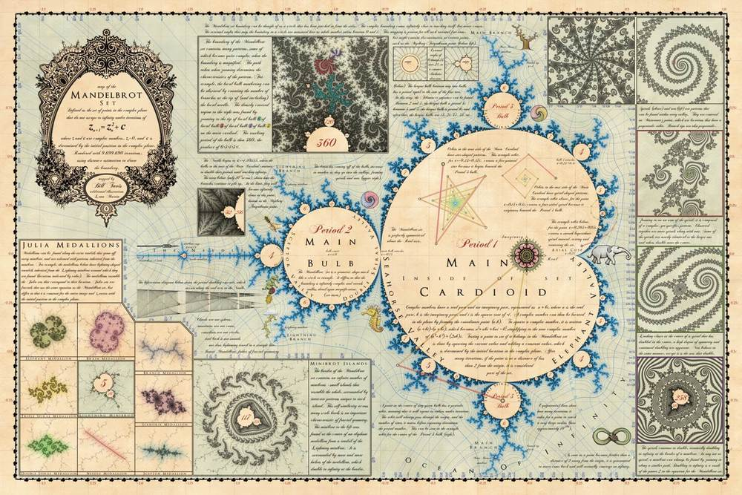
In Memorium: Mandelbrot
https://www.mandelmap.com/

Slide 10
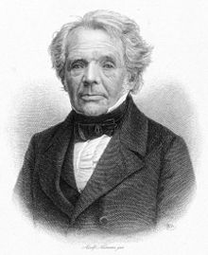
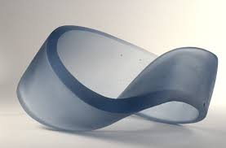
Möbius Strip
August Ferdinand Möbius (1790–1868)
  German mathematician & astronomer
  Descendent of Martin Luther
Discovered the simplest non-orientable surface

Slide 11
Möbius Strip
Activity
  Make a Möbius Strip for yourself...
  Take a pen/pencil and draw a line
  down the middle of your Möbius Strip
    What happened?
  Take a scissors and cut along the line you drew
    What happened?
  Make another Möbius Strip
  This time draw the line 1/3 of the way rather than in the middle. What happens this time?
  Cut along that line.
    What happened?
  Take the first one that you already cut. Cut down the middle again.
    What happened?

Slide 12
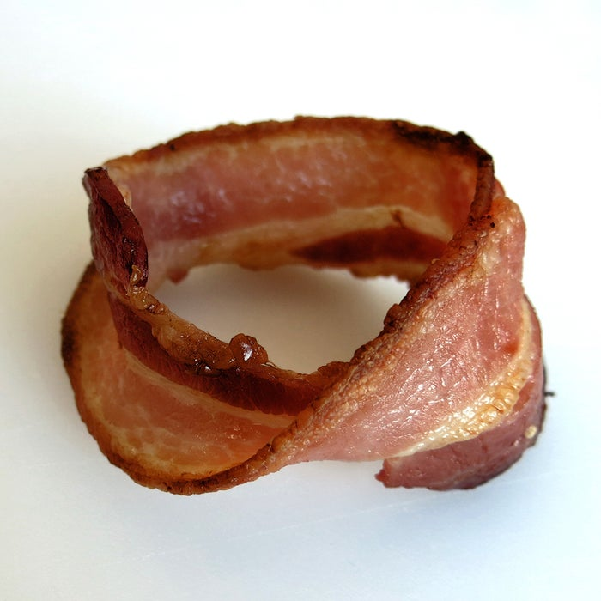
Möbius Bacon

