Slide 1
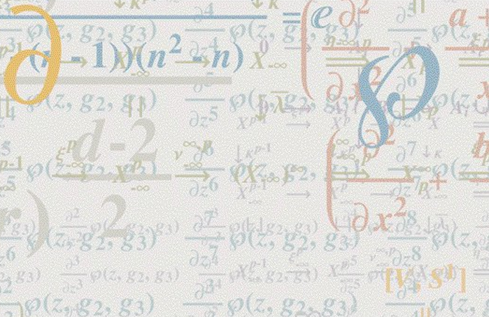

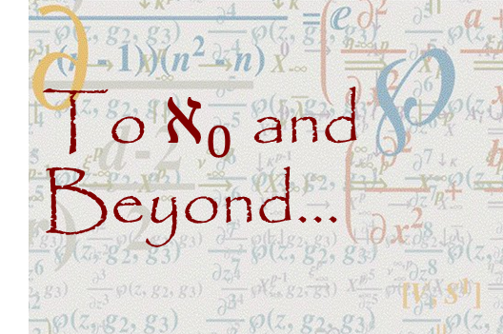
To $ℵ_{0}$ and Beyond...
FYS 1023

Slide 2
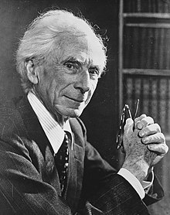
Bertrand Russell (1872-1970)
If any philosopher had been
asked for a definition of infinity, he might have produced some unintelligible rigmarole, but he would certainly not have been able to give a definition that had any meaning at all.

Slide 3


