Slide 1
Crushing it During Finals
Provided by
the Academic Support Center
Visit them @ 226 Library
Notes:
It’s important to begin thinking about final exams at least a few weeks before so you can be as prepared as possible.

Slide 2
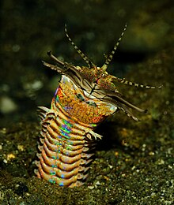






Eunice Aphroditois
Bobbit worm, sand-striker, trap-jaw worm
Fossils dating back 21m years
Habitat: coral reefs
Can grow to 10ft long

Slide 3
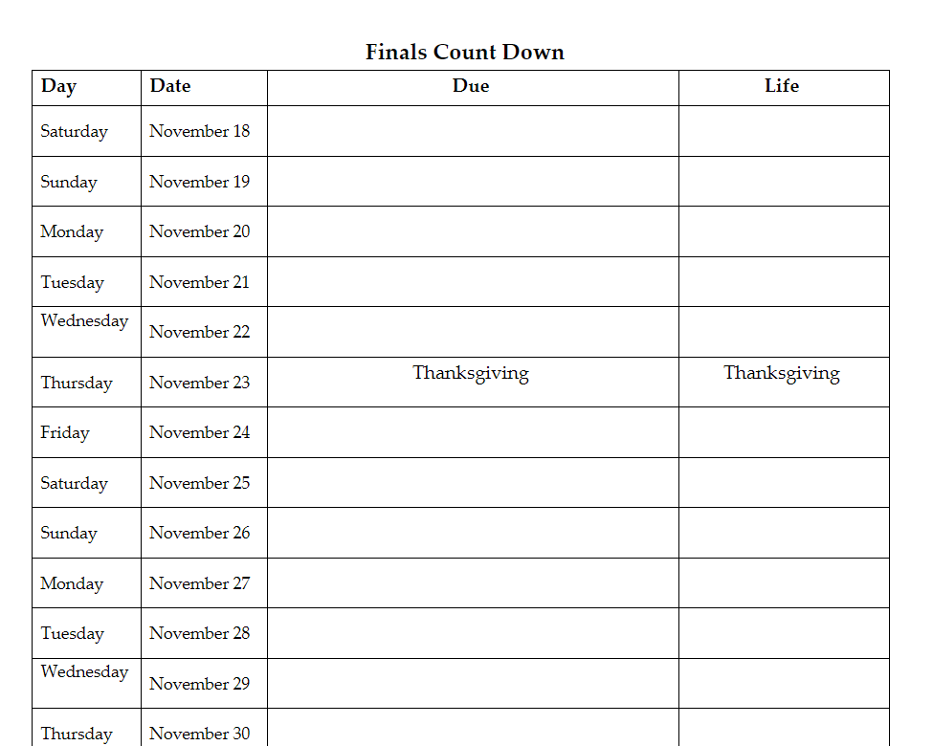
Finals Count Down
You have a lot to do over the next few weeks.
You need to account for all of those to-dos.
You don’t want an assignment or commitment (like work) to sneak up on you.
Complete the Finals Count Down to account for all of your tasks:
  school work goes into the middle -Due - column (e.g., papers, projects, exams)
  personal commitments go into the last – Life – column (e.g., work, sports, choir, meetings, socials)
Notes:
I’m passing out the Finals Count Down worksheet. You will have 7-10 minutes to complete this. Look at your syllabi for all of your courses and see what you have to do starting November 19th through the end of the semester. The goal of this worksheet is to help you see everything you need to accomplish so you can stay organized and best manage your time.

Slide 4
No Surprises
You need to know the format, requirements, and expectations of your final exams.
Check the course site on Brightspace & the syllabus or course plan – the information might be there
Final Exam Schedule: https://www.otterbein.edu/wp-content/uploads/2024/05/final-exam-schedule-24-25.pdf
If necessary, email your professor or ask in class.
  Or request to chat during office hours
  Connecting face-to-face can be particularly helpful if you’re feeling overwhelmed or anxious
Notes:
You want to be sure you know as much as possible about your final exams and projects. The format of an exam can change the way you study (e.g. open book versus take-home).
If you do not know the final exams or projects due for a class after reviewing the syllabus, now is a good time to reach out to the instructor for clarification. Take time in class to do this now so you know sooner rather than later.

Slide 5
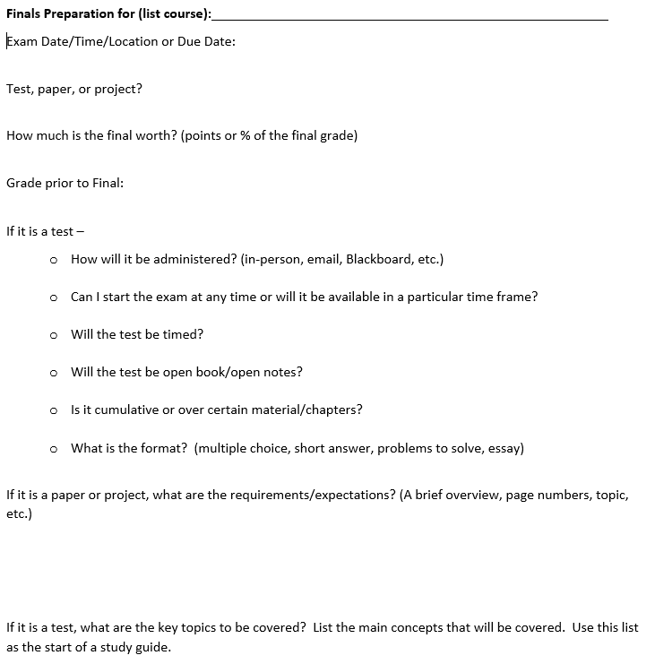
Get Organized:
Create a Finals Prep Course Sheet for each class
Notes:
Now I am passing out the Finals Prep sheet. You should have one of these for each course you are taking. Take a few minutes to get started on this for each course you are taking. Again, review your syllabus and/or look in Banner to find the answers to these questions if you don’t already know them. If you are still unsure at that point, contact your professor.

Slide 6
Create a Study Schedule
Build in time to complete final papers, projects, and study for exams.
If you receive testing accommodations be sure that you request those accommodations from your professor at least 3 days prior to each exam.
  The sooner the better actually! Email your professor now.
  Sara Banaie in Disability Services can help – ODSTest@Otterbein.edu
  Disability Services can help – DisabilityServices@Otterbein.edu
Have a plan, work the plan.
  Students who create study schedules spend 50% more time studying than those who don’t plan out their study time*
  Start preparing study materials for your most challenging classes two weeks in advance
  Studying over several days is much more effective than studying for 20 hours over 1-2 days.
Have realistic goals and schedules.
  Break tasks into manageable chunks
  Use the Pomodoro Technique to follow your study schedule
  Build in time to take care of yourself (exercise, sleep, socialize)
*Sheeran, P., Webb, T. L., & Gollwitzer, P. M. (2005). The Interplay Between Goal Intentions and Implementation Intentions. Personality and Social Psychology Bulletin, 31(1), 87–98.
Notes:
It is important to create a study schedule ahead of time so you stay organized and allot for enough time to dedicate to each course.
If you need testing accommodations, it’s important to reach out sooner than later to the professor and follow up if necessary. Disability Services can also assist.
Creating a study schedule will help you better plan out your time. Start prepping your materials by the weekend of November 18. Since you have some time off the next weekend, that gives you the flexibility to start studying over a long weekend.
Studying over several days is more effective than studying all day for a couple days.
Look into the Pomodoro Technique (show video).
It’s almost important to set aside time for exercise, sleep, socialization. It’s all about balance.

Slide 7
What if I am not caught up?
Be strategic in what you can accomplish – not likely that you can read 5 chapters of your text before the exam.
Review notes/PowerPoints. Read chapter introduction & goals. Read end of chapter summary and outcomes. Then strategically read key parts of the chapter and take notes on that key information.
Notes:
If you’re not caught up, be strategic about what you need to do. Review your notes or powerpoints. Read important concepts like highlights, introductions, and goals.

Slide 8
Do Not Forget the Basics
Where to study
When to study
Eat, sleep, exercise
Sleep! 7-9 hours each night
Bed time
Avoid the drama
Anxiety is contagious
Keep things in perspective
Be good to yourself

Slide 9
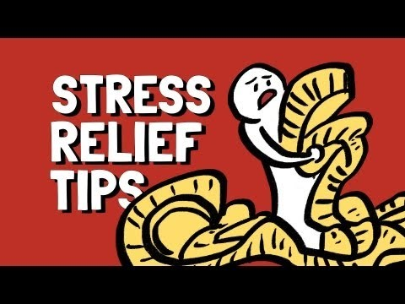
Notes:
This short video provides some stress relief tips if you find yourself feeling overwhelmed leading up to finals.

Slide 10
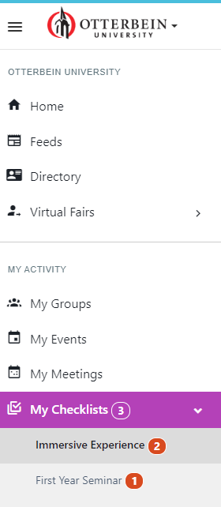
Campus Groups:
How to Submit
Go to otterbein.campusgroups.com
Select My Checklists
Select First Year Seminar

Slide 11
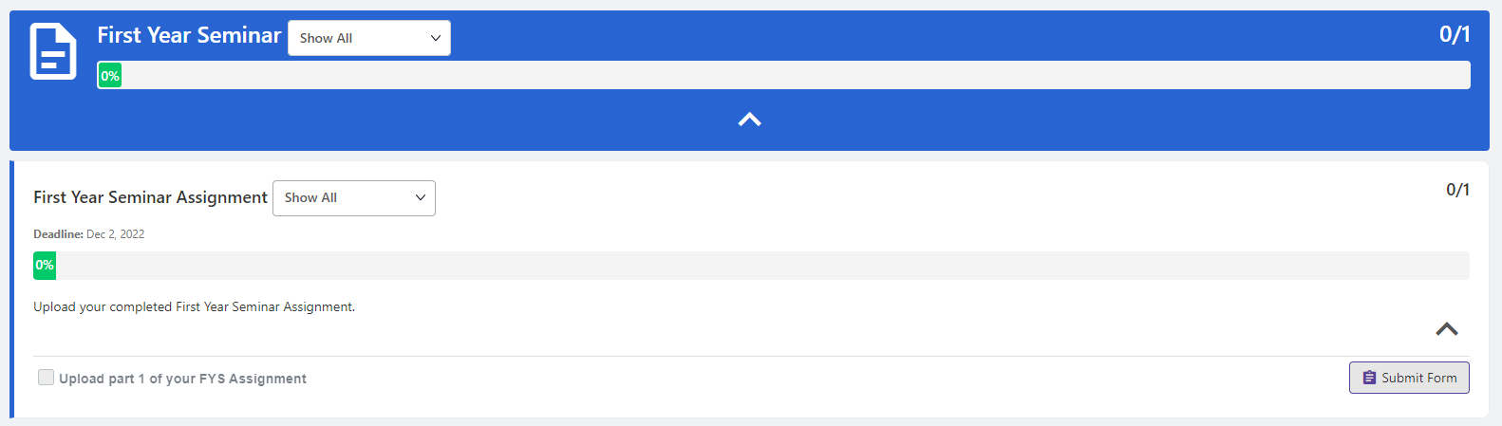
Click Submit Form to upload assignment

Slide 12
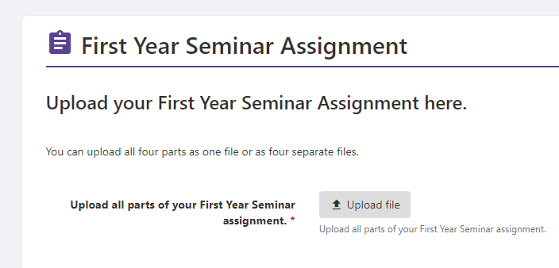
Upload all parts of your READY Plan assignment
Hit Submit or Save as a Draft

Slide 13
Return to My Checklists to ensure you have submitted your assignments
When the READY Plan assignment is complete you will note a 100% completion bar

Slide 14
FYS Post-Survey
Notes:
https://otterbein.co1.qualtrics.com/jfe/form/SV_7ZJl2Mw3NtiDmIK

