Slide 1
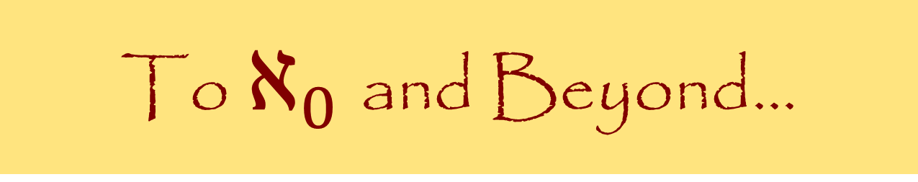
To $ℵ_{0}$ and Beyond...
FYS 1023

Slide 2
Georg Cantor
The fear of infinity is a form of myopia that destroys the possibility of seeing the actual infinite, even though it in its highest form has created and sustains us, and in its secondary transfinite forms occurs all around us and even inhabits our minds.

Slide 3
Kabbalah
FYS 1023
David J. Stucki

Slide 4
Judaism 101 – Scripture
Jewish Scripture is hierarchical
  Torah: The Law, the five books of Moses
    Nevi’im: The Prophets
      Ketuvim: The Writings
  (These three are often referred to as the Tanakh, or simply Torah)
        Talmud: Oral law, eventually written down as the Mishnah, and Gemara, rabbinic commentaries on Torah and Mishnah
Jewish tradition is that Torah was given to Moses in written form with oral commentary.
The Tanakh was completed around 400 BCE. The Mishnah was compiled in written form around 200 CE.
There are many additional writings incorporated into modern Judaism.

Slide 5
Judaism 101 – History
Bird’s-Eye view of Jewish History
  2000 BCE: Abram called by G-d
  1500 BCE : Moses leads Israelites out of Egypt (The Exodus)
  1000 BCE : David/Solomon, Kings of Israel
    Wisdom of Solomon
    Solomon built 1st Temple
  586 BCE : Israel conquered & exiled to Babylon (Temple destroyed)
    2nd Temple finished in 516 BCE
  70 CE : Romans destroy Jerusalem, including the Temple; diaspora
  312-1945: Persecution (Crusades, Spanish Inquisition, Holocaust, Anti-Semitism)
  1882: Jewish people begin to return to Israel
  1948: Modern State of Israel established
Since 70 A.D. Biblical Judaism has been replaced with Rabbinical Judaism.

Slide 6
Kabbalah (Cabbala, Qabala)
Judaism has ancient mystical teachings (How far back?)
This mysticism is called Kabbalah, some of which was written in the 13th century in a book called the Zohar.
Kabbalah has been the victim of distortions and abuse from occultists and new age mystics, so beware. [quote]
Traditionally Kabbalah is only taught to Jewish men thoroughly schooled in Torah and Talmud, after they attain the age of 40. (Why?)
The Chasidic branch of Orthodox Judaism today is based on Kabbalah. It was founded in Eastern Europe in the 18th century.
Notes:
Readings in this area should be undertaken with extreme caution. There is entirely too much literature out there under the name "Kabbalah" that has little or nothing to do with the true Jewish teachings on this subject. Any book on the subject of practical Kabbalah should be disregarded immediately; no legitimate source would ever make such teachings available to a faceless mass audience. Books written by Christians should be viewed with extreme skepticism, because many Christian sources have reinterpreted Kabbalah to fit into Christian dogma. [http://www.jewfaq.org/kabbalah.htm]

Slide 7
Rabbi Joseph ben Akiva (50-132 CE)
The Way of the Chariot
  A practice of meditation through visual imagination
  Recitation of scripture & Chanting
  A way to achieve closeness to the Divine
Followers claimed to see an infinitely bright light that symbolized G-d; had out-of-body experiences; experienced altered mental states; etc.
Kept as a secret knowledge
  Viewed as dangerous due to the intensity of the experience
  To avoid persecution
Notes:
Amir D. Aczel, The Mystery of the Aleph, pp. 26f

Slide 8
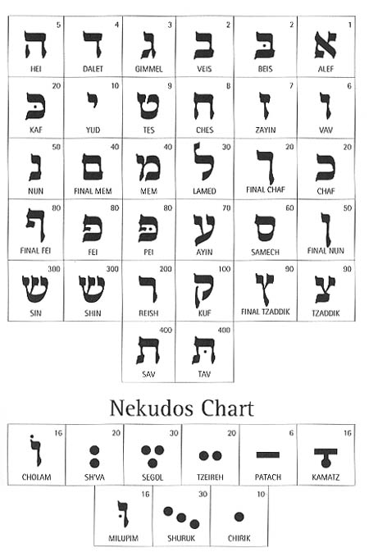
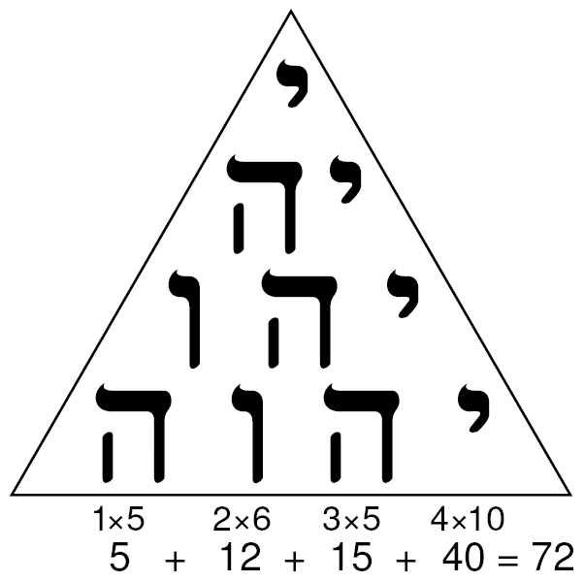
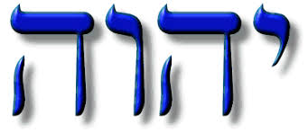
The Middle Ages
Gematria
  A practice adopted by Kabbalists where letters of the alphabet are given numerical values
  Words or names that had the same numerical value (via addition) had mystical connections
YHWH – the name of God
  Tetragrammaton (Yodh / He / Waw / He)
  Written Hebrew often lacks vowels, so the pronunciation is uncertain
  The 12 (or 24) permutations of the letters are recited
  Meditation with chanting, body movement, and breathing
The Tetractys
Notes:
For Kabbalists, the letters of the Hebrew alphabet are the royal road to the sacred source within us. They make it possible to ascend to transcendence. ...the text of the Torah is the Great and Divine Name, and the tetragrammaton YHVH is at its core... All of the Kabbalistic teachings stress the essential role of the names of God in order to attain the mystical state. – Marc-Alain Ouaknin, Mysteries of the Kabbalah

Slide 9
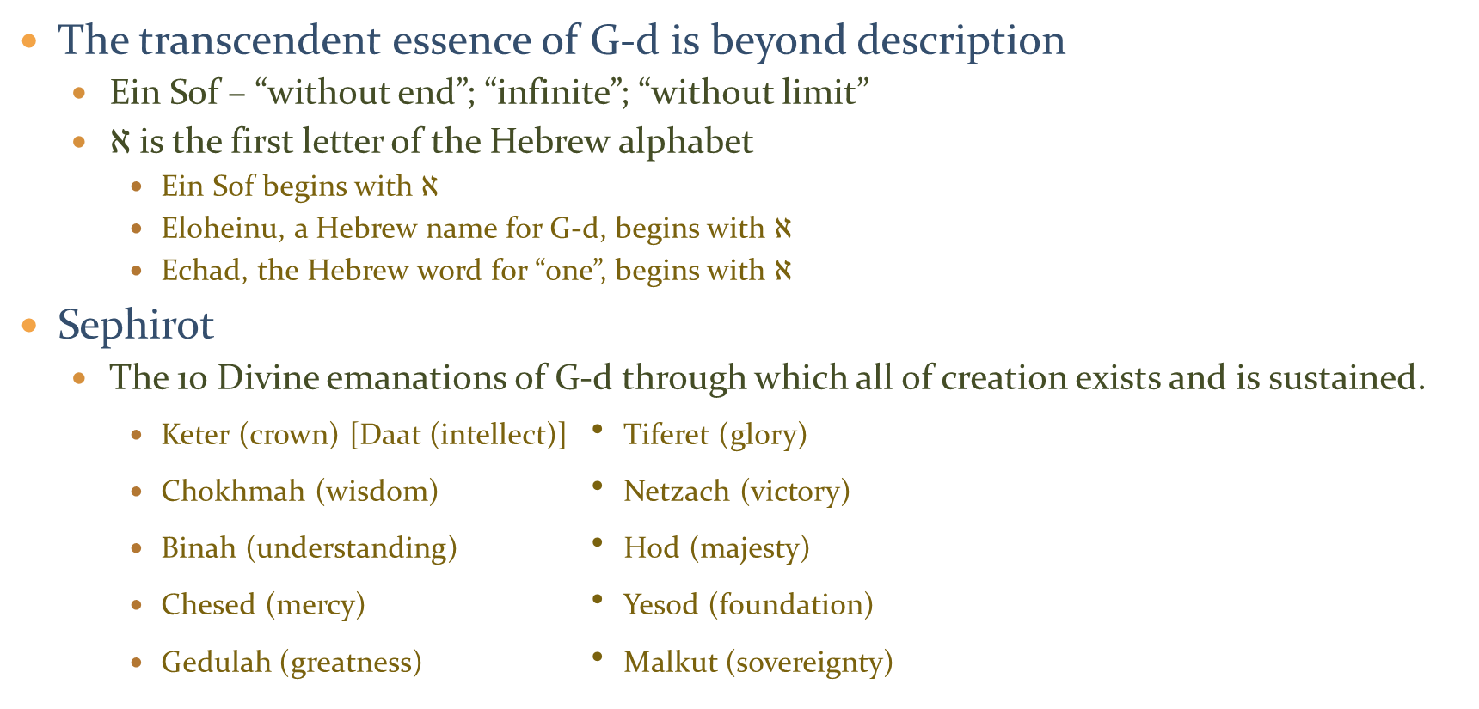
Ein Sof
The transcendent essence of G-d is beyond description
  Ein Sof – “without end”; “infinite”; “without limit”
  $ℵ$ is the first letter of the Hebrew alphabet
    Ein Sof begins with $ℵ$
    Eloheinu, a Hebrew name for G-d, begins with $ℵ$
    Echad, the Hebrew word for “one”, begins with $ℵ$
Sephirot
  The 10 Divine emanations of G-d through which all of creation exists and is sustained.
    Keter (crown) [Daat (intellect)] • Tiferet (glory)
    Chokhmah (wisdom) • Netzach (victory)
    Binah (understanding) • Hod (majesty)
    Chesed (mercy) • Yesod (foundation)
    Gedulah (greatness) • Malkut (sovereignty)
Shema
שְׁמַע יִשְׂרָאֵל יְהוָה אֱלֹהֵינוּ יְהוָה אֶחָֽד
She-ma yisrael, adonai eloheinu, adonai echad
Hear O’ Israel, the Lord is our G-d, the Lord is One
Notes:
Altogether 11 sephirot are named. However Keter and Daat are unconscious and conscious dimensions of one principle, conserving 10 forces. The names of the Sephirot in descending order are:
Keter (supernal crown, representing above-conscious will, humility)
Chochmah (The highest potential of thought, selflessness)
Binah (the understanding of the potential, happiness)
Daat (intellect of knowledge)
Chesed (sometimes referred to as Gedolah-greatness) (kindness, loving-kindness, creation)
Gevurah (sometimes referred to as Din-justice or Pachad-fear) (severity/strength, might, heroism)
Rachamim also known as Tiphereth (Mercy, compassion, beauty, elegance)
Netzach (victory/eternity, security)
Hod (glory/splendour, flexibility, sincerity)
Yesod (foundation, truth, formation)
Malkuth (kingdom, action, perception)

Slide 10
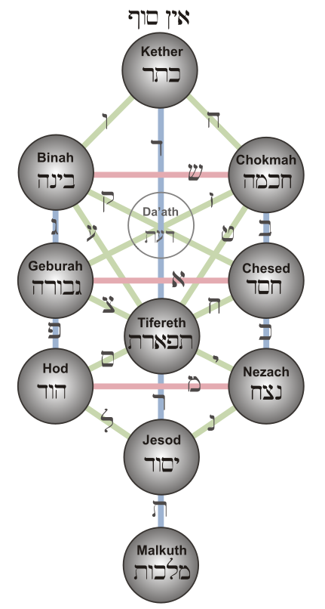
Tree of Life

