Slide 1
To $ℵ_{0}$ and Beyond...
FYS 1023

Slide 2
Purnamadah purnamidim purnat purnamudachayte purnasya purnamadaya purnamevavashishyate.
Vedic mantra (3rd-2nd millennium BC)
That is infinite, this is infinite, from infinite arises infinite, when infinite is
subtracted from infinite, what is left is infinite.
English translation of Sanskrit

Slide 3
“The buying of more books than one can read is nothing less than the soul reaching toward infinity...”
A. Edward Newton

Slide 4
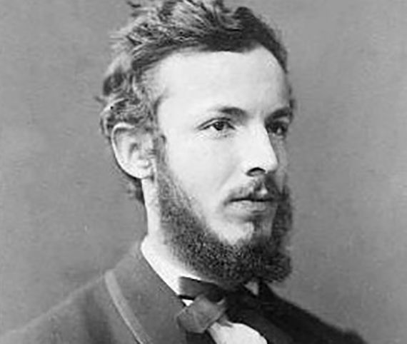
Georg Cantor (1845-1918)
Born in St. Petersburg
Father, a Danish Lutheran merchant (born Jewish)
Mother, a Roman Catholic
Moved to Frankfurt in 1856 and entered boarding school in Darmstadt; graduated in 1860
In 1862 he entered the University of Zurich, where his father wanted him to be an engineer, but…

Slide 5
Georg Cantor (1845-1918)
After his father’s death in 1863 he transferred to the University of Berlin to study mathematics
University of Berlin, 1863-1867
His dissertation was on Number Theory
After a brief teaching position at a Berlin girls’ school he obtained a faculty position at the University of Halle, where he continued to pursue number theory

Slide 6
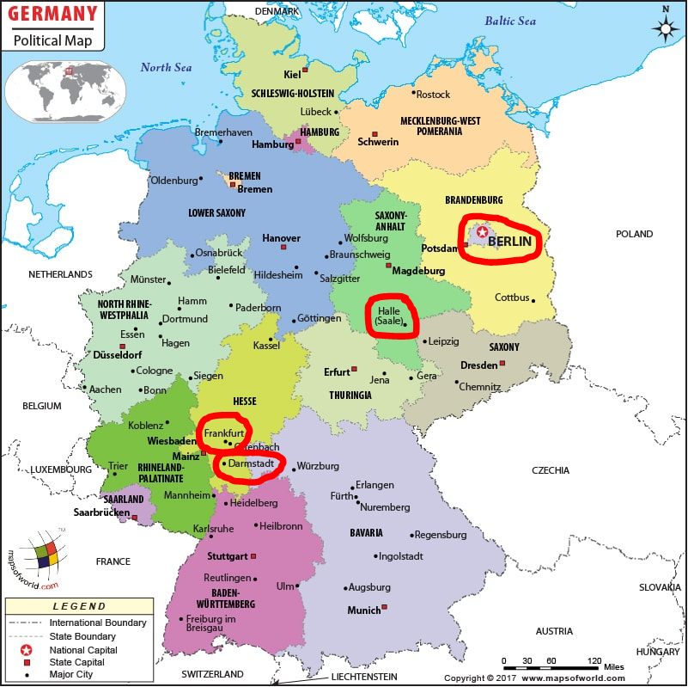

Slide 7
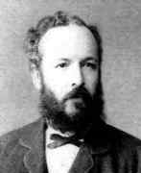
Georg Cantor (1845-1918)
In 1874 Cantor married Vally Guttmann
They had 6 children over the next 12 years
He was promoted to Extraordinary Professor in 1872, and then Full Professor in 1879
His first hospitalization for depression was in 1884
He took some time off from mathematics to study philosophy and literature (he believed that Francis Bacon might have authored Shakespeare’s plays)
Battles with mental health resumed in 1899, and he died in poverty and alone, in a sanitarium in 1918

Slide 8
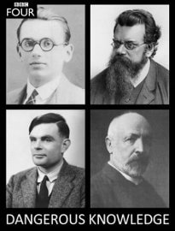
Dangerous Knowledge
BBC Documentary
thoughts? questions? other responses?

Slide 9
Set Theory
What is our (21st century) understanding?
Bolzano (1847)
Set: “an embodiment of the idea or concept which we conceive when we regard the arrangement of its parts as a matter of indifference”
Cantor & Dedekind (1867 - 1872)
Crelle’s Journal & Kronecker (1874-8)
“I see it, but I don’t believe it!” (1877)

Slide 10
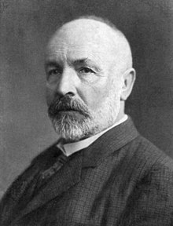
Georg Cantor (1845-1918)
A set is a Many that allows itself to be thought of as a One.

Slide 11
Infinite Hotel
Finite hotels: “No vacancy” means … ?
Infinite hotel: “No vacancy” means be creative!
One new guest arrives
A large (but finite) number of guests arrive
An infinite number of guests arrive
Several waves of infinite guests arrive
An infinite number of waves…
When is it impossible to find room for more guests?

Slide 12
Set Theory
A set is a collection of objects in which
the elements are not ordered, and
there are no duplicates
Sets can be specified explicitly
A = {a, b, c} B = {1, 2, 3, 4} C = {red, blue, green}
$ℕ=\{0, 1, 2, 3, …\}$ $ℤ=\{…,−2,−1, 0, 1, 2,…\}$
They can also be specified implicitly
D = {x | x is even} $ℚ=\left\{\frac{p}{q} \right|p,q∈ℤ, q≠0\}$

Slide 13
Cardinal Numbers
How big is a set?
The size of a set is the number of elements it contains. This is called the cardinality of the set. And the numbers that can be used for this are called cardinal numbers.
Cantor: two sets have the same cardinality if their elements can be put into 1-1 correspondence
Finite example
Infinite examples

Slide 14
Set Theory
Cardinality: the number of elements in a set (or equivalently, the size of a set)
|A| represents the cardinality of set A
$\left|\{a,b,c,d\}\right|=4$ $\left|\{red, blue, green\}\right|=3$
$\left|ℕ\right|=\left|\{0, 1, 2, 3, …\}\right|=ℵ_{0}$
$ℵ_{0}$ is the symbol Cantor used to represent the cardinality of the natural numbers
Aleph is the first letter of the Hebrew alphabet
Cantor had an interest in Medieval Jewish Mysticism

Slide 15
$ℵ_{0}$ vs. ∞
∞ is not a number!
It is an abstract concept or idea, and is ambiguous
It still has built-in Greek bias against the infinite
It is generically applied to anything and everything that lies beyond the realm of the finite
$ℵ_{0}$ on the other hand is a number
Cantor’s genius is to give a name, for the first time, to a number that is not finite.
By defining it as the cardinality of the natural numbers, it is incredibly precise and specific

Slide 16
Relative Cardinality
Do the following pairs of sets have the same cardinality?
{a, b, c, d} & {£, ®, §, µ}
{red, blue, green} & {Denver, Chicago}
How did you determine your answer?
What about these:
{0, 1, 2, ...} & {1, 3, 5, ...}
$ℕ$ & $ℤ$
We need a better technique than counting

Slide 17
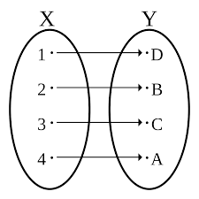
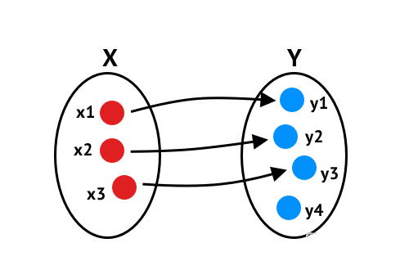
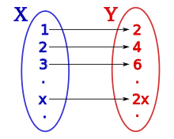
1-1 Correspondence
Class Activity
January – June vs. July – December
Handshakes
Pairing up elements from two sets (so that they are shaking hands) creates a 1-1 correspondence between the two sets.
If there are elements on either side that don’t have a match, then the sets are not the same size.

Slide 18
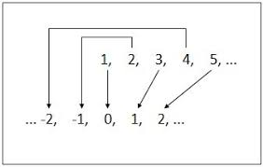
$$ℵ_{0}$$
$\left|ℕ\right|=ℵ_{0}$ by definition
$\left|\{x|x is even\}\right|=ℵ_{0}$ by previous slide
$\left|\{x^{2}|x∈ℕ\}\right|=ℵ_{0}$ by Galileo’s paradox
$\left|ℤ\right|=ℵ_{0}$ by ... ?
$\left|ℚ\right|=ℵ_{0}$
Wait, what?? No, this is too much to take! Isn’t it?

