Slide 1
To ∞ and Beyond...

Slide 2
Nicholas of Cusa
(1401-1464)
A finite intellect ... cannot by means of comparison reach the absolute truth of things.
Being by nature indivisible, truth excludes ‘more’ or ‘less’, so that nothing but truth itself can be the exact measure of truth....
In consequence, our intellect, which is not the truth, never grasps the truth with such precision that it could not be comprehended with infinitely greater precision.

Slide 3
Infinity in the Renaissance:
God, Art, & Math
FYS 1023
David J. Stucki

Slide 4
God
Recall: Maimonides (1135-1204) developed an argument (proof) of God’s existence based on the impossibility of the infinite
Aquinas pushed this farther, concluding that “God and God alone is infinite”
  Lines are not infinite, but only as long as is required for mathematical analysis
  Mathematics is quantifiable, God is not
This created a conceptual chasm between theology and mathematics, placing infinity on the side of theology
(where it remained for centuries)

Slide 5
God
During the Middle Ages monotheistic religion was the central driving influence, culturally & intellectually
  Judaism, Christianity, & Islam became the dominant world religions in the West
  Throughout Europe, church and state were deeply inter-connected
Many speculations on the infinite:
  Is time eternal – no beginning or end?
  Is God infinitely powerful?
    Can He create a stone so heavy that He can’t lift it?

Slide 6
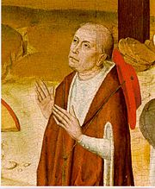
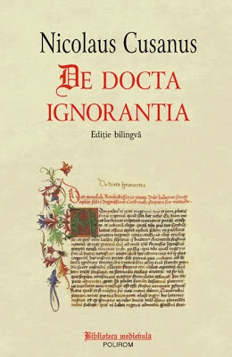
God
Nicholas of Cusa (1401-1464)
  German Cardinal
  On Learned Ignorance (1440)
  “Wisdom is an awareness of the limits of our mind”
The road to infinity is the path to God
  Finite beings are partial appearances of the infinite
  God is as immanent as He is transcendent
  From our perspective, the natural world is infinite, but from God’s perspective it is finite; so it is ‘privatively infinite’, that is lacking boundary
  God’s infinity on the other hand is negative, or from abundance

Slide 7
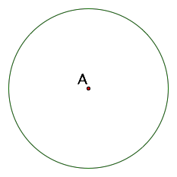
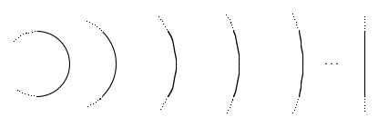
God
Cusa’s Coincidence of Opposites
  Circles & Polygons (à la Archimedes)
  Rest vs. Motion: opposites? – Not at infinity
    If a point is moving around the circle while A rests
    What happens when its speed becomes infinite?
  Straight vs. Curved
  The center of the infinite circle is “everywhere and nowhere”: theological implications
  The incarnation of Jesus: the orthodox view is a coincidence of opposites—fully human and fully God

Slide 8
Space
Ancient & Medieval view: finite cosmos
Cusa: “God is the center and circumference of all the stellar regions”
  Although medieval in his views (Cusa was firmly Aristotelianin his cosmology), his mathematical philosophy was neo-Platonic and appears to foreshadow the 17th century infinite universe of Newton
Maimonides: “The eternal God is a dwelling place…” (Deuteronomy 33:27)
  Again with a medieval world view, Maimonides is inverting the relationship between God & the world.

Slide 9
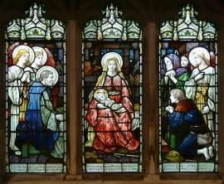
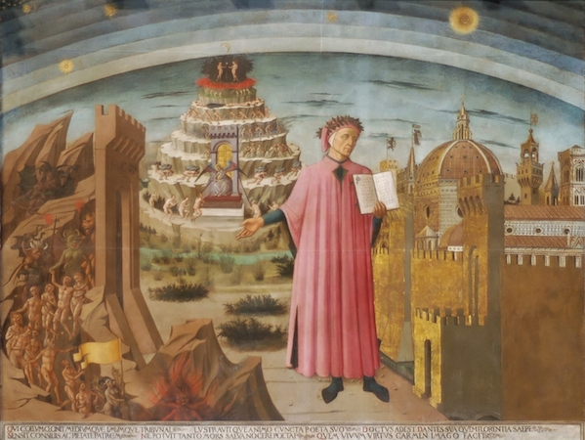
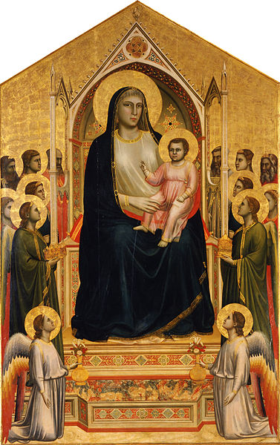
Art
Before the 15th century, art lacked perspective, lacking depth (2D vs 3D)
Art was for looking AT, not INTO.
Spiritual vs. Physical

Slide 10
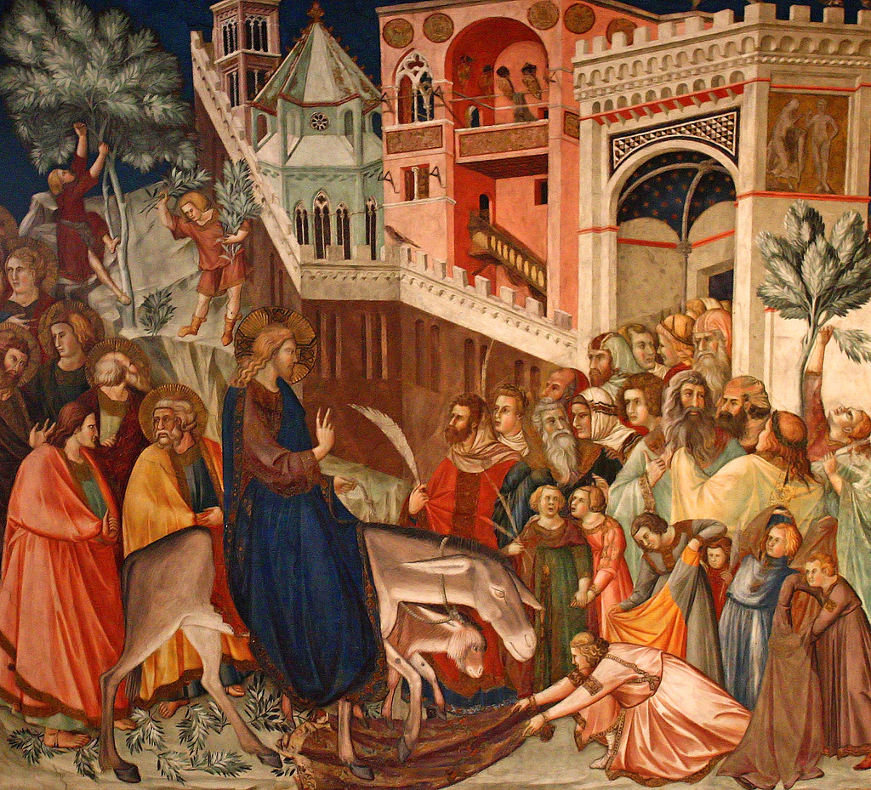
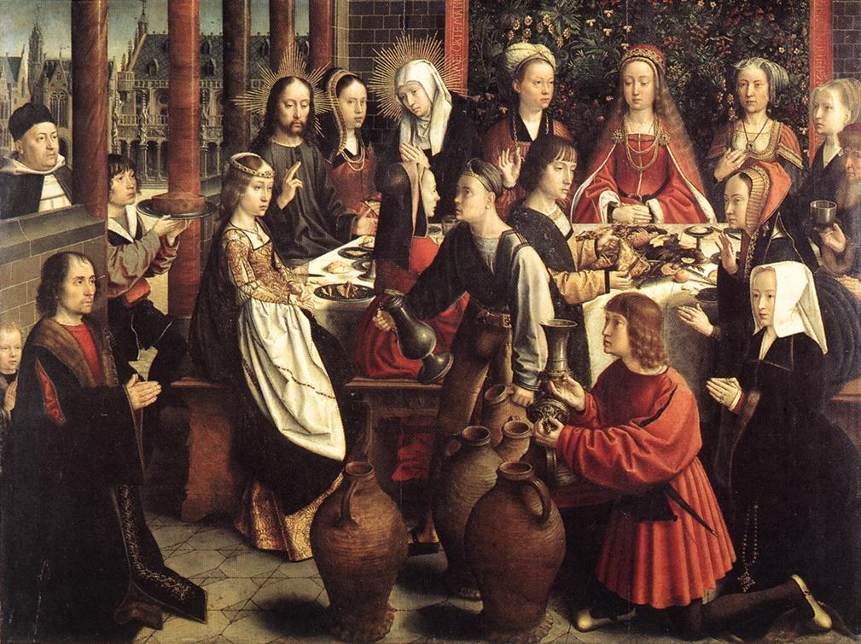
Art
The transition in the 15th century used window & mirror metaphors to rethink the use of space
This transformation was accomplished by Brunelleschi (1377-1446) and Alberti (1404-1472), who discovered linear perspective
Video

Slide 11
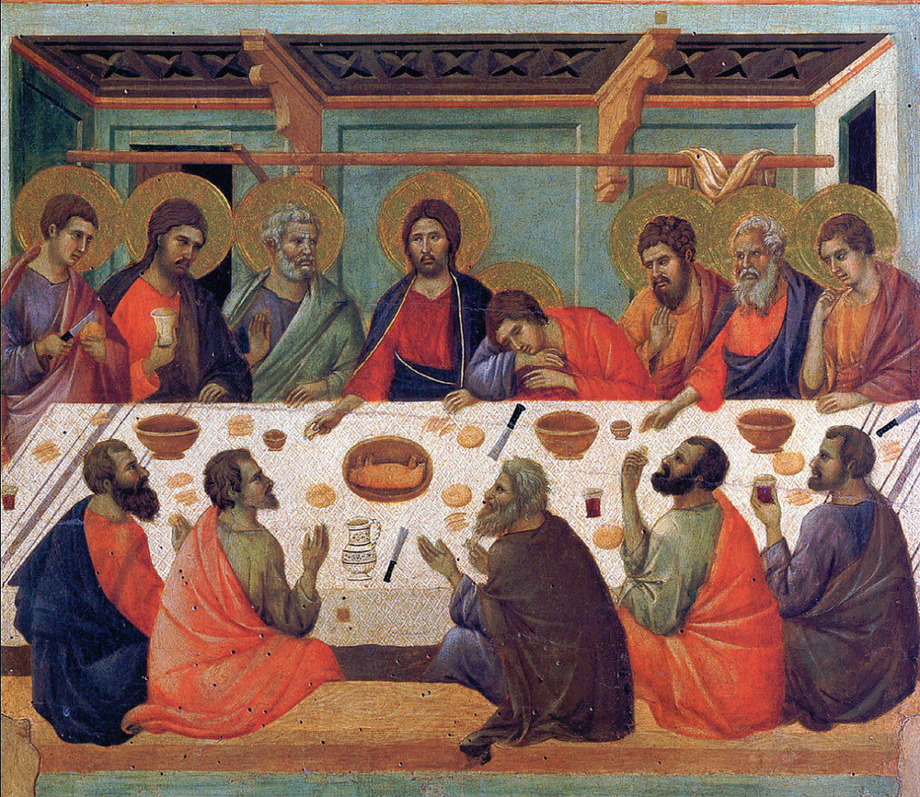
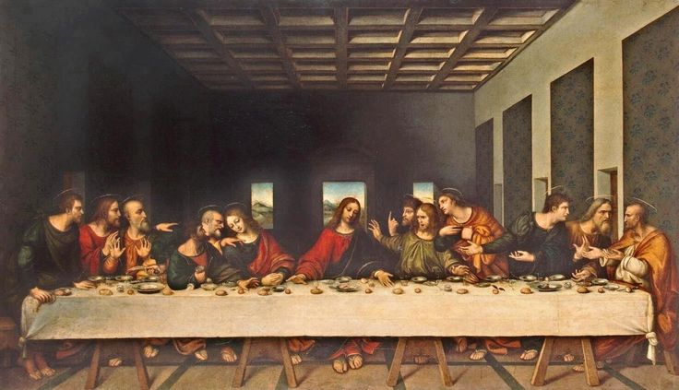
Last Suppers before and after Brunelleschi

Slide 12
Art
The vanishing point of Brunelleschi is the entry of infinity into art via geometry.
Or alternately, the entry of infinity into geometry via art.
Perspectival drawing/painting provides a visual mechanism for embracing infinity without the phobias of the Greeks.

Slide 13
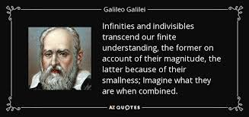
Math
Integral Calculus
  Determining the areas of curved regions
  Begins by approximating the results with a sum of rectangles.
  Continues by increasing the number of rectangles, while decreasing their widths

Slide 14
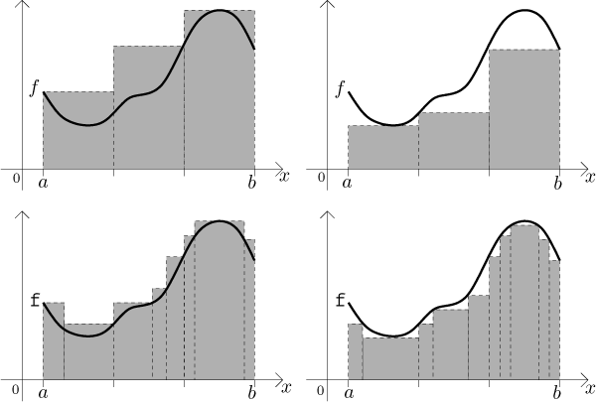
Math
Fitting a variety of rectangles to a curve
The narrower the rectangles, the smaller the error

Slide 15

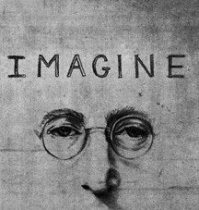
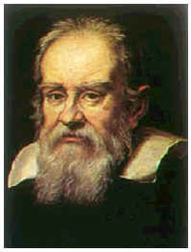
Math
Imagine:
  Make the individual rectangles infinitesimally narrow…
  This will require there to be an infinitely large number of rectangles…
  What happens to the error?
    IT VANISHES!! (i.e., it becomes zero)

