Slide 1
To
and Beyond...

Slide 2
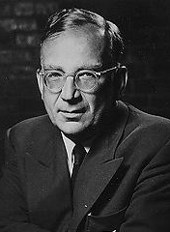
George Gamow (1904-1968)
There was a young fellow from Trinity, Who took the square root of Infinity. But the number of digits, Gave him the fidgets; He dropped Math and took up Divinity.

Slide 3
Alert
Midterm exam Friday, November 1

Slide 4
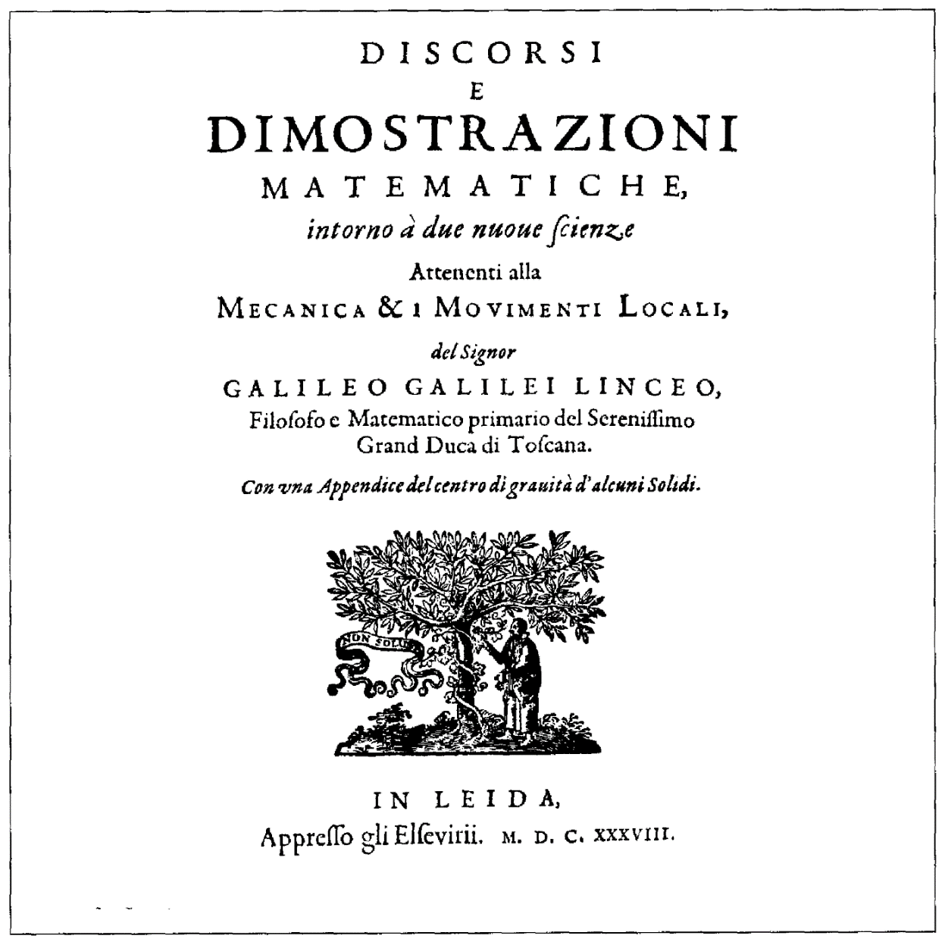
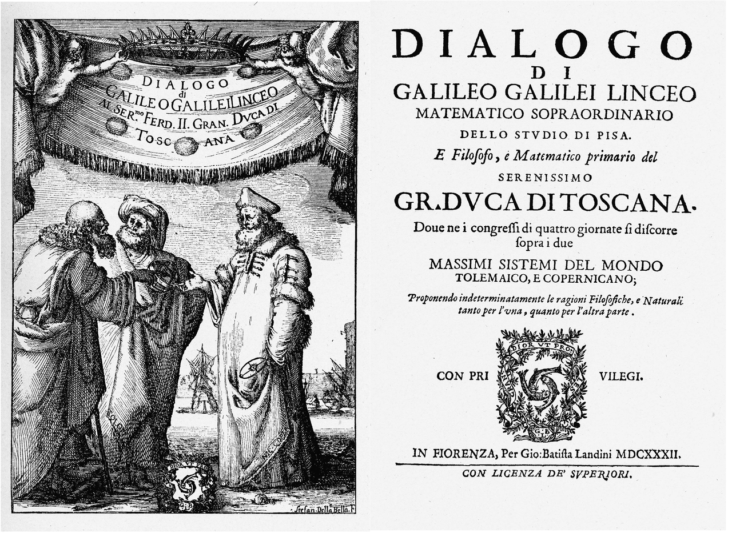
Galileo’s Paradox
“Two New Sciences”
Discourses and Mathematical Demonstrations Relating to Two New Sciences
Published in 1638
His final book, it was written partly in Italian and partly in Latin
His previous book, Dialogue Concerning the Two Chief World Systems, got him in trouble with the Roman Inquisition which placed him on house arrest under suspicion of heresy
Both books took the classical form of dialogues between two philosophers and a layman

Slide 5
Galileo’s Paradox
Salviati: represents Galileo’s views
Sagredo: an intelligent layman
In Two Chief World Systems he starts as a neutral party
In Two New Sciences he represents Galileo’s views in the middle of his life
Simplicio:
In Two Chief World Systems he is follower of Aristotle, who presents the traditional view held by the Church leaders in Rome
In Two New Sciences he represents Galileo’s views in the early part of his life

Slide 6
Galileo’s Paradox
Simplicio: Here a difficulty presents itself which appears to me insoluble. Since it is clear that we may have one line greater than another, each containing an infinite number of points, we are forced to admit that, within one and the same class, we may have something greater than infinity, because the infinity of points in the long line is greater than the infinity of points in the short line. This assigning to an infinite quantity a value greater than infinity is quite beyond my comprehension.
Salviati: This is one of the difficulties which arise when we attempt, with our finite minds, to discuss the infinite, assigning to it those properties which we give to the finite and limited; but this I think is wrong, for we cannot speak of infinite quantities as being the one greater or less than or equal to another. To prove this I have in mind an argument which, for the sake of clearness, I shall put in the form of questions to Simplicio who raised this difficulty.
I take it for granted that you know which of the numbers are squares and which are not.

Slide 7
Galileo’s Paradox
Simplicio: I am quite aware that a squared number is one which results from the multiplication of another number by itself; thus 4, 9, etc., are squared numbers which come from multiplying 2, 3, etc., by themselves.
Salviati: Very well; and you also know that just as the products are called squares so the factors are called sides or roots; while on the other hand those numbers which do not consist of two equal factors are not squares. Therefore if I assert that all numbers, including both squares and non-squares, are more than the squares alone, I shall speak the truth, shall I not?
Simplicio: Most certainly.
Salviati: If I should ask further how many squares there are one might reply truly that there are as many as the corresponding number of roots, since every square has its own root and every root its own square, while no square has more than one root and no root more than one square.

Slide 8
Galileo’s Paradox
Simplicio: Precisely so.
Salviati: But if I inquire how many roots there are, it cannot be denied that there are as many as the numbers because every number is the root of some square. This being granted, we must say that there are as many squares as there are numbers because they are just as numerous as their roots, and all the numbers are roots. Yet at the outset we said that there are many more numbers than squares, since the larger portion of them are not squares. Not only so, but the proportionate number of squares diminishes as we pass to larger numbers, Thus up to 100 we have 10 squares, that is, the squares constitute 1/10 part of all the numbers; up to 10000, we find only 1/100 part to be squares; and up to a million only 1/1000 part; on the other hand in an infinite number, if one could conceive of such a thing, he would be forced to admit that there are as many squares as there are numbers taken all together.

Slide 9
Galileo’s Paradox
Sagredo: What then must one conclude under these circumstances?
Salviati: So far as I see we can only infer that the totality of all numbers is infinite, that the number of squares is infinite, and that the number of their roots is infinite; neither is the number of squares less than the totality of all the numbers, nor the latter greater than the former; and finally the attributes "equal," "greater," and "less," are not applicable to infinite, but only to finite, quantities. When therefore Simplicio introduces several lines of different lengths and asks me how it is possible that the longer ones do not contain more points than the shorter, I answer him that one line does not contain more or less or just as many points as another, but that each line contains an infinite number.

Slide 10
Assignment
Based on Galileo’s observation that there is this paradox in the number of perfect squares:
Come up with 3 additional examples similar to his
Each example should identify two infinite sets of numbers
One of those sets should be contained within the other (it is a subset)
Bring your typed lists on Monday

Slide 11
Activity
Playing with infinite series

