Slide 1

Immersive Experiences and the READY Plan

Slide 2
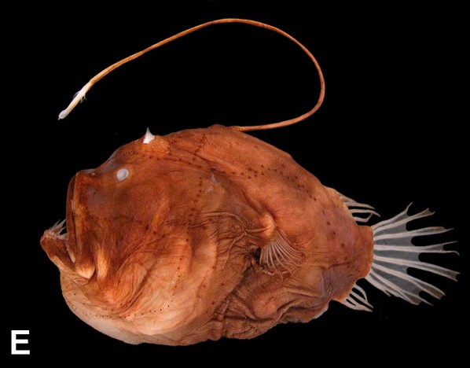
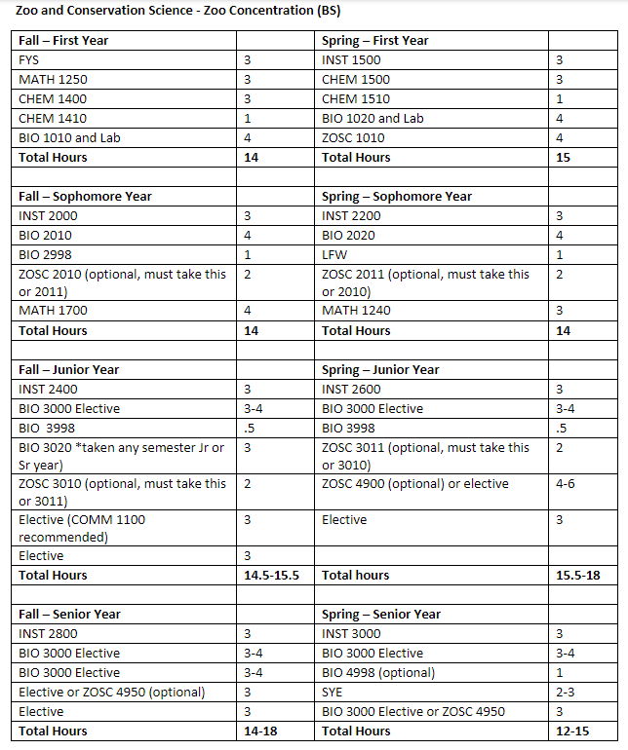
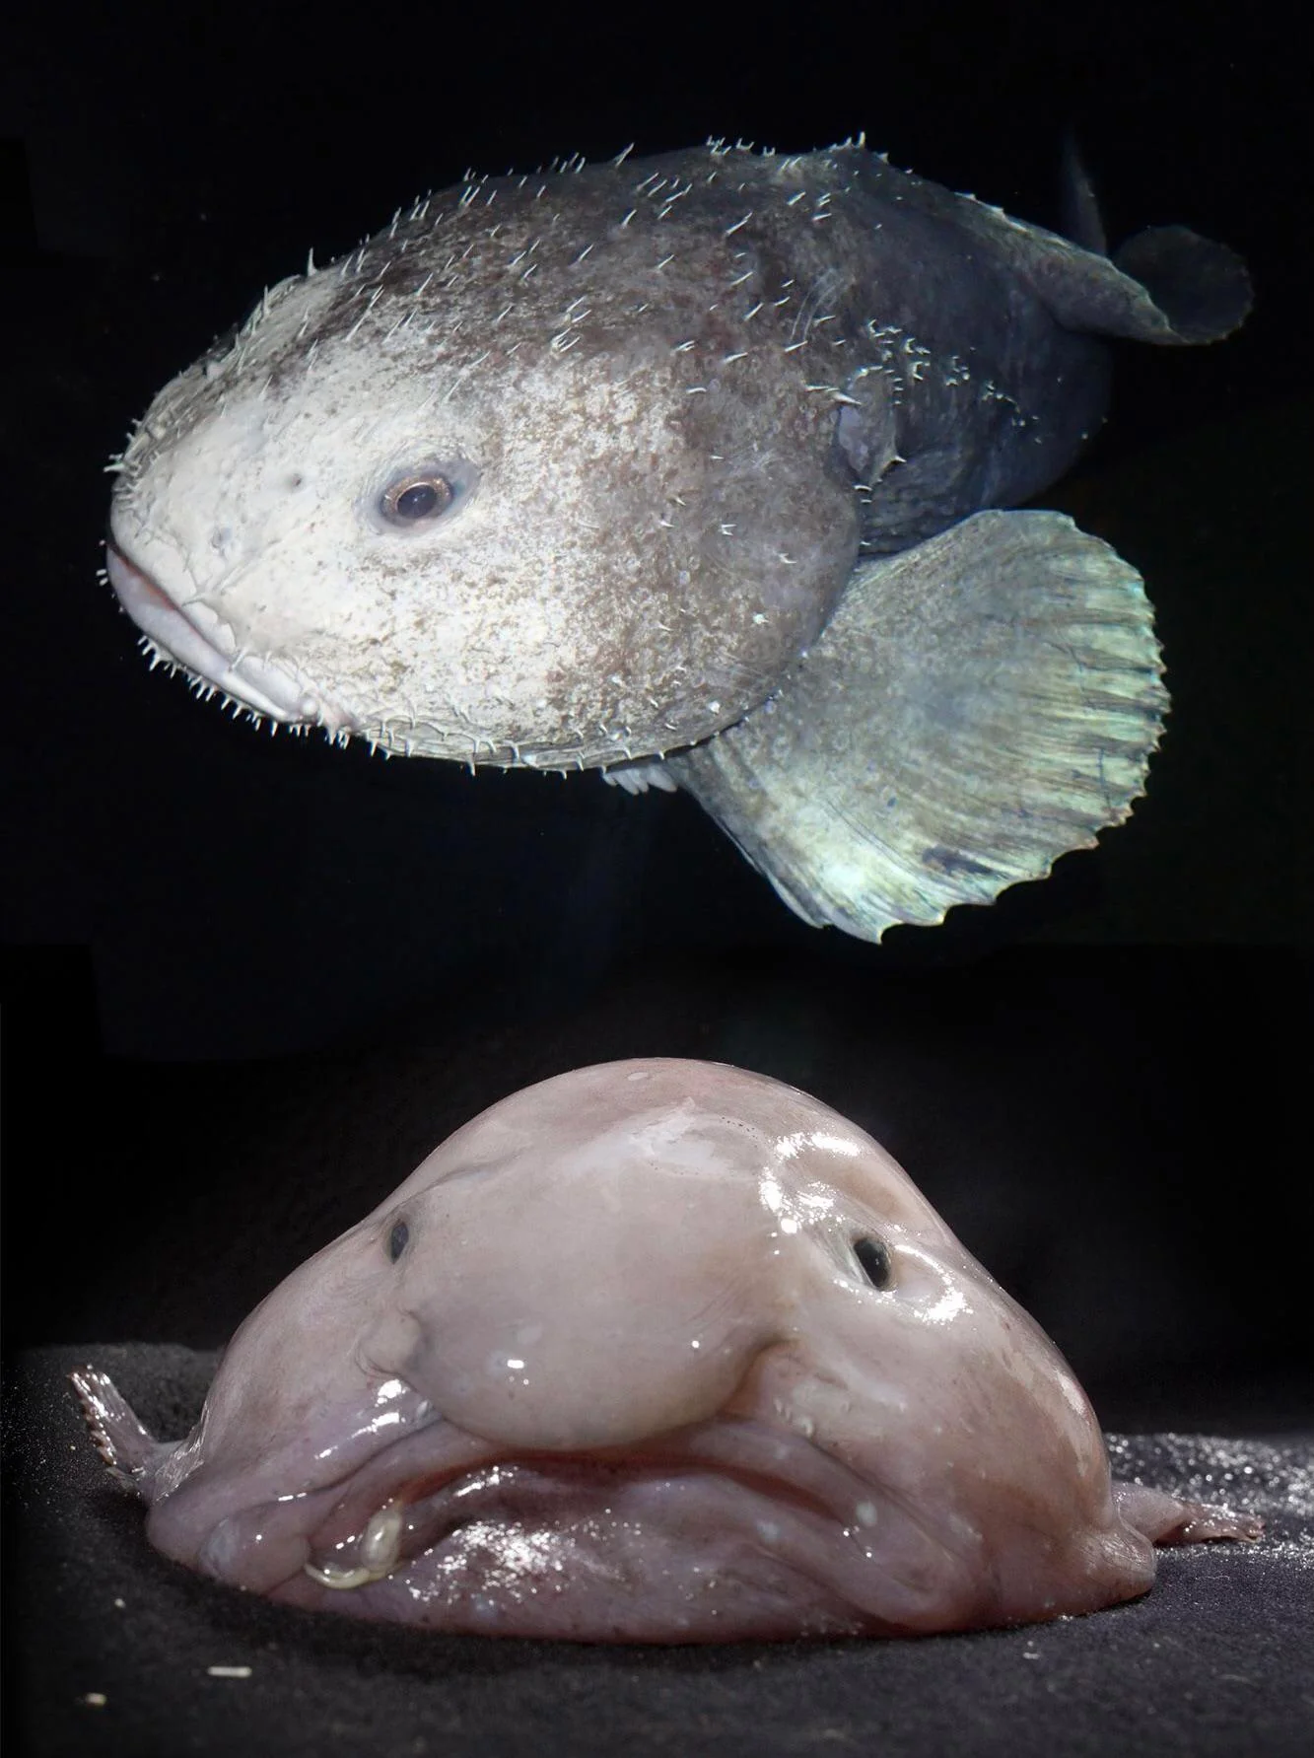
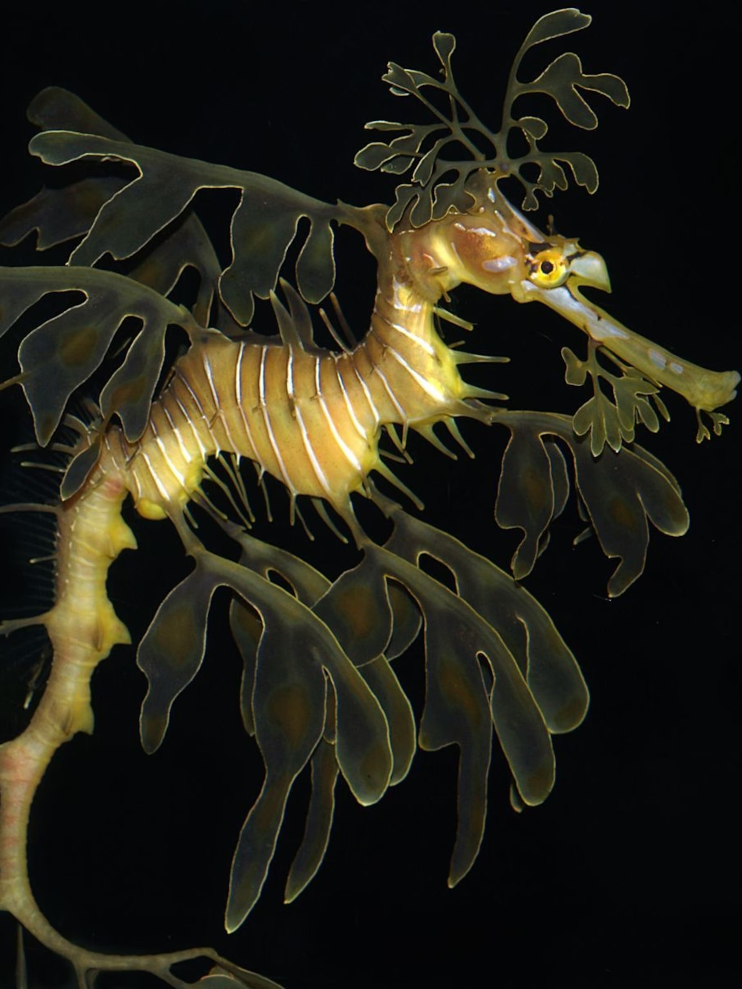

Slide 3
Focus for Today:
What Do You Want to Become?
What's Important to You?
What Immersive Experiences are You Interested In?

Slide 4

3 Important Questions
3 Important Questions video--Vishen Lakhiani
Notes:
The 3 Most Important Questions to Ask Yourself (youtube.com)

Slide 5
Immersive
Experiences
Research
Off-Campus Learning Experiences
Global and Intercultural Experiences
Leadership
Creative Work
Community Engagement
Internships and Professional Experiences
Notes:
We’ve talked about different types of immersive experiences. Today we are going to take a deeper dive into each type of experience and begin exploring your interests relating to immersive experiences. You may have an immersive experience you are already planning to complete or maybe you have not yet thought through this experience.

Slide 6
Exploring Immersive Experiences
Go
Go to otterbein.edu/ready
Scroll
Scroll to READY Guides by Major
Begin
Begin exploring

Slide 7

READY Plan
Pre-Otterbein Reflection worksheet
1
Resume
2
Life Design (begin in-class today)
3
READY Plan 1000-word minimum paper
4
Due Date:
Notes:
Now we will dive in to the FYS Reflection Paper assignment. Share the due date (consult with the FYS instructor).
Today we are going to start on Parts 1-3 of this assignment so that you have a good foundation to complete Part 4.

Slide 8
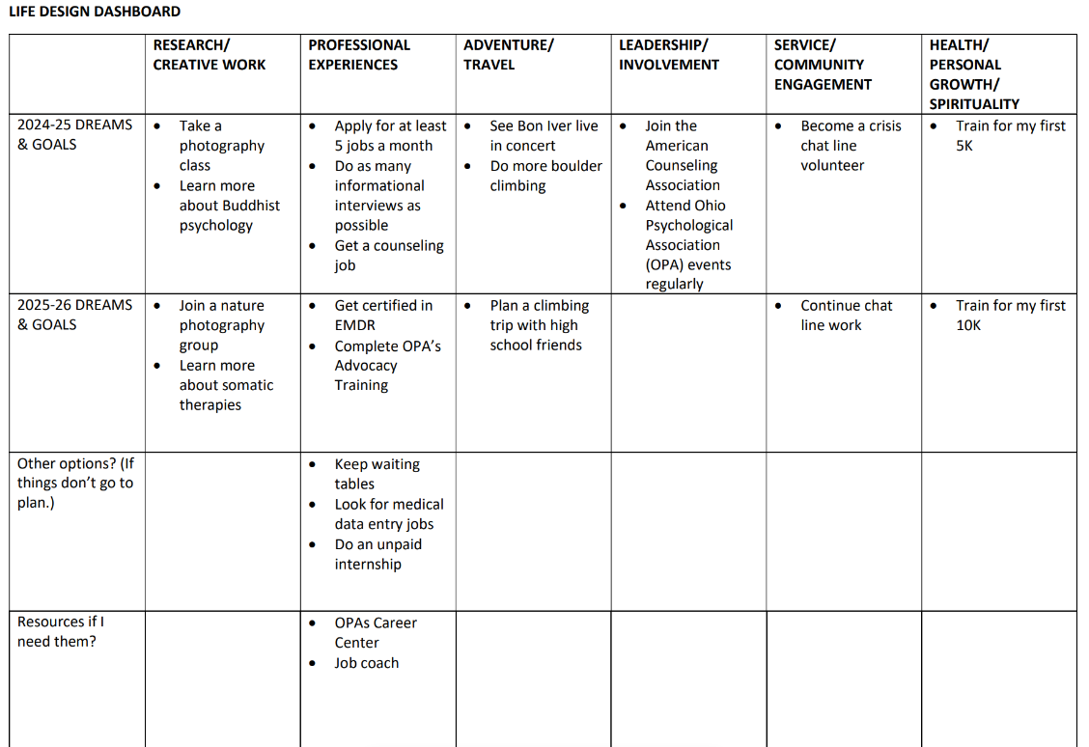
Part 3
Life Design
Notes:
Next we move on to Part 3. This worksheet will help you develop a plan for your time at Otterbein. You will also look forward to the first two years after graduation, five years post-graduation, and then longer term. Write specific goals as to what you would like to achieve during those years. Highlight your goals using bullet points on the worksheet and the identify courses and experiences you plan to pursue. Think about your career, your passions, what you hope to accomplish in your free time.

Slide 9
Part 4
Who are you?
What’s important to you?
Who do you want to become?
READY Plan 1000 word paper
Notes:
You will want to refer to the READY Plan Assignment, but as a reminder, it has the description of your Part 4 1,000 word paper. This will be a reflection of everything that’s come before and anticipating the next chapters in your life path and work path. Consider the insights you made in your wandering map, and other relevant exercises. At least 1000 words in writing.
- Who are you? What previous experiences taught you the most? Inspired you the most? Shaped you the most? What are your strengths and challenges? What’s your learning style? How do you relate to new ideas, questions, or contexts?
- What’s important to you? What fuels, inspires, and motivates you? What have you discovered about your individual passions and values -- inside and outside the classroom?
- Who do you want to become? What new life, work, service, leadership, creative, athletic, or academic experiences are most important to you now and why? What makes you feel most and least empowered as you consider your goals for the future? What choices will you make next – as you anticipate your Otterbein journey -- to align your future with the things that matter most to you? What resources or guidance do you need? What options will you consider if things don’t go to plan.

Slide 10
Reminder:
Oct. 28 is the last day to drop a class with a W

Slide 11
Exit Ticket

