Slide 1
The Divine Infinite
FYS 1023
David J. Stucki

Slide 2
Alerts
35 of 46 FYE reports (0 days left)
2 per person due today
15 of you have 2 or more done
5 of you have 1 done
3 of you have 0 done
Next two weeks are messy
M 10/14: fall break, W 10/16: normal, F 10/18: team consent
M 10/21: Katie & CB, W 10/23: review, F 10/25: midterm

Slide 3
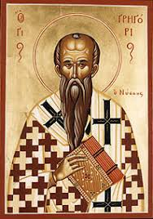
St. Gregory of Nyssa (335-395 AD)
One of the Cappadocian Fathers of the Church
First to argue that God was not only infinite, but theologically was actually infinite
It was actually a necessary step in an argument he wanted to make about the nature of Jesus' divinity
A consequence was that God is essentially incomprehensible to the limited minds of finite creatures

Slide 4
St. Gregory of Nyssa (335-395 AD)
Believed that both in life and in the afterlife man progresses towards the unreachable knowledge of God, continually transcending what has already been accomplished
Three stages of spiritual growth:
initial darkness of ignorance
spiritual illumination
a darkness of the mind in mystic contemplation of the God who cannot be comprehended

Slide 5
St. Gregory of Nyssa (335-395 AD)
An argument based on God's unchangeability
Two assumptions: God is unchangeable & attributes can only be limited by reference to their opposites
Because God is unchangeable, there is no opposite in his essence
If God is superior to the realm of opposites, where nonbeing and evil also are, he must be perfect
Because God cannot be limited in his goodness (or other attributes), he is unlimited
Being without limits is identical with infinity
—Infinity as a Transformative Concept in Science and Theology, by Wolfgang Achtner

Slide 6
St. Gregory of Nyssa (335-395 AD)
In the end, he opened up a number of new horizons (theological, spiritual, ethical, & intellectual) in his theology of the infinite:
A firm conception of God as infinite, overthrowing the finite view of God from Aristotle's metaphysics
He asked how it is that we can relate to this infinite God
He claimed that it is not the mind or intellect, but the ascending and purifying spirit or consciousness and moral virtue that are ways to approach God, but as a limiting process (à la Zeno) that never ends
—Infinity as a Transformative Concept in Science and Theology, by Wolfgang Achtner

Slide 7
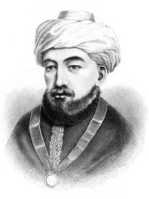
Maimonides (1135-1204 a.d.)
Jewish Scholar, both theological and scientific
Born in Cordova; head of Jewish community in Egypt.
On Infinity
But as for what is infinite in potentia or accidentally, the existence of such an infinite has, in some cases, been demonstrated: thus it has been demonstrated that the division of magnitudes to infinity is possible in potentia, and likewise the division of time to infinity. Another case is an object of speculation: namely, the existence of what is infinite by way of succession. This is what is called the infinite by accident. And it consists in a thing coming to exist after the passing-away of another thing, the latter’s coming to exist after the passing-away of a third thing, and so forth to infinity.

Slide 8
Maimonides (1135-1204 a.d.)
A[n] … argument was put forth…in Islamic culture by the Jewish sage Moses Maimonides…in his Guide for the Perplexed. Unmistakably also basing his physical framework on Aristotle, Maimonides presented the causal argument, noting that “the series does not extend to infinity” because:
impossible is the existence of an infinite series of causes, namely, that a certain thing should be the cause of another thing, but itself the effect of another cause, which again is the result of another cause, and so on to infinity, …[and so we must stop at] the Creator…. He is therefore the ultimate cause.
As with [Aristotle] the fulcrum of the logic for Maimonides was the impossibility of infinity, and this led to his proof of God’s existence.
—Idolatry & Infinity: Of Art, Math, & God, by David R. Topper

Slide 9
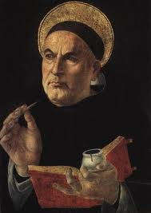
St. Thomas Aquinas (1225-1274 a.d.)
Dominican Priest
Synthesized Aristotle’s philosophy with Christian theology
On Infinity
The existence of an actual infinite multitude is impossible. For any set of things one considers must be a specific set. And sets of things are specified by the number of things in them. Now no number is infinite, for number results from counting through a set of units. So no set of things can actually be inherently unlimited, nor can it happen to be unlimited.

Slide 10
St. Thomas Aquinas (1225-1274 a.d.)
… it should be noted that different ways of knowing (ratio cognoscibilis) give us different sciences. The astronomer and the natural philosopher both conclude that the earth is round, but the astronomer does this through a mathematical middle that is abstracted from matter, whereas the natural philosopher considers a middle lodged in matter. Thus there is nothing to prevent another science from treating in the light of divine revelation what the philosophical disciplines treat as knowable in the light of human reason. (Summa theologiae, Ia, q. 1, a., ad 2)

Slide 11
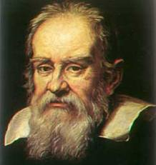
Galileo Galilei (1564-1642 a.d.)
“Mathematics is the language with which God wrote the universe.”
“Philosophy is written in this grand book, the universe ... It is written in the language of mathematics, and its characters are triangles, circles, and other geometric figures;”
“we must say that there are as many squares as there are numbers”

Slide 12
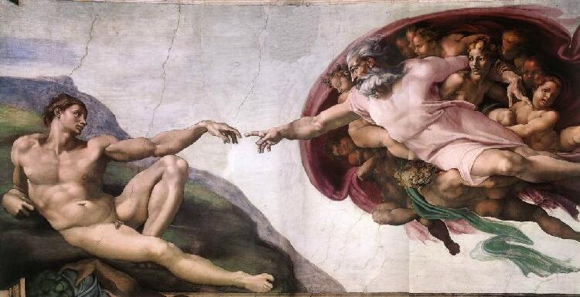
finis… …infini!
Creation of Adam, Michelangelo, 1511

