Slide 1

Preparing for Spring 2025

Slide 2

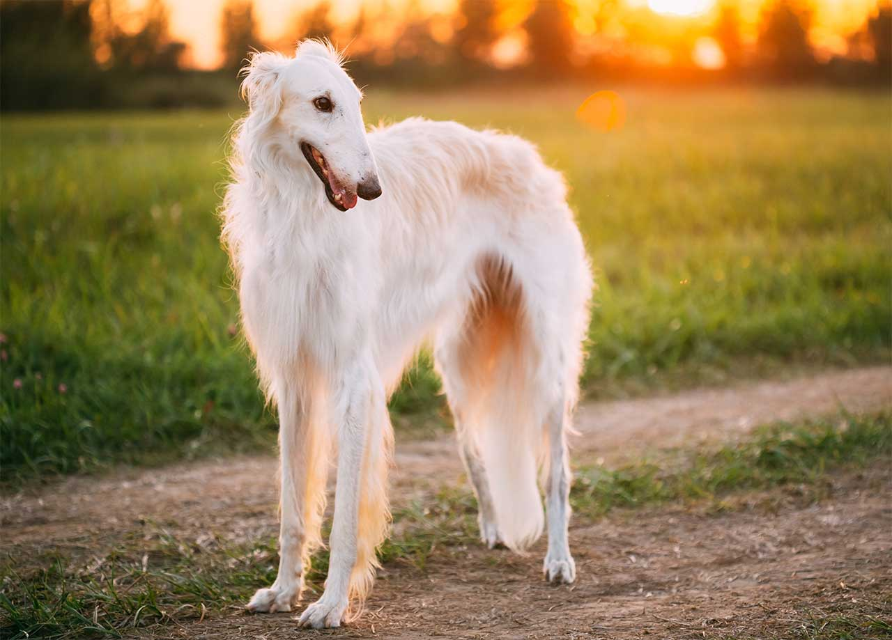
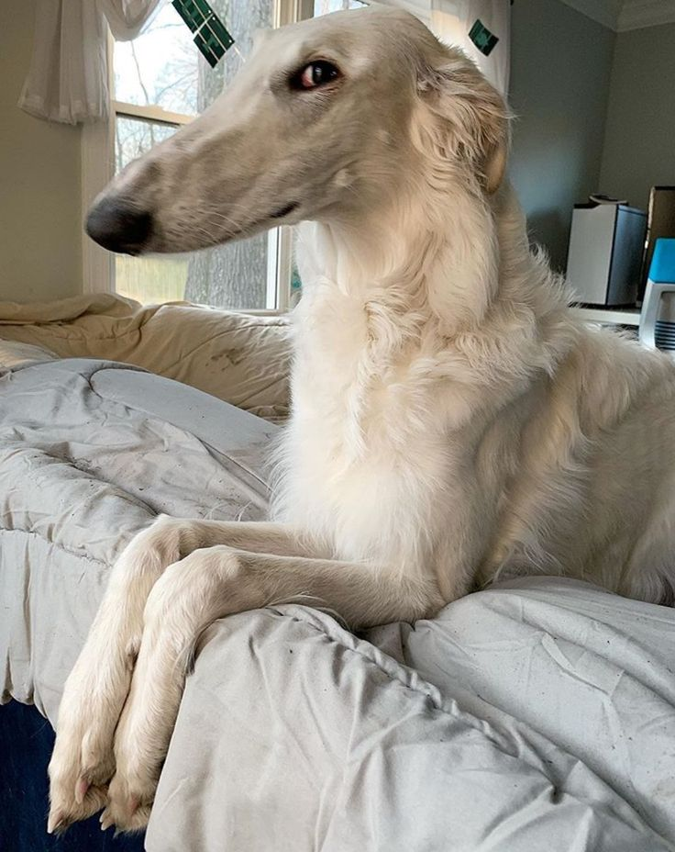
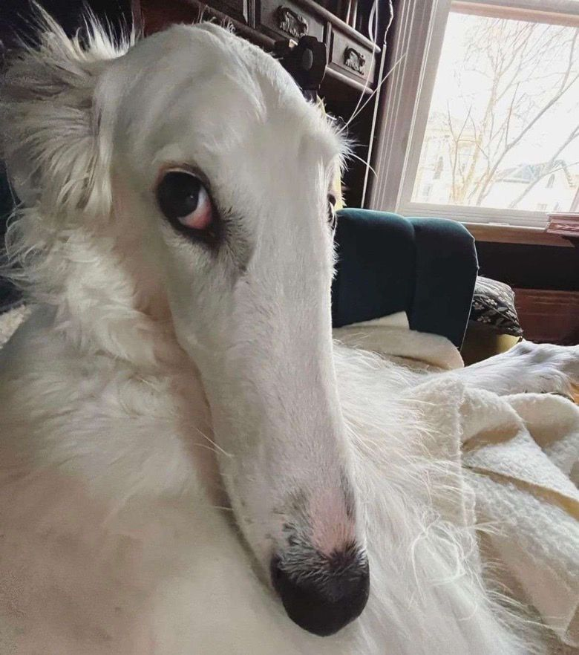
Borzoi
Russian Wolfhound
From a Russian word meaning “fast”
“Noodle horse”
Associated with Russian aristocracy and mass-slaughtered after 1917 revolution
Relatively rare today
Affectionate, calm, but very stubborn
Total couch potatoes

Slide 3
Focus for Today:
How Do I Schedule Classes?
How Do I Look Up Classes?
How Do I Locate My Advisor?

Slide 4
Reminders
Don’t forget to attend FYS events
https://www.otterbein.edu/fye/
Major and Minor Fair in Roush Hall
Learn about majors and minors you may be interested or explore yours even more!

Slide 5
Academic Advisors
Primarily faculty members
Experts in your major and their field
Majority of their work every day is teaching in the classroom
Not in their office every day, all day
Love to talk about what to do with your major, how to develop a career, etc.
They might suggest classes, but you determine days/time

Slide 6
Meeting With your Advisor
Schedule
Schedule a meeting with your advisor ASAP
Meet
Meet with your advisor every semester.
Email
Send an email to your advisor with the times you are available throughout the week​. Pro Tip: Contact them at least a few weeks ahead of scheduling so you have time to meet with them before your scheduling window opens.
Discuss
Talk to them about your major/s and minor/s. Do you have any concerns to talk through?​
Check-In
Let them know how your classes are going this semester.​
Ask
Ask them for recommendations for next semester’s classes based on your Degree Works and what is being offered.

Slide 7
Communicating with your Academic Advisor
Address them by name.
1
Introduce yourself.
2
Share the specifics of what you would like to get out of your meeting.
3
Offer multiple times that work for your schedule.
4

Slide 8
Sample Email
Dear Professor Miller,
My name is Sarah Smith, a first year Biology major and one of your advisees. I hope this week has treated you well. I am reaching out in order to discuss my spring classes ahead of course registration on October 28. I have some courses pre-selected, but would like to review them with you. Do you have any availability next week? I am free Tuesday and Thursday after 1pm and Wednesday from 11am – 1:30pm. Do you have any of those times work for you?
Thank you,
Sarah Smith

Slide 9
Changing Advisors
Select an advisor
1
Ask the faculty member if they would be willing to advise you.
3
Pick someone in your field of interest
2
If they are willing, email registrar@otterbein.edu to update your advisor
4
If you are unsure who you would like, you will be assigned to a new advisor in your academic department.
5

Slide 10
Logging into Banner
  Go to www.otterbein.edu
  Select the menu sandwich in the top right corner
  Select O-Zone from the top menu bar
  Log-in using your email and password
    If you do not have access or remember your login, please email helpdesk@otterbein.edu.
  Select the Banner icon from the left menu

Slide 11
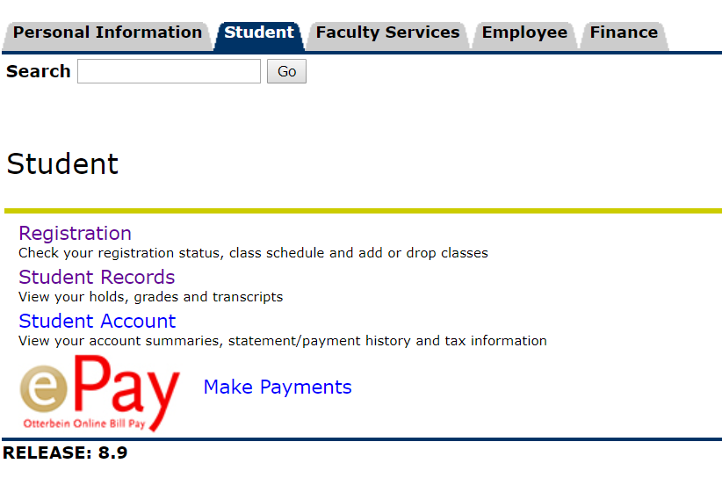
You find your Degree Audit in Self-Service Banner or My Banner. Click on Student Records.

Slide 12
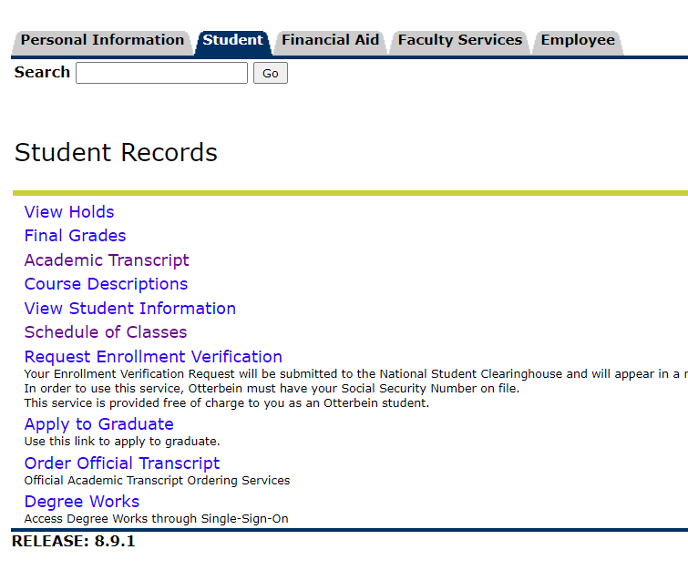
Then click on
Degree Works

Slide 13
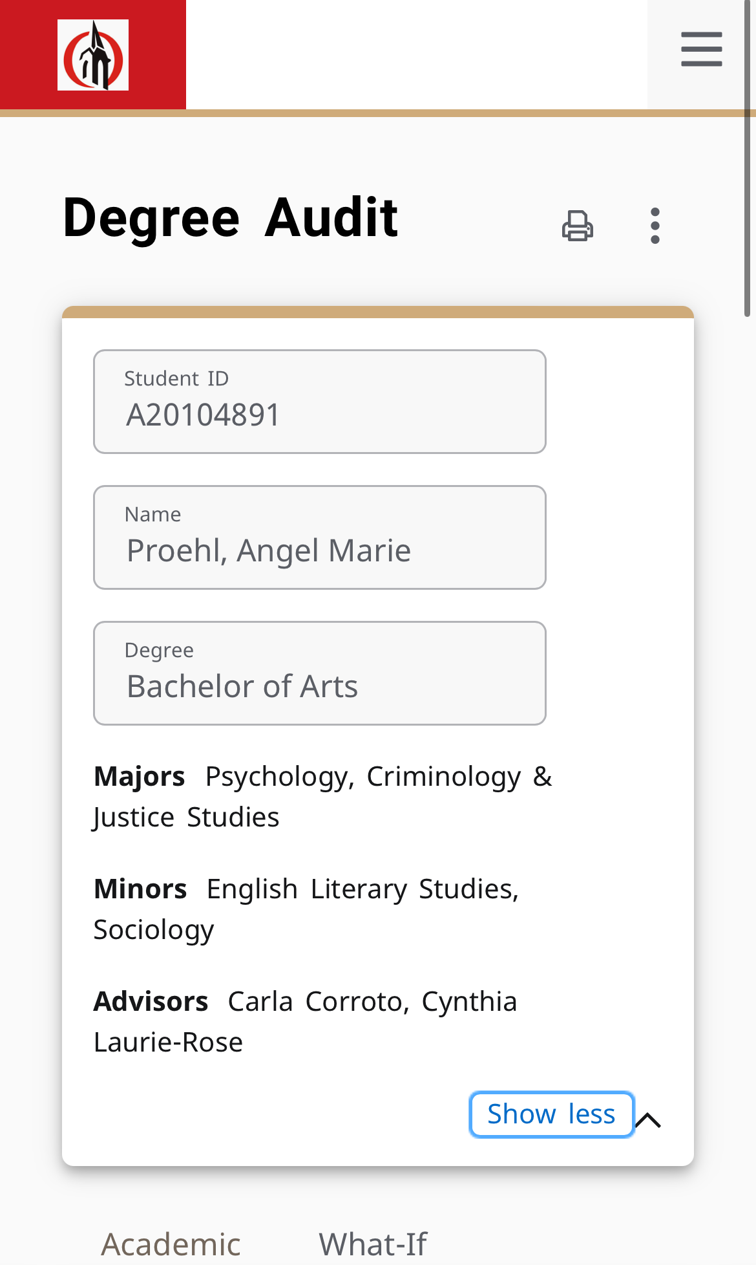
Who is your Academic Advisor?
Once in Degree Works, you can see your major(s), minor(s), and advisor(s) listed.

Slide 14
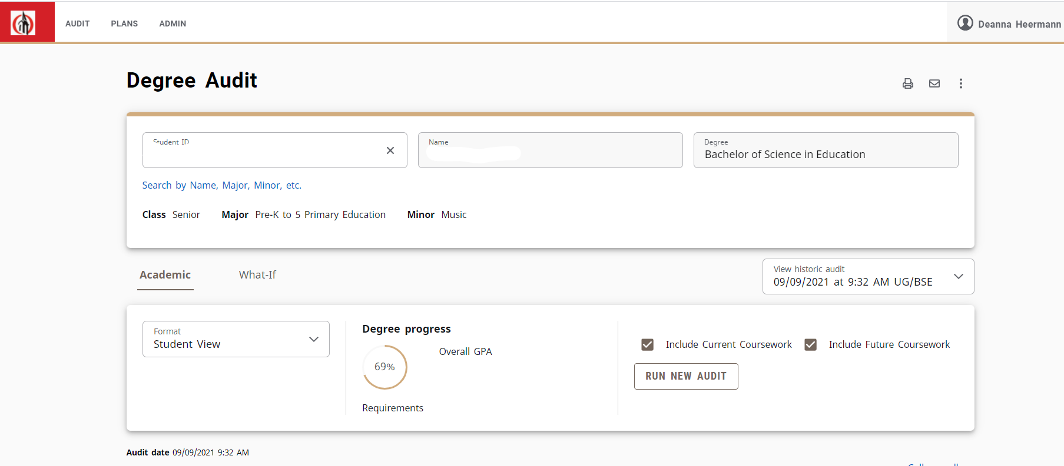

Slide 15
https://www.screencast.com/t/AjZHpyp1B

Slide 16
Run a “What If” to see what your requirements would look like if you switched majors, added or dropped a minor, etc.
Rerun your audit immediately after registering to make sure that the courses you are taking are fulfilling the requirements you thought that they would.

Slide 17
Deciding what classes to take
Review your Degree Works!​
Check what classes are offered in the upcoming semester​
Talk to your advisor to decide which classes you should be taking next semester. Be sure to have a Plan B for any classes that might fill up quickly!​
—or— ​
Schedule a meeting with Student Success and Career Development if your advisor is not able to help you (https://www.otterbein.edu/sscd/)
Talk to other students

Slide 18
Things To Keep in Mind
Most students take 15-16 hours per semester to stay on track to graduation (12-18 is full time)
Students will typically need to take 1 INST class per semester– there are 8 total! If you bring in credits to Otterbein you may be able to skip an INST one semester, but you should NOT be taking more than 1 at a time.​
A balanced schedule:​
Major Classes​
General Education​
Electives

Slide 19

Electives
Classes, or credit hours, taken in addition to your major requirements and general education classes to reach a total of 120 total hours​
Strategies for choosing electives:​
      Second majors​
      Minors​
      Classes that will teach you skills, but not necessarily a full minor (think of Modern Language classes, an art course, etc.)​
      Classes that are just interesting!

Slide 20

Next Steps
Once you have your classes chosen, all you have to do is register!​
​
Prior to Banner opening, make sure you do not have holds on your account that will keep you from registering. You can check this under the student tab in Self-Service Banner under “View Holds”

Slide 21


Notes:
Adding a class

Slide 22
Notes:
Dropping a class

Slide 23
Notes:
Adding yourself to a waitlist

Slide 24

Registration Dates
Registration will open on the week of October 28th! Be on the lookout for an email from
registrar@otterbein.edu
which will tell you the exact date and time that registration will open for you!

Slide 25

Reminder:
Major and Minor Fair
October 9th, 11am-1pm
Roush Hall, Fisher Gallery

Slide 26
Exit
Ticket

