Slide 1
To
and Beyond...

Slide 2
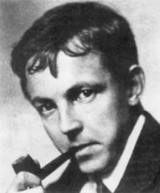
G.H. Hardy (1877-1947)
Archimedes will be remembered when Aeschylus is forgotten, because languages die and mathematical ideas do not. “Immortality” may be a silly word, but probably a mathematician has the best chance of whatever it may mean.

Slide 3
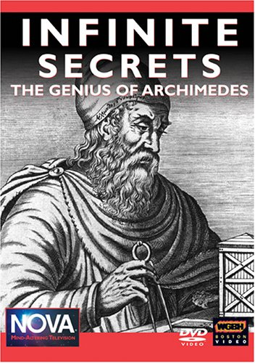
Infinite Secrets: Archimedes (288-212 BC)
https://www.pbs.org/wgbh/nova/archimedes/
First aired on PBS, September 30, 2003
Let's finish...

Slide 4
Whole Class Discussion
Thinking about the Infinite Secrets video (the part we watched last time)
Name one thing that you remember
Everyone participates & no repeated contributions
Thoughts & Discussion...
Writing prompts (essay prep work)
Name one application of infinity (no repeats)
Name one idea or concept treated by multiple authors (no repeats)
Thoughts & Discussion...

Slide 5
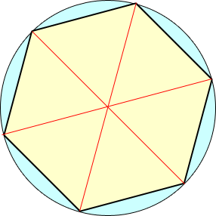
Archimedes Method
He borrowed the general concept from Eudoxus
The method of exhaustion
[Hint: good students who are not familiar with Eudoxus or the method of exhaustion will look them up after class]
Consider the circle whose diameter is 1
The circumference will be what?
$C=2πr=2π\frac{1}{2}=π$
Inscribe a regular hexagon
Each side of the hexagon will be ½
What is the circumference of the hexagon?
$C_{1}=6×\frac{1}{2}=3$

Slide 6
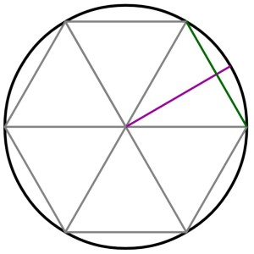
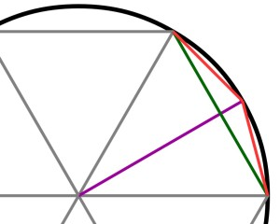
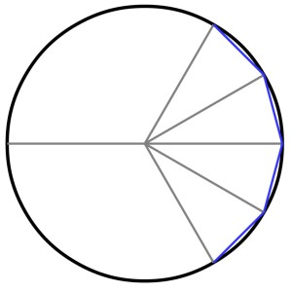
Archimedes Method
To get a better approximation we will double the number of sides
Begin by dividing each triangle in half: the purple line
This line will intersect the green edge of the hexagon at right angles
Each half of the green edge will also be of equal length
Then draw lines from where the purple line hits the circle to the neighboring vertices of the hexagon
Each of these red lines will also be equal in length
If we continue this all the way around the circle we get a dodecagon (12-sided regular polygon)
What is the circumference of the dodecagon?

Slide 7
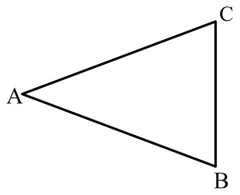
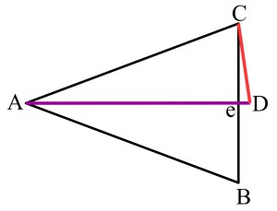
Archimedes Method
Consider the isosceles triangle ABC
recall that this means two sides have the same length
in this case AB & AC both have length ½ since they are radii of the circle
If you bisect angle CAB with line segment AD, where $\overline{AB}=\overline{AD}$
Triangle AeC is a right triangle
Triangle DeC is also a right triangle
So the Pythagorean Theorem applies
To keep the notation simple, let $\overline{Ae}$ = a; $\overline{eD}=b$; $\overline{BC}=s_{1}$; $\overline{CD}=s_{2}$
Then $a^{2}+{\left(\frac{s_{1}}{2}\right)}^{2}=1^{2}$
And $b^{2}+{\left(\frac{s_{1}}{2}\right)}^{2}={s_{2}}^{2}$

Slide 8
Archimedes Method
To keep the notation simple, let $\overline{Ae}$ = a; $\overline{eD}=b$; $\overline{BC}=s_{1}$; $\overline{CD}=s_{2}$
Then $a^{2}+{\left(\frac{s_{1}}{2}\right)}^{2}=1^{2}=1$, which is the same as ${\left(\frac{s_{1}}{2}\right)}^{2}=1−a^{2}$
And $b^{2}+{\left(\frac{s_{1}}{2}\right)}^{2}={s_{2}}^{2}$
We also know that $a+b=1$, so ${\left(a−1\right)}^{2}={(−b)}^{2}$, or $a^{2}−2a+1=b^{2}$
So, ${s_{2}}^{2}={\left(\frac{s_{1}}{2}\right)}^{2}+b^{2}={\left(\frac{s_{1}}{2}\right)}^{2}+a^{2}−2a+1$
${s_{2}}^{2}=\left(1−a^{2}\right)+a^{2}−2a+1=2−2a$
Since $4a^{2}+{s_{1}}^{2}=4$, $({2a)}^{2}=4−{s_{1}}^{2}$, and $2a=\sqrt{4−{s_{1}}^{2}}$
${s_{2}}^{2}=2−\sqrt{4−{s_{1}}^{2}}$
Finally, $s_{2}=\sqrt{2−\sqrt{4−{s_{1}}^{2}}}$

Slide 9
Your turn...
Archimedes Worksheet
Start working on it now, getting help from people around you
Finish it up on your own and turn it in Monday.

