Slide 1
To
and Beyond...

Slide 2
If the doors
of perception
were cleansed,
everything
would appear to man
as it is - infinite.
  William Blake (1757-1827)

Slide 3
ALERT
FYE Reports: 24 of 46
  Two weeks left to get first two reports done
Make sure you get your 3 prompts & essay #1 to me today.

Slide 4
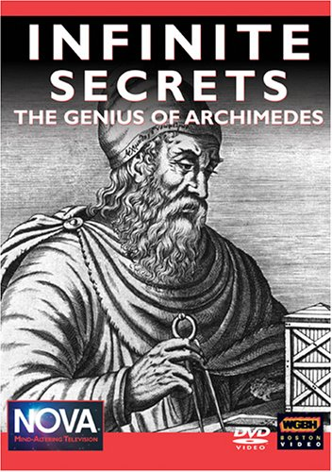
Infinite Secrets:
Archimedes (288-212 BC)
https://www.pbs.org/wgbh/nova/archimedes/
First aired on PBS, September 30, 2003

