Slide 1
To
and Beyond...

Slide 2
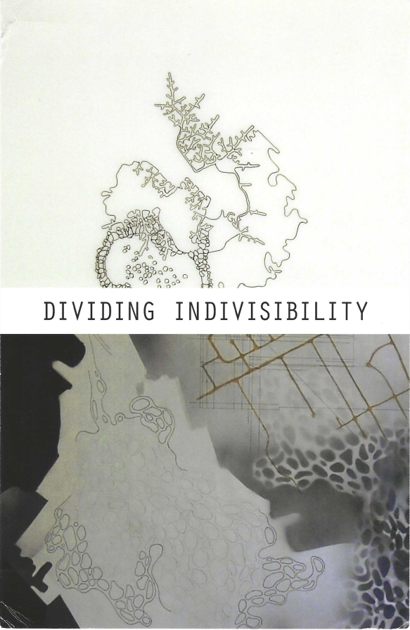


Slide 3
Douglas Adams (1952-2001)
It is known that there are an infinite number of worlds, simply because there is an infinite amount of space for them to be in. However, not every one of them is inhabited. Any finite number divided by infinity is as near nothing as makes no odds, so the average population of all the planets in the Universe can be said to be zero. From this it follows that the population of the whole Universe is also zero, and that any people you may meet from time to time are merely products of a deranged imagination.

Slide 4
Homework
Take the handout that has some short writing prompts.
  Over the next day or two, reflect on the readings and fill out this part of the worksheet.
  Then follow the instructions for the larger writing assignment to compose an essay that pulls ideas from the work you did on the worksheet.
  Monday, September 30 : turn in both the worksheet and the well-written essay.

Slide 5
I woke up this morning and thought “It is a great day for mathematics!”
The First Great Crisis in mathematics: Incommensurables!
  Say what?
  Let's break it down
    Mensurate: to determine the measurements of something or somebody
    Mensurable: able to be measured
    Co-mensurable: to be able to be measured together;
    to have a common unit of measurement
    Incommensurable: to Not have a common unit of measure
  So what?
    Remember, the Pythagoreans had a virtually religious commitment to the idea that All is Number, which implied commensurability was a built-in feature of reality
    Death to the Heretics: any demonstration that undermined this belief carried a danger of persecution, or even execution

Slide 6
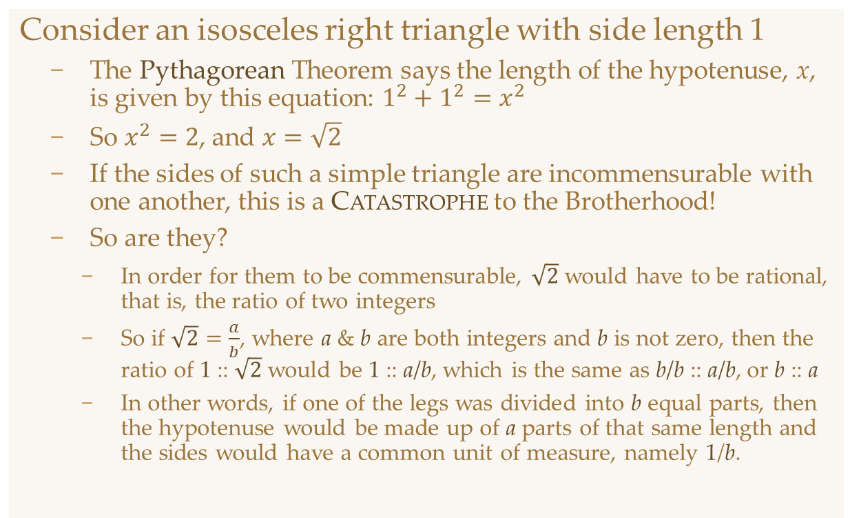


It's All Pythagoras' Fault: $\sqrt{2}$
Consider an isosceles right triangle with side length 1
  The Pythagorean Theorem says the length of the hypotenuse, x, is given by this equation: $1^{2}+1^{2}=x^{2}$
  So $x^{2}=2$, and $x=\sqrt{2}$
  If the sides of such a simple triangle are incommensurable with one another, this is a Catastrophe to the Brotherhood!
  So are they?
    In order for them to be commensurable, $\sqrt{2}$ would have to be rational, that is, the ratio of two integers
    So if $\sqrt{2}=\frac{a}{b}$, where a & b are both integers and b is not zero, then the ratio of 1 :: $\sqrt{2}$ would be 1 :: a/b, which is the same as b/b :: a/b, or b :: a
    In other words, if one of the legs was divided into b equal parts, then the hypotenuse would be made up of a parts of that same length and the sides would have a common unit of measure, namely 1/b.
$$\sqrt{2}$$
x
1
1

Slide 7
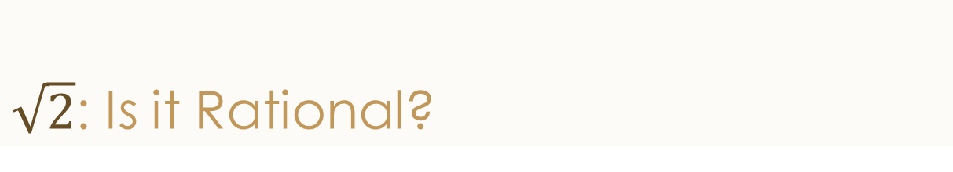
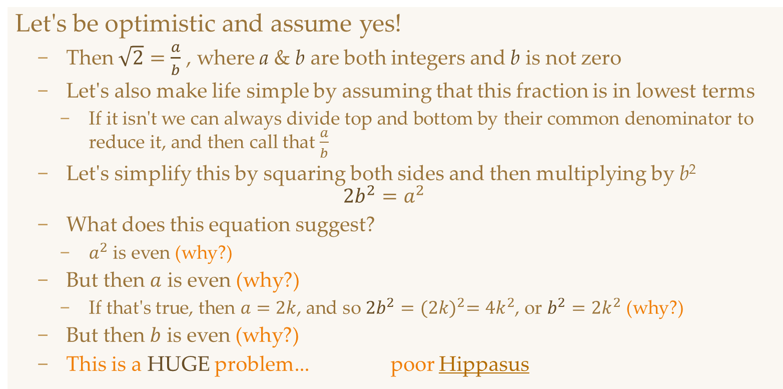
$\sqrt{2}$: Is it Rational?
Let's be optimistic and assume yes!
  Then $\sqrt{2}=\frac{a}{b}$ , where a & b are both integers and b is not zero
  Let's also make life simple by assuming that this fraction is in lowest terms
    If it isn't we can always divide top and bottom by their common denominator to reduce it, and then call that $\frac{a}{b}$
  Let's simplify this by squaring both sides and then multiplying by b²
  $$2b^{2}=a^{2}$$
  What does this equation suggest?
    $a^{2}$ is even (why?)
  But then $a$ is even (why?)
    If that's true, then $a=2k$, and so $2b^{2}={(2k)}^{2}=4k^{2}$, or $b^{2}=2k^{2}$ (why?)
  But then $b$ is even (why?)
  This is a HUGE problem... poor Hippasus

Slide 8
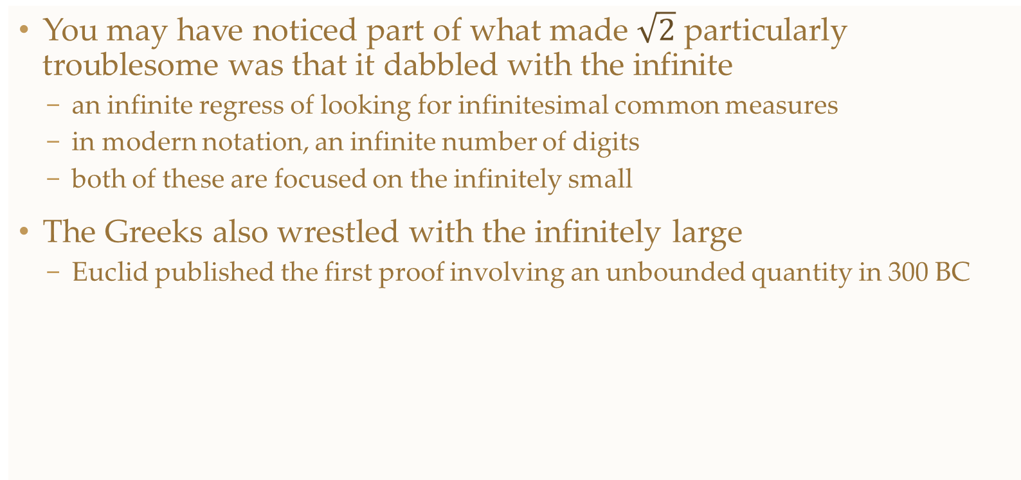
Segue
You may have noticed part of what made $\sqrt{2}$ particularly troublesome was that it dabbled with the infinite
  an infinite regress of looking for infinitesimal common measures
  in modern notation, an infinite number of digits
  both of these are focused on the infinitely small
The Greeks also wrestled with the infinitely large
  Euclid published the first proof involving an unbounded quantity in 300 BC

Slide 9
The Infinitude of the Primes
What is a prime number?
  Be careful, most high school definitions are wrong...
  Any natural number that has exactly two factors.
Marcus du Satoy
The argument
  Assume that you have a list of all the prime numbers
  Multiply them all together and then add 1
  The result is a number that will have a remainder of 1 if you divide it by any of the numbers on your list.
    So either the new number itself is prime
    Or it has a prime factor that is not on the list
  Therefore this list wasn't complete!

