Slide 1
Important Reminders & To Do Items
The last day to drop a class without a "W" (Withdraw) on your transcript is Friday, Sept. 27.
Spring class registration opens in about one month! Now is the time to reach out to your academic advisor to find a time to meet to discuss what classes you need.
We will teach you how to register when it gets closer!

Slide 2
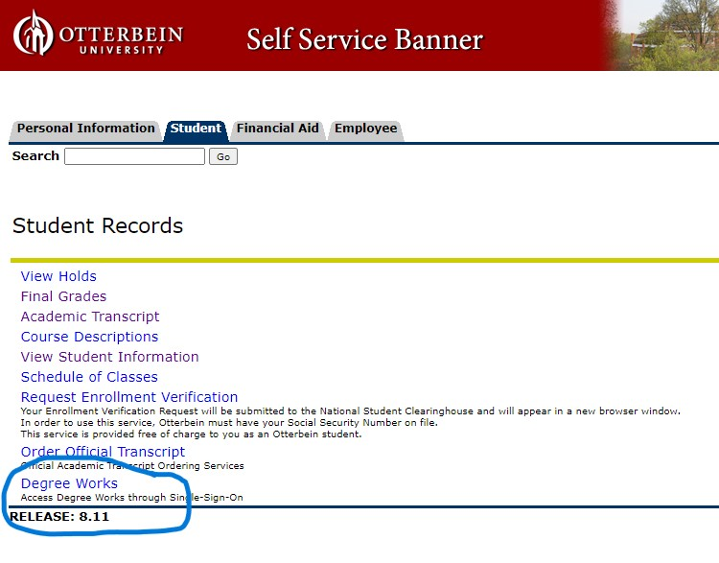
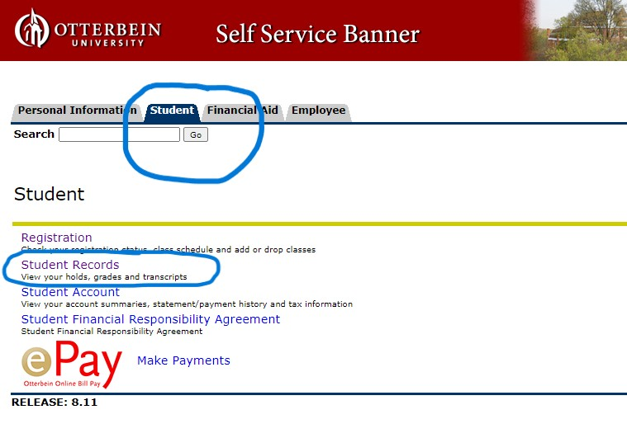
Who is my advisor?
You can find your advisor listed in Degree Works!
Step 1 & 2 : Log in to My Banner and click on the Student tab and then on Student Records
Step 3: Click on Degree Works

Slide 3
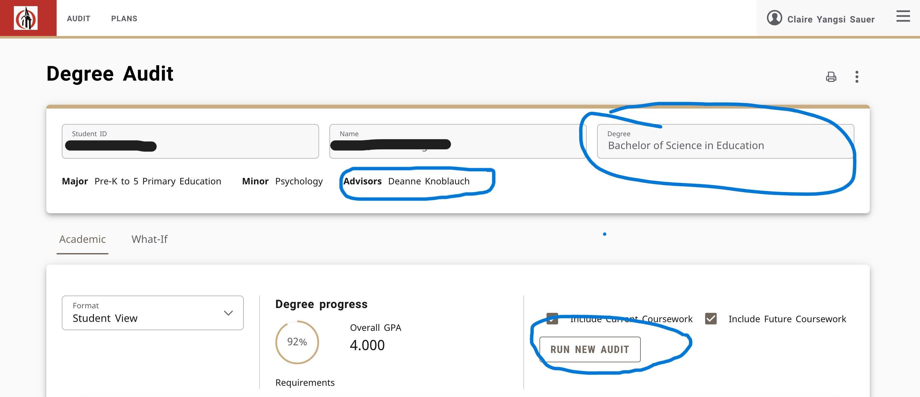
Who is my advisor?
You can find your advisor listed in Degree Works!
Step 4: When you come to your Degree Audit, you must always click Run New Audit. Now you can confirm your advisor. If you have two majors, you will find a drop down option under Degree and you will be able to switch majors.

Slide 4
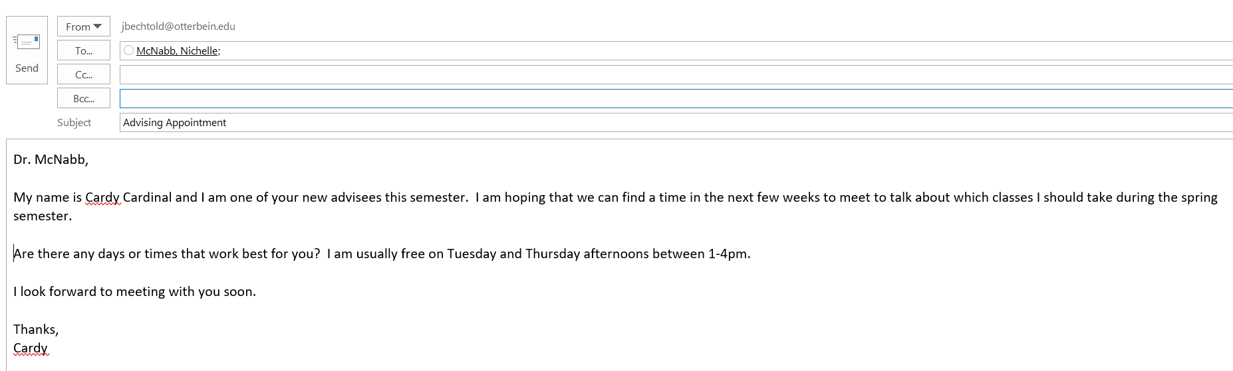
Send them an email! Remember the email etiquette we talked about a few weeks ago.
  Subject Line
  Format
  Appropriate greeting
  Punctuation, grammar, spelling
Feel free to copy the email below if that's helpful!

Slide 5

Week 5
READY Plan

Slide 6
Focus for Today:
Who Am I?
How Do I Think and Learn?
What's Important to Me?

Slide 7
Reflecting On Your Wandering Map and Energy Map
Are you surprised by the list of categories? How do these themes or categories align with your values, interests, skills? How might they align with your major or intended career?
Which themes are most exciting/enjoyable to you?
Name two or three things you are most proud of. What skills were needed to accomplish them? How might you connect those skills to your major or intended career?
If you cannot see any themes, what would you imagine would be some prominent themes throughout your life? If you do see themes, are there any you feel are missing?

Slide 8

Continued Reflection
Identify how these themes may connect to a career or passion. What do you still need to learn? Where do you still want experiences?
How might you continue developing or gaining experiences related to these themes or the career competencies?
How might you use what you’ve learned from this exercise in your career decision making process?
How do these maps connect or not connect to your major?
What do you want more/less of personally, academically, professionally?
What do the maps reinforce about:
  Who you are?
  How you think and learn?
  Who you want to become?

Slide 9

READY Plan
Part 1

Slide 10
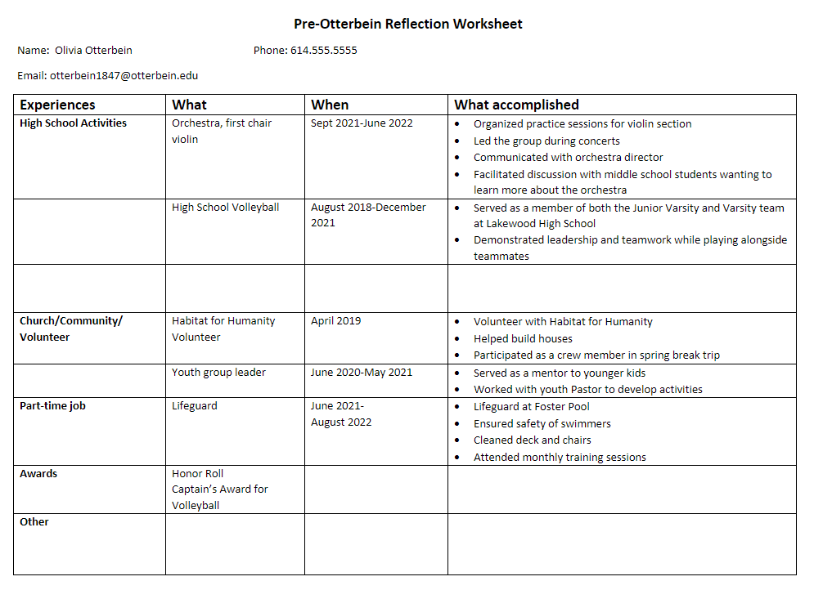

Slide 11

READY Plan
Part 2

Slide 12
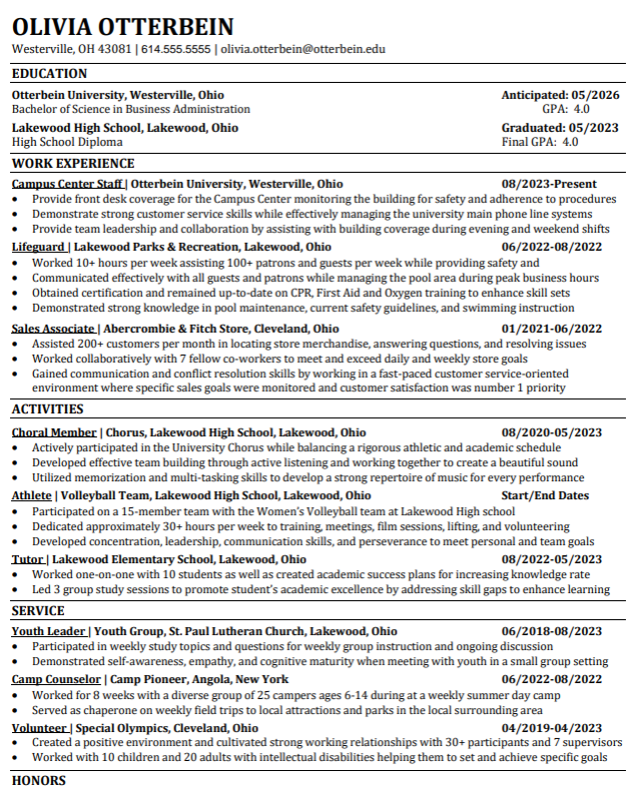

Slide 13


Helpful Resources
Prepping for Midterms

Slide 14
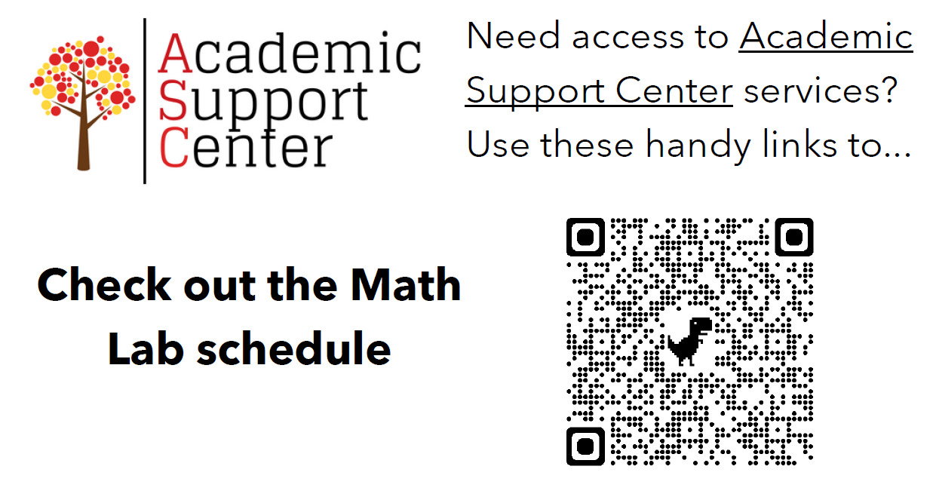

Slide 15
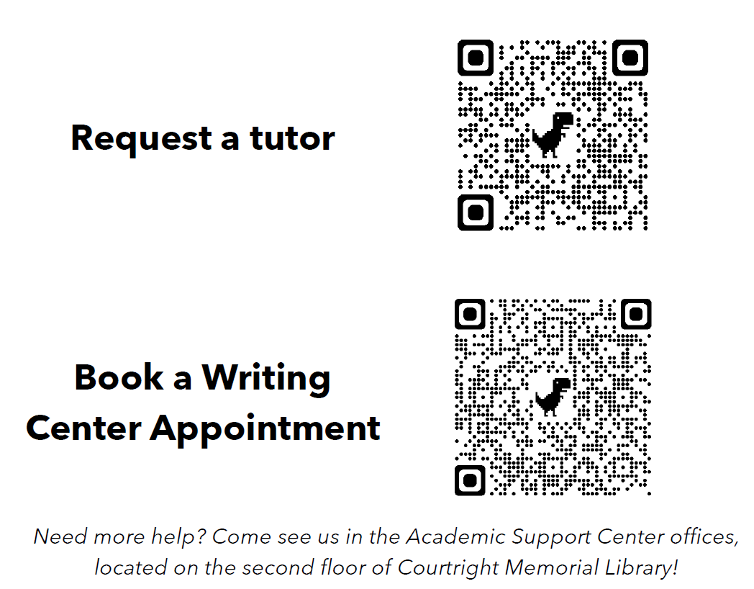

Slide 16
Reminders
Study Abroad Fair: October 2nd 11am-2pm Roush Hall
Major & Minor Fair: October 9th 11am-1pm Roush Hall

Slide 17
Exit Ticket

