Slide 1
To
and Beyond...

Slide 2
Thomas More (1477-1535)
By confronting us with irreducible mysteries that stretch our daily vision to include infinity, nature opens an inviting and guiding path toward a spiritual life.

Slide 3
ALERT
Disclaimer: today will be different
(you never know what to expect when you show up for class)

Slide 4
Framing Theology
Some of you are religious, some are not
Nevertheless, I think you’ll come to see that you all have a theology
θεολογία (theologia): theos = god; logos = logic/words/sayings/stories
So theology is God-logic, God-words, God-reasoning, God-stories
Theology includes your set of beliefs, your assumptions about the material world and the spiritual world, your attitude towards life, death, & after, etc.
I expect that we represent a diverse range of views
Who here believes in God?
Who here was raised in a religious environment?
What was your religious/faith background?
▪ Catholic? ▪ Protestant? ▪ Jewish? ▪ Muslim?
▪ Atheist? ▪ Hindu? ▪ Taoist? ▪ Sikh Other?

Slide 5
Group Activity Preliminaries
In some of the readings it has been suggested that infinity can be thought of as quantitative or qualitative. What does this mean?
When we discussed Aristotle we observed the he introduced the distinction potential infinity vs. actual infinity. Some of the readings also talked about this. What does this mean?

Slide 6
Group Activity
Ground Rules
In your group of 4 record your personal answers to the first two questions, and then share them with your group (introduce yourselves as well).
As a group, brainstorm each of the group questions, discuss amongst yourselves, and then record the group consensus on your sheet.
Take about 8 minutes per question.
Whole-class discussion

Slide 7
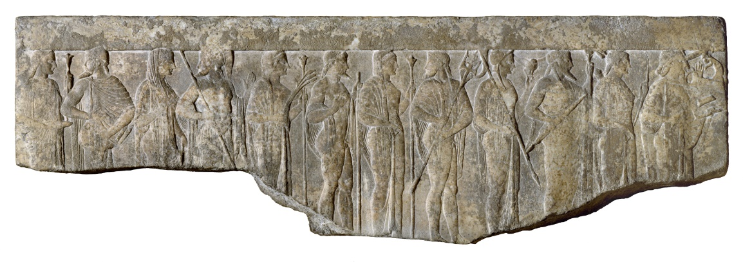
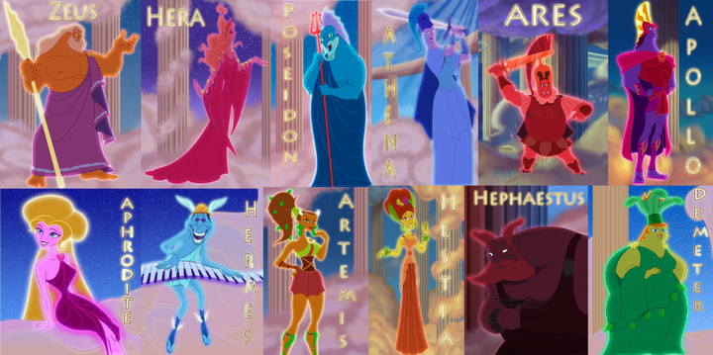
The Greek Pantheon
Were these gods infinite?
Well, they were immortal, so temporally (in time), yes...
But in terms of attributes & power, NO !
Recall that the Pythagoreans worshipped the finite
And the Greeks in general (with a couple of exceptions), feared the infinite
So how do the notions of infinity & divinity become intertwined and inter-dependent?
To be continued...
Zeus
Hera
Poseidon
Demeter
Athena
Apollo
Artemis
Ares
Hephaestus
Aphrodite
Hermes
Hestia
Dionysus
Hades

