Slide 1
To
and Beyond...

Slide 2
Wherever there is number, there is beauty.
—Proclus
Once we know the number one, we believe that we know the number two, because
one plus one equals two. We forget that first we must know the meaning of plus.
—Jean-Luc Godard
The concept of number is the obvious distinction between the beast and man. Thanks to number, the cry becomes a song, noise acquires rhythm, the spring is transformed into a dance, force becomes dynamic, and outlines figures.
—Joseph de Maistre

Slide 3
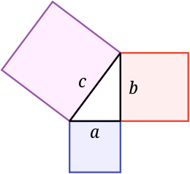
We Take Numbers for Granted!
You have a 20th century “model” of numbers...
They haven’t always been what they are now!
The Greeks: only whole, positive numbers (greater than two)
  Geometrical, not algebraic: numbers were lengths not quantities
    “the square of x”
    The Pythagorean Theorem
  Ratios vs. Fractions
    For us 1/2 = 3/6
    For the Greeks 1:2 :: 3:6 (what's the difference?)
x
rather than x²
rather than a² + b² = c²

Slide 4
Logos (λογωσ)
The Latin word ratio is a translation of the Greek λογωσ, the word used by the Pythagoreans for the proportion between two whole numbers.
  Rational: mathematical, intellectual/linguistic
  Logic: mathematical, intellectual/linguistic
  “Before the advent of Pythagorean mathematical philosophy, the word logos had implicit in its use certain structural potential meanings that were compatible with its later mathematical accretions. Logos comes from the verb lego, which means in the oldest literature to gather. Lego in Homer often means to count, which is a gathering one after another of similar things. Also, but less frequently used in Homeric literature, the word means to enumerate, a process where one recalls from memory things of a same kind. After the writings of Homer, a further step was taken in the evolution of the meaning of lego. A complete enumeration of things or events became a narration, logos. Contemporary with this use we find lego meaning to say, and logos, the noun form, meaning, speech, saying, or word.” —Granville C. Henry, Mathematics and Christian Theology pp. 77-8
  “In the beginning was the λογωσ, and the λογωσ was with God, and the λογωσ was God.” —The Gospel of John (1:1)

Slide 5
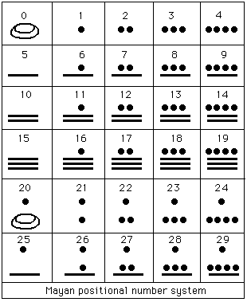
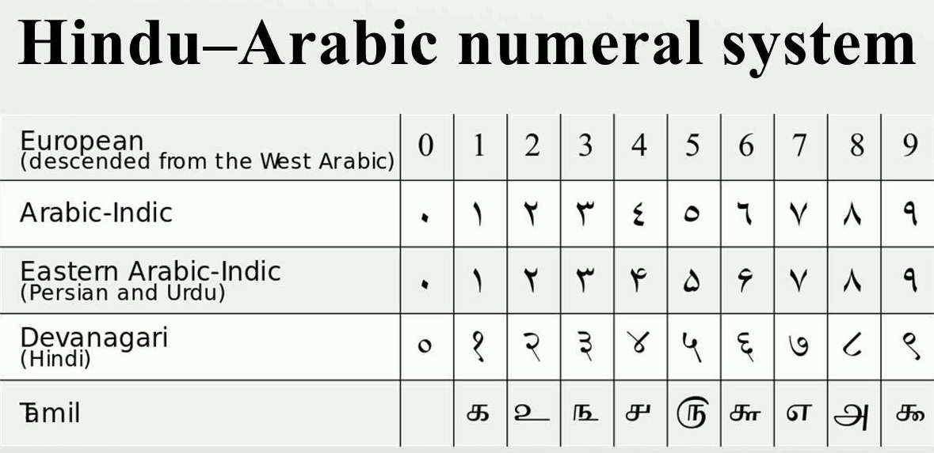
Zero
The Greeks were unsure what to make of it.
  How could nothing be anything?
The Mayans are the 1st to use it positionally in their number system
  At least as early as 36 BC
  They had a base-20 (vigesimal) number system
In 870 AD, the Arabs introduce it to the west in the context
of the Hindu-Arabic notation for numbers (which is what
we still use today)

Slide 6
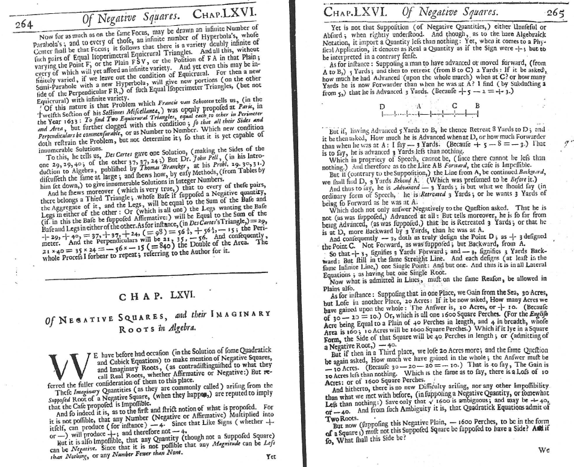
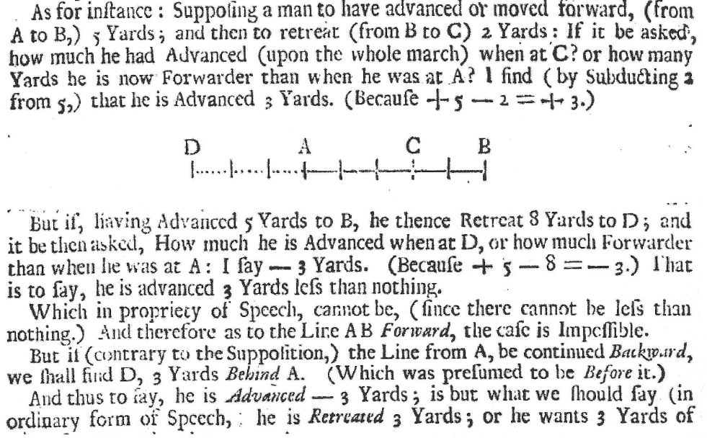
Why do you have to be so negative?
Negative numbers were not widely accepted by mathematicians until late in the 17th century AD (less than 400 years ago)
John Wallis (1685)
  A treatise of algebra historical and practical

Slide 7
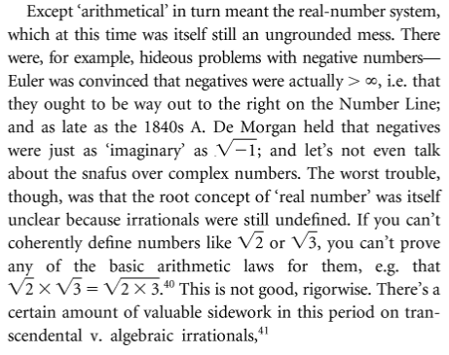
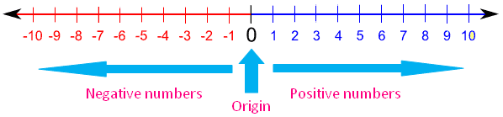
Why do you have to be so negative?
Negative numbers were not widely accepted by mathematicians until late in the 17th century AD (less than 400 years ago)
John Wallis (1685)
  A treatise of algebra historical and practical
DFW, Everything and More, p. 166
The Number Line

Slide 8
Genesis, numerically that is
Positive whole numbers: start with 1 and addition...
  Multiplication is repeated addition, no problem
Subtraction is a problem
  We need to admit zero and negative numbers so it always works
  Natural numbers & Integers
Division is a problem
  We need to admit rational numbers so it (almost) always works
Taking roots is a problem
  We need to admit irrational numbers and complex numbers to make it work
And there’s more: algebraic, transcendental, real, imaginary, surreal

