Slide 1
Notes:
You learned about this briefly during orientation, but today we will take a closer look at Every Student Will and what each year looks like.

Slide 2
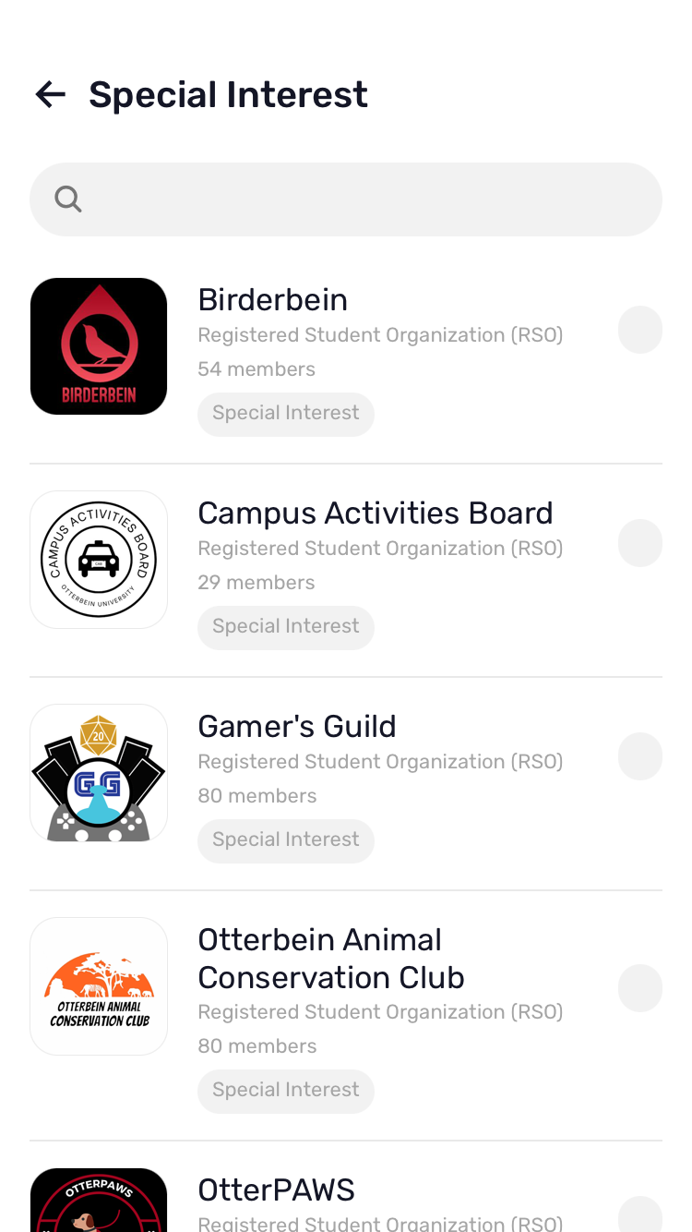
Histology study help
Histology | GetBodySmart
Self-Guided Virtual Histology Lab
Histology Guide
Free digital planners for students:
Notion
Trello
My Study Life
Upbase
MyHomework
Egenda
Meal Plans & Munch Money
You can check your meal plan balance by asking Parkhurst staff the balance when you swipe a meal
You can add Munch Money to your account here!
Student Resources LibGuide!!!
Great places to eat in Uptown:
Uptown Deli
Koble
Everbowl
Thai Grille
Java Central

Slide 3
Focus for Today:
Who Are You?
What Gives You Energy?
What Drains Your Energy?

Slide 4
First Year Focus
Meet Your Team
Checklist
What You Will Start to Think About
Who Am I?
How Do I Think and Learn?
What's Important to Me?
What Do I Want to Become?

Slide 5
Campus Groups
First Year
FYS Assignment Submission
Core Years
Career Jumpstart
Immersive Experience Intention
Immersive Experience Completion and Reflection
Senior Year
SYE Assignment Submission
Notes:
As students you will use Campus Groups many times throughout your college career. All students will have an account and be assigned a checklist with each of the things outlined here. Each year, you will log in and complete that portion of your checklist. These submissions will be accessible throughout your time at Otterbein.

Slide 6
Creating Your
Wandering Map

Slide 7
Drawing Your Wandering Map
Get a large sheet of unlined paper and writing utensils (pens, pencils, markers, crayons, etc.)
Think about important things that have happened to you throughout your lifetime.
Start writing these thoughts or keywords down as they come to your mind. Pictures or symbols are okay, too!
Draw a shape around each word or phrase.
Consider the following: Why does this matter to you? What is it that matters about this? How does fit into the bigger picture? What does it teach you about what matters to you and does? What does it tell you about what gives you energy?

Slide 8
In case you get stuck…
Objects or People: musical instruments, books, camera, journal, parents/grandparents, teacher, supervisor/manager, president/politician
Events: hiking trip, vacations, college courses, jobs, internships, volunteering, sporting events, cultural or religious events, hobbies

Slide 9
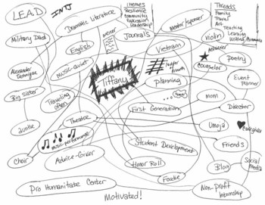
Sample:

Slide 10
Analyzing Your Wandering Map
Look for items on your map that fit into categories. Make a list of your categories, as well as the items that fit into each.
Look for overarching themes or patterns/ similarities or differences within your map that differ from the categories. Draw lines on your map to connect the themes.
Pair and share your map with someone in the class to see if they find any different or additional themes.

Slide 11
Creating Your
Energy Map

Slide 13
Analyzing Your Energy Map
What commonalities do you see in the things that give you energy? Things that drain your energy?
How does this relate to your major, interests, etc.?
What does this express to you?

Slide 14
Reminders
Make sure you're able to log in to Campus Groups. If you have any issues, email studentsuccess@otterbein.edu.
Bring your Wandering Map and Energy Map to class next week.

Slide 15
Exit Tickets
Notes:
As I mentioned earlier, we will do some self-exploration.
Pass out the Values Activity sheet and follow the directions on the instructions sheet.

