Slide 1
To
and Beyond...

Slide 2
Dr. Martin Luther King Jr.
We must accept finite disappointment, but never lose infinite hope.

Slide 3
Otterbein READY
Week #2: Introductions, time management, and study tips

Slide 4
Focus for Today:
Who are you?
How do you manage your time?
How do you study best?

Slide 5
FYS Pre-Test

Slide 6
Introduction – Staff Mentor
A little Information about me
Serve as support person for all of you
Share information about academic resources & support
Provide information about Otterbein READY program
Notes:
I will serve as another support person for you during your first semester at Otterbein. I will share important information about academic resources and support, but also share information about Every Student Will and what that program entails.

Slide 7
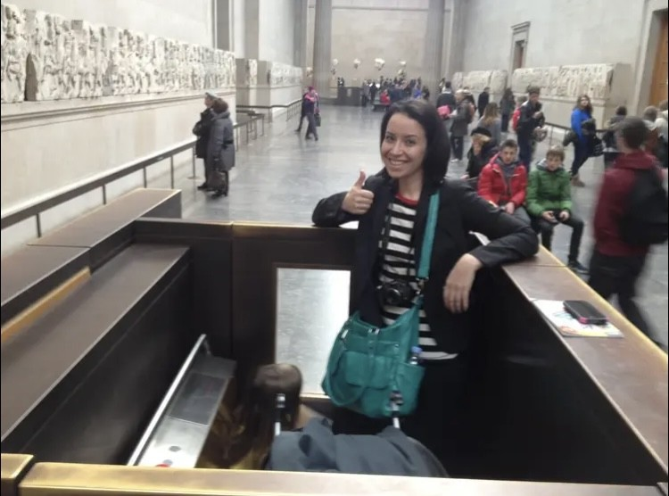
Katie Albright albright2@Otterbein.edu

Slide 8
Otterbein READY Class Topics
Time Management & Study Tips
Otterbein READY
Registration, Degree Audits, and Course Catalogs
READY Plan
Exam Prep
Notes:
Each week I will share a new topic that will help prepare you for your time at Otterbein. Some of the things we will be covering is how to effectively use a planner, time management, study strategies, exam prep, scheduling for classes, Every Student Will Introduction, Focus2 Assessment and Values Activities, and more. Each week I will cover important information that will help set you up for success.

Slide 9
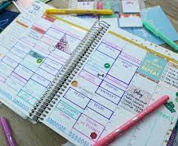
Using a Planner
Biggest issue – Time Management
Map out your class schedule and plan in study time
Use the calendar every day – Take it to class & update every day
What kind of planning tool have you used in the past or plan to use?
Notes:
Time management is one of the biggest challenges for college students. We’ve developed the planner as a tool to help you better manage your time. When is the calendar most effective? When students use it every day. Take it to every class, update it daily, and refer to it daily.
Between now and next week, you will focus on building out your weekly and monthly schedule to help you get started. You will have two copies (one as a draft and one as your permanent copy). Work on outlining what you think your weekly schedule will look like. Think about not only your classes, but any jobs or other responsibilities you have. Maybe you are already involved in a student organization or athletic team. Add meeting or practice times. Don’t forget to plan for times to study. The common rule is to plan for 2-3 hours of study for every hour in class. While it may seem easy to manage your schedule now, keep in mind as the semester continues you will have more projects, exams, and co-curriculars to keep track of. It’s good to set a thorough and realistic schedule early on so you can adopt these positive behaviors.

Slide 10
Steps for Planning Ahead
Build weekly & monthly schedule
Create a Draft & Final Copy of Schedule
Outline what schedule will look like
Add classes, jobs, other responsibilities
Also add Athletics, Practices, activities, student Organizations
Plan fop study time for each subject – 2-3 hours per 1 hour Class
Think about projects, exams, co-curriculars
Create Thorough and realistic schedule early
Notes:
Between now and next week, you will focus on building out your weekly and monthly schedule to help you get started. Work on outlining what you think your weekly schedule will look like. Think about not only your classes, but any jobs or other responsibilities you have. Maybe you are already involved in a student organization or athletic team. Add meeting or practice times. Don’t forget to plan for times to study. The common rule is to plan for 2-3 hours of study for every hour in class. While it may seem easy to manage your schedule now, keep in mind as the semester continues you will have more projects, exams, and co-curriculars to keep track of. It’s good to set a thorough and realistic schedule early on so you can adopt these positive behaviors.

Slide 11
Planning Your Time
Complete your weekly schedule along with Cardy
Be honest with yourself about your time and how you spend it

Slide 22
Self Reflection

Slide 23
Confused? Use Your Resources
Review your notes
Go to office hours
Form a study group
LibGuides from the library
Stop by the writing center
Open source textbooks – Professors and Librarians can help you find them
Visit the math lab
Get a tutor from the Academic Support Center
Specialized Resources for different disciplines
Stanford Encyclopedia of Philosophy.
Oxford Art Online.

Slide 24
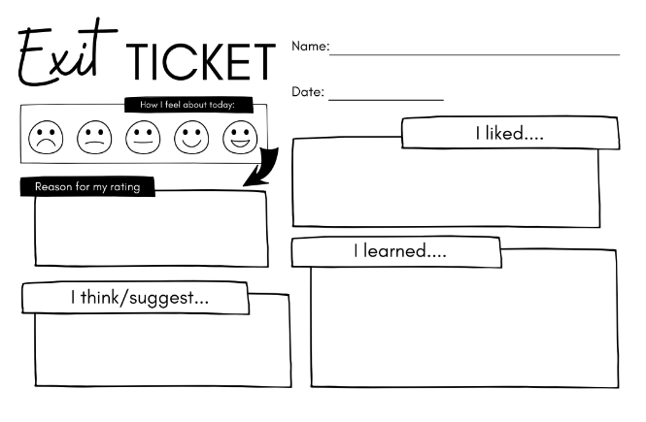
Exit Ticket

