Slide 1
To
and Beyond...

Slide 2
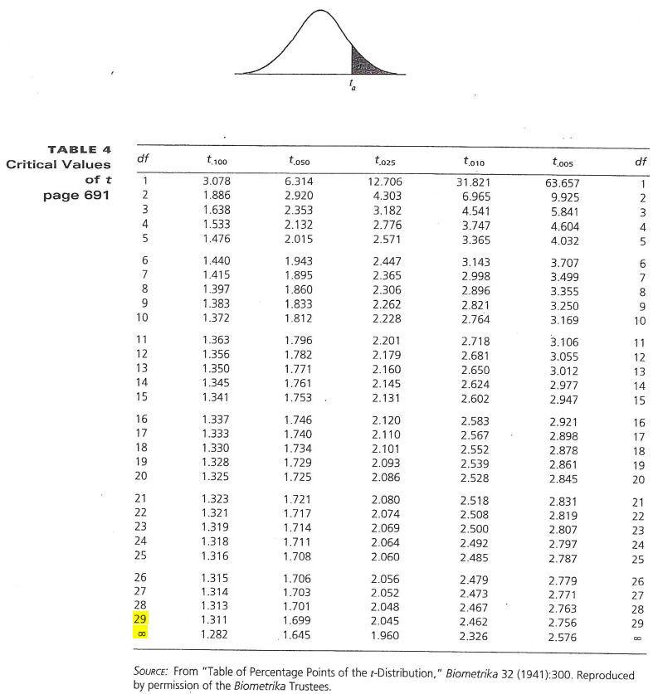
Statistical Infinity
Statistician’s are weird
Exhibit A
Exhibit B
  Sir William of the 'Bein stops at Marky Mo's (Arlington, OH)
  for lunch

Slide 3
A Statistical Infinity Story
Sally: in addition to your Mo Burger order, we do
have umpteen flavors of homemade ice
cream
SWB: that’s one of my favorite numbers
Sally: me, too
SWB: is that the same as infinity?
Sally: you mean like God and all?
are you a preacher?
SWB: hmm, I do preach statistics & probability
Sally: is that Protestant?
SWB: well, I guess it shares the belief that hard
work will result in a better afterlife in some
sense
Sally: ice cream?
SWB: no, just the Mo Burger
Sally: you know that the Mo Burger has
everything on it plus more
SWB: an infinite amount of things
Sally: you are silly.
I’ll bring your food in a bit
SWB: I am infinitely happy
Sally: (winks)
SWB: (later to himself while driving away)
To 30 and beyond!

Slide 4
ALERT
First submission of Reflective Journal is due before midnight on Saturday, 9/14 (remember it should be a Microsoft Word document)
On Wednesday we will have another group activity based on readings 3—5: DFW section §2a, Clegg chapter 2, &
Maor chapter 23

Slide 5
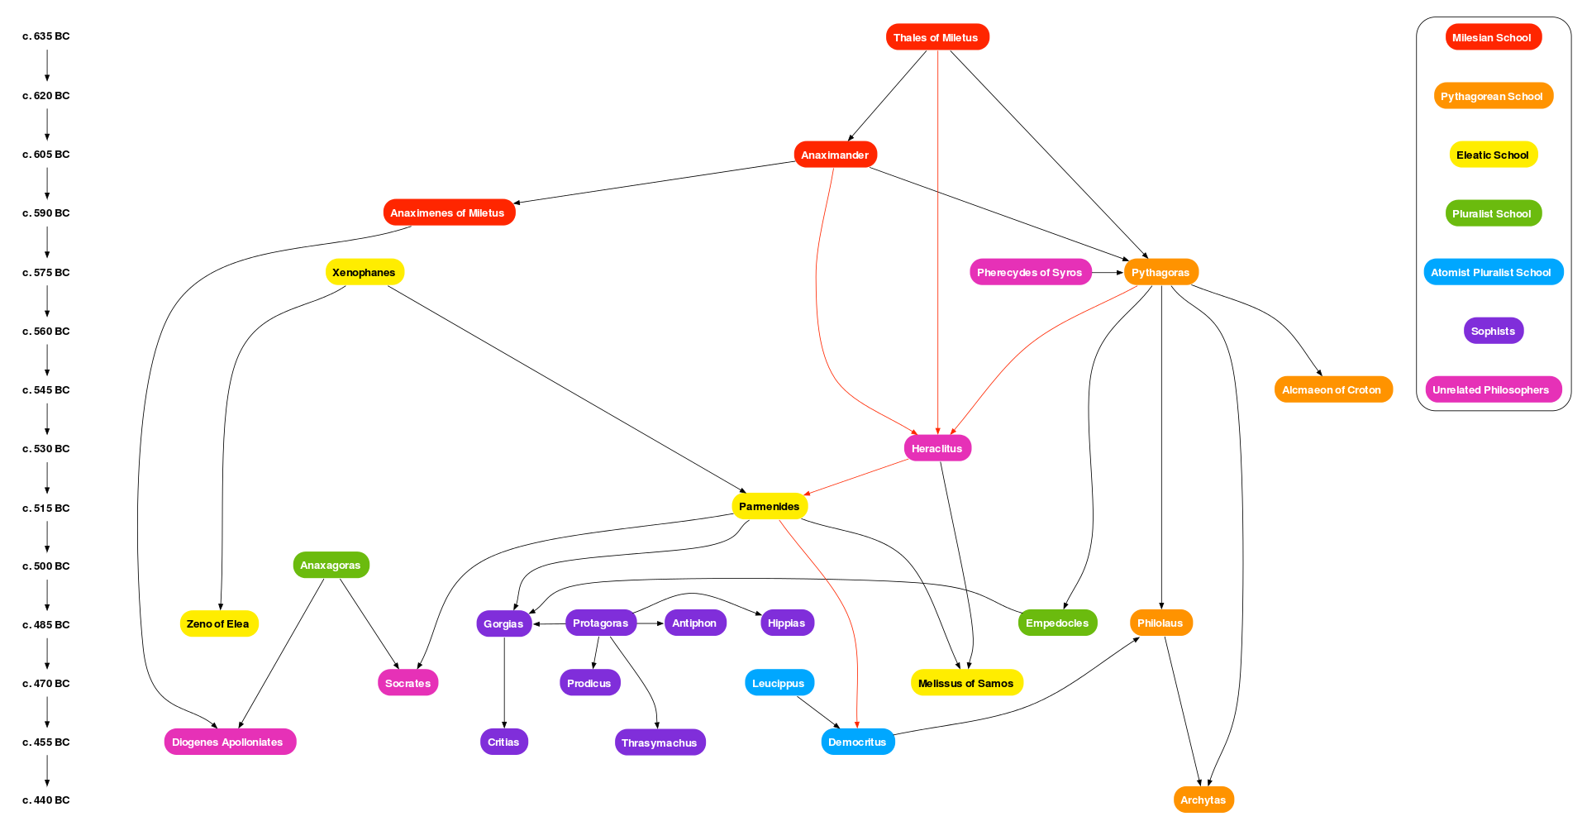
Wikipedia
Pre-Socratic Philosophy

Slide 6
Zeno of Elea
(490-425 BC)
Dichotomy (demo)
Zeno was a member of the Eleatic school, founded by Parmenides
Recall that Eleatic Monists believed that “All is One”
  the Monad was the metaphysical concept that included one/unity
  change is an illusion (including motion)
Developed a series of arguments (40 of them, but only 4 have survived)
to demonstrate that opposing views were absurd.
  Dichotomy: motion is impossible because you can’t get out of the gate
  Achilles & tortoise: fast runner can’t catch up to slow runner with head start
  Arrow: an arrow at an instant of time is not moving
  Stadium: rate of motion is relative, which for the Greeks seemed paradoxical
While on the surface all of these paradoxes are about motion, they also were deeply tied to controversies about the infinite.

Slide 7
So what?
What is at stake in Zeno’s paradoxes?
  The nature of reality
  The nature of infinity
  The relationship of mathematics to the physical world
The late Greek philosopher Proclus wrote of Zeno:
    “[He] elaborated forty different paradoxes following from the assumption of plurality and motion, all of them apparently based on the difficulties deriving from an analysis of the continuum.”
The continuum is the idea in Geometry that a line segment is a succession of points with no gaps.
  The Dichotomy illustrates that this implies an infinite number of points along any line. In other words it suggests that space is infinitely divisible.
  Both Achilles and the Arrow suggest that time is infinitely divisible as well.

Slide 8
Let’s Review
The 6th century BC saw the emergence of many novel and unique forms of thought, particularly the rise of Greek philosophy that was devoted to asking the big questions about the nature of reality
Over a span of 200 years, many schools and many thinkers produced wildly different views
  In particular, the Pythagorean Brotherhood believed that everything could be measured by whole numbers or ratios of whole numbers.
  A century later, Zeno is making up puzzles about infinity and the continuum
  There was a tension between physics and metaphysics: geometry was based on experience in the world that pointed to continuous lengths, but dividing or measuring these geometrical lengths led to difficulties in their metaphysical principles and beliefs.
There’s something missing here, a piece of the puzzle that leaves me unsatisfied...

Slide 9
το ἀπείρων
Let’s return to Anaximander...

Slide 10
Anaximander (Ἀναξίμανδρος)
610 – 546 BC
For there are some who make this (i.e. a body distinct from the elements) the infinite, and not
air or water, in order that the other things
may not be destroyed by their infinity.
They are in opposition one to another
—air is cold, water moist, and fire hot—
and therefore, if any one of them were infinite,
the rest would have ceased to be by this time. Accordingly they say that what is infinite is something other than the elements,
and from it the elements arise.

Slide 11
το ἀπείρων
Let’s return to Anaximander...
  peras (πέρας) in Greek means limit or bound
  to apeiron (το ἀπείρων) means ‘that which has no peras’: the infinite
  Passage from A. W. Moore, pp. 15-17 that elaborates on his view
Pythagoras weighs in...
  The brotherhood took an opposite view, reversing the roles of good and bad
  Passage from A. W. Moore, p. 17
  Passage from Zellini, p. 9
Parmenides, the rebellious Pythagorean...
  He swings the pendulum back towards Anaximander, but much further
  Reality should be all-encompassing, so any reference to ‘what is not’ is incoherent
  Rejected the Pythagorean view that reality was finite within the infinite void
Infinity is good
Infinity is bad
Infinity doesn’t exist

Slide 12
Observations
This course is constructed more like a tapestry or woven cloth than you may be used to.
Repetition and redundancy is intentional.
My experience suggests that it won’t all make sense the first time.
Just like Bloom can be interpreted as a spiral, where you keep cycling back to each level, the material in this course will also spiral back to intersect itself in new and interesting ways.
So, GYHITC !!
  Get your head in the course !!

Slide 13
Observations
This course is constructed more like a tapestry or woven cloth than you may be used to.
Repetition and redundancy is intentional.
My experience suggests that it won’t all make sense the first time.
Just like Bloom can be interpreted as a spiral, where you keep cycling back to each level, the material in this course will also spiral back to intersect itself in new and interesting ways.
So, KYHITC !!
  Keep your head in the course !!
  Journal, readings, Blackboard, FYE events, office hours, staff mentor, etc.

