Slide 1
To
and Beyond...

Slide 2
Douglas Adams
Infinite (definition):
Bigger than the biggest thing ever and then some.

Slide 3
Douglas Adams
Infinite (definition):
Bigger than the biggest thing ever and then some. Much bigger than that in fact, really amazingly immense, a totally stunning size, "wow, that's big".

Slide 4
Douglas Adams
Infinite (definition):
Bigger than the biggest thing ever and then some. Much bigger than that in fact, really amazingly immense, a totally stunning size, "wow, that's big". Infinity is just so big that by comparison, bigness itself looks really titchy.

Slide 5
Douglas Adams
Infinite (definition):
Bigger than the biggest thing ever and then some. Much bigger than that in fact, really amazingly immense, a totally stunning size, "wow, that's big". Infinity is just so big that by comparison, bigness itself looks really titchy. Gigantic multiplied by colossal multiplied by staggeringly huge is the sort of concept we're trying to get across here.
The Hitch-Hikers' Guide to the Galaxy

Slide 6
Syllabus
Questions?
Journal
FYE/IS Events
Common Book events
Others?

Slide 7
Bloom’s Taxonomy
Over a period of several years in the 1940s and 1950s, Benjamin Bloom, Max Englehart, Edward Furst, Walter Hill and David Krathwohl developed and proposed a model of learning to the annual meetings of the American Psychological Association
In 1956 this was published as the Taxonomy of Educational Objectives, and was organized into three areas:
Cognitive (mental)
Affective (emotional)
Psychomotor (physical)
The cognitive domain formed a pyramid with 6 levels

Slide 8
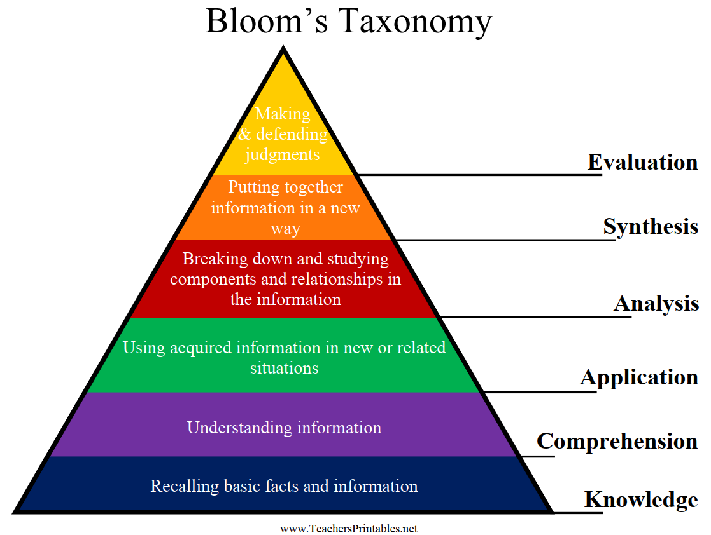

Slide 9
Knowledge
The ability to recall previously learned information.
Knowledge typically involves the memorization of facts.
Verbs: list, define, identify, recall, name, recognize, describe, label, reproduce, outline, record
Examples?
The knowledge level is the lowest form of learning, but serves as a foundation for the remaining levels.

Slide 10
Comprehension
The ability to understand the meaning of learned information.
Verbs: predict, interpret, explain, summarize, estimate, convert, infer, paraphrase, rewrite, distinguish, extend
Examples?
Comprehension goes beyond knowledge, bridging from form to meaning, syntax to semantics.

Slide 11
Application
The ability to use learned material in a novel situation.
Verbs: demonstrate, solve, calculate, use, apply, discover, produce, show, illustrate, operate, practice, translate
Examples?
While knowledge and comprehension can be passive forms of learning, application requires action.
These first three layers are considered to be lower forms of cognitive development.

Slide 12
Analysis
The ability to separate material into its component parts for the purpose of understanding its organizational structure.
Verbs: categorize, separate, select, diagram, inspect, analyze, differentiate, study, examine, inventory, break down, dissect
Examples?
The first of the higher order cognitive abilities.
Ancient associations with, philosophy, science, and mathematics.

Slide 13
Synthesis
The ability to combine component parts into a new structure.
Verbs: create, design, organize, derive, formulate, compose, write, arrange, plan, assemble, construct, build, generate
Examples?
More aligned with engineering and creative arts than science.

Slide 14
Evaluation
The ability to judge the value of material according to specified criteria.
Verbs: criticize, examine, judge, compare, contrast, conclude, critique, justify, argue, support, assess, score, appraise
Examples?
There has been some controversy over whether evaluation or synthesis is a higher cognitive function.

Slide 15
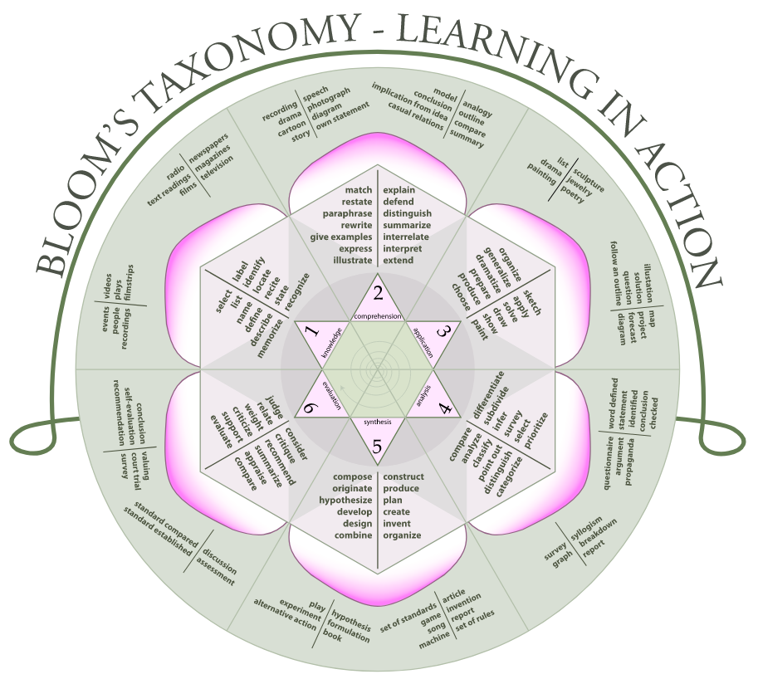
Bloom’s Rose
Source: Wikipedia

